Slide 1


Slide 2


Additional Revenue Streams for Marinas.
The leader in on the water lodging

Slide 3
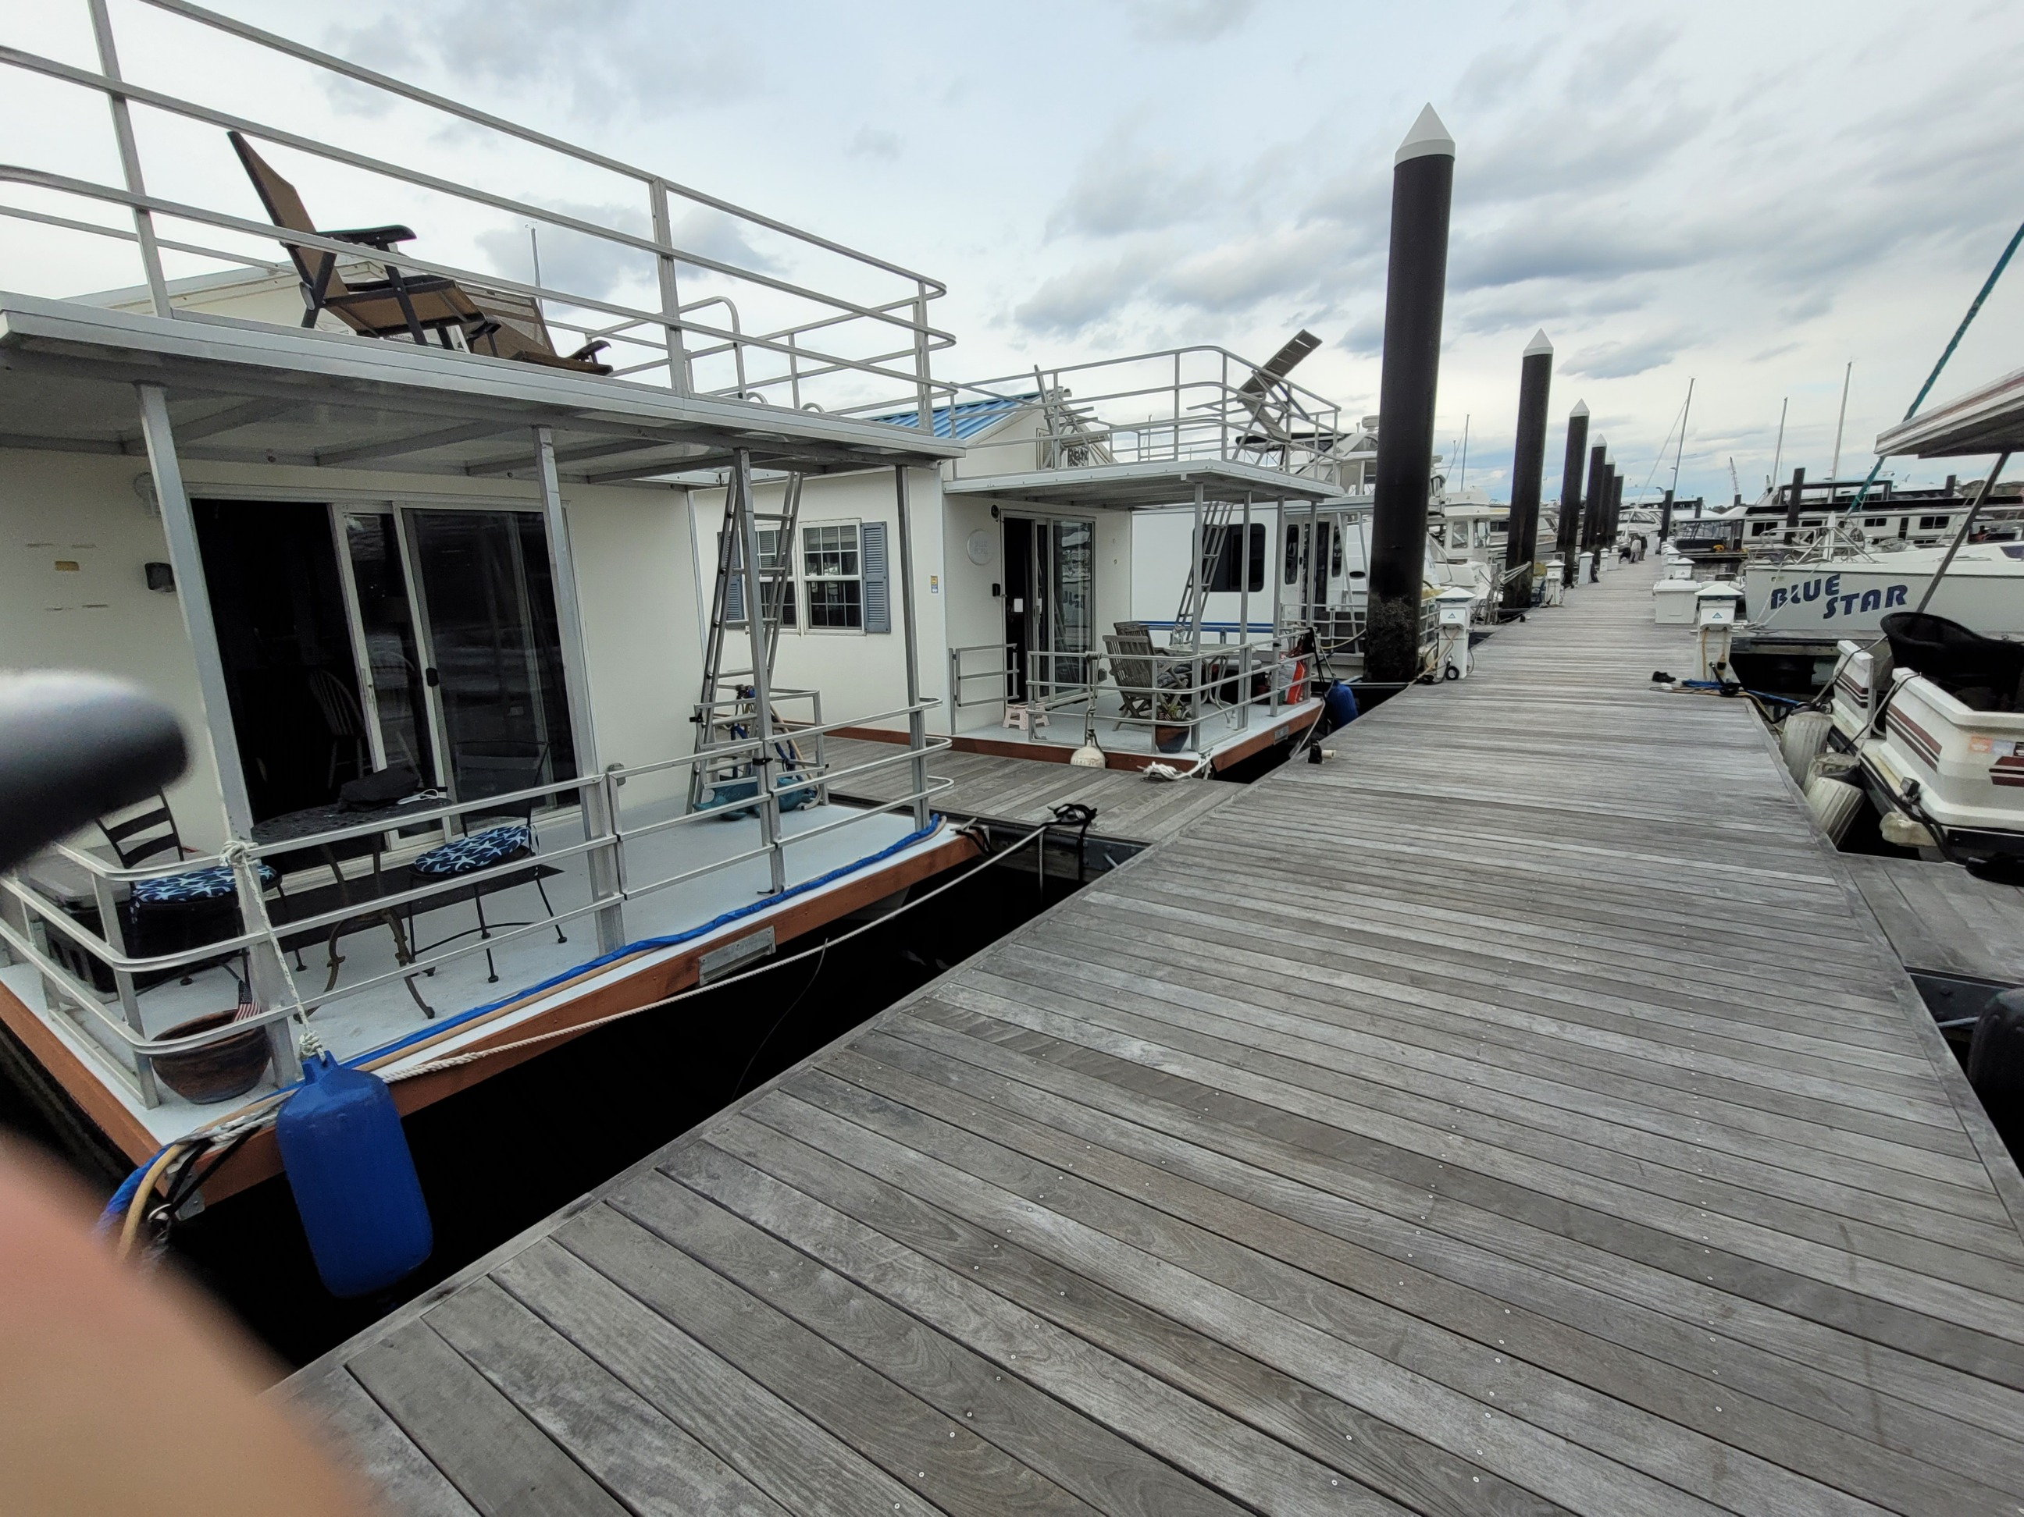
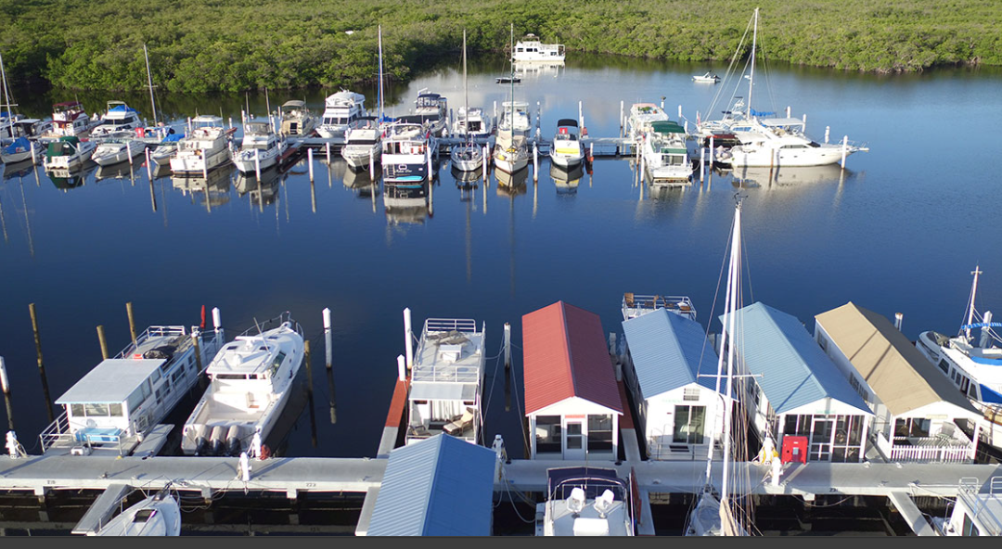
Houseboats as revenue streams
Three of the ways marinas can generate revenue using houseboats at their location.
Own the houseboats directly
Partner with outside entity for a revenue split
Allowing outside owners, the ability to operate their own str business within the marina.

Slide 4
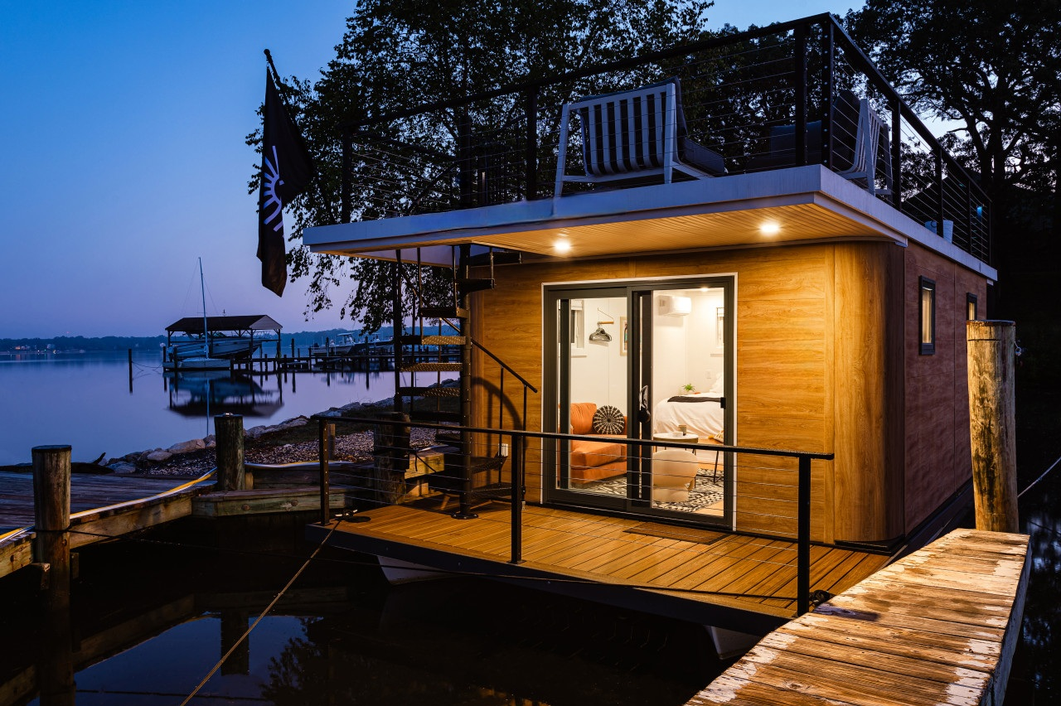
Suitewater 26’

Slide 5
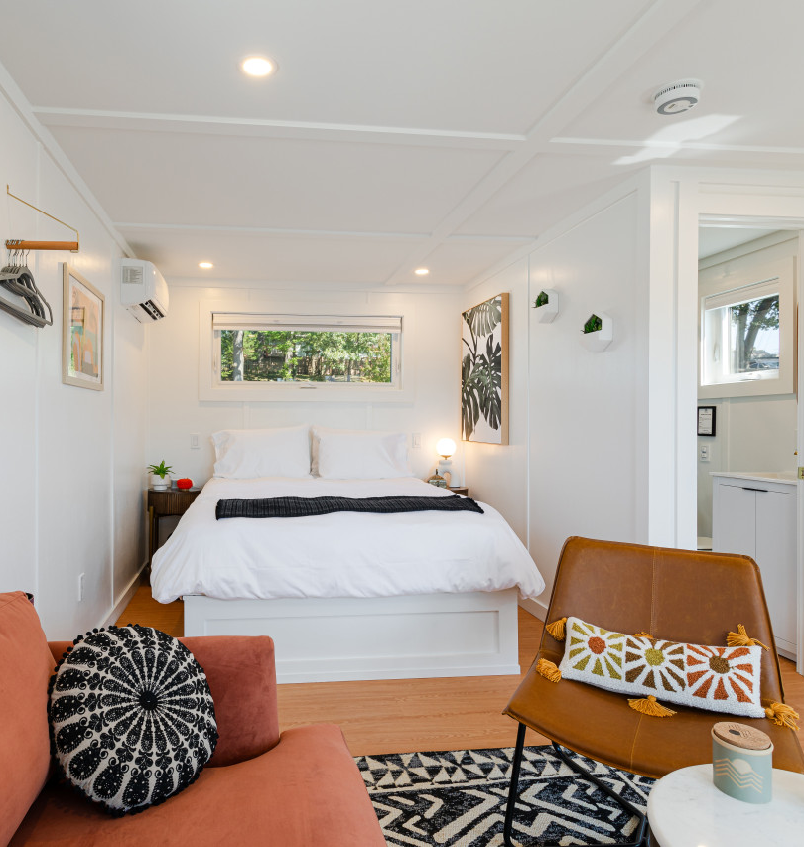
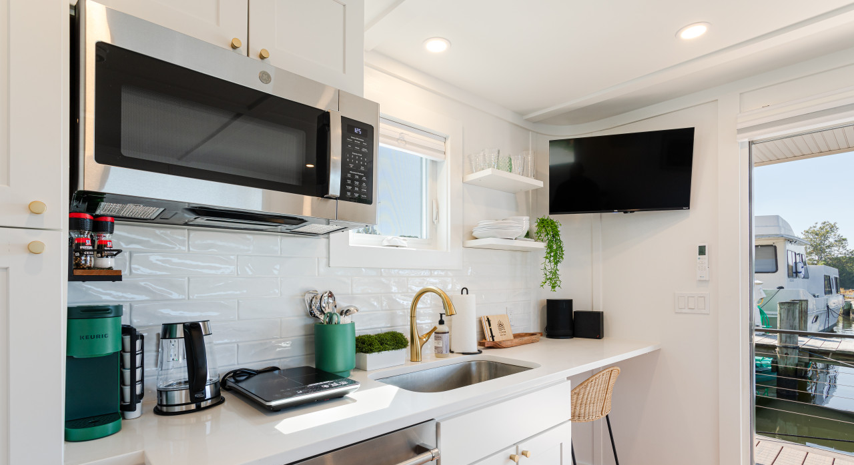
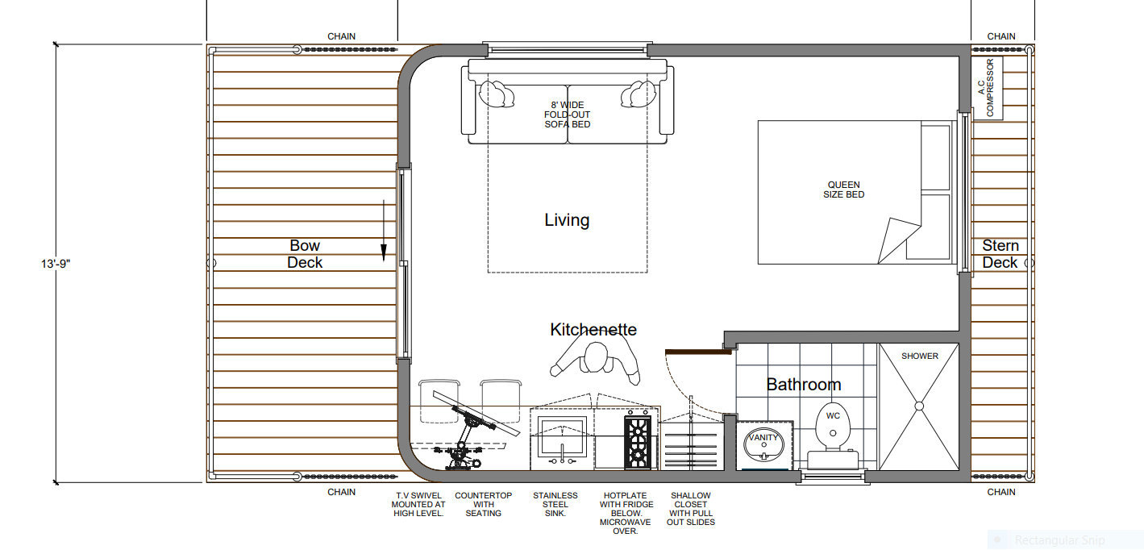

Slide 6
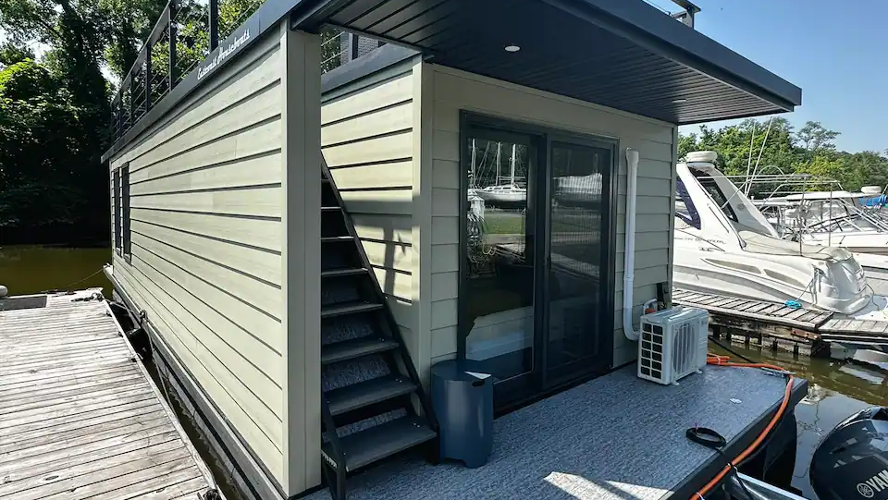
Freedom 40’

Slide 7
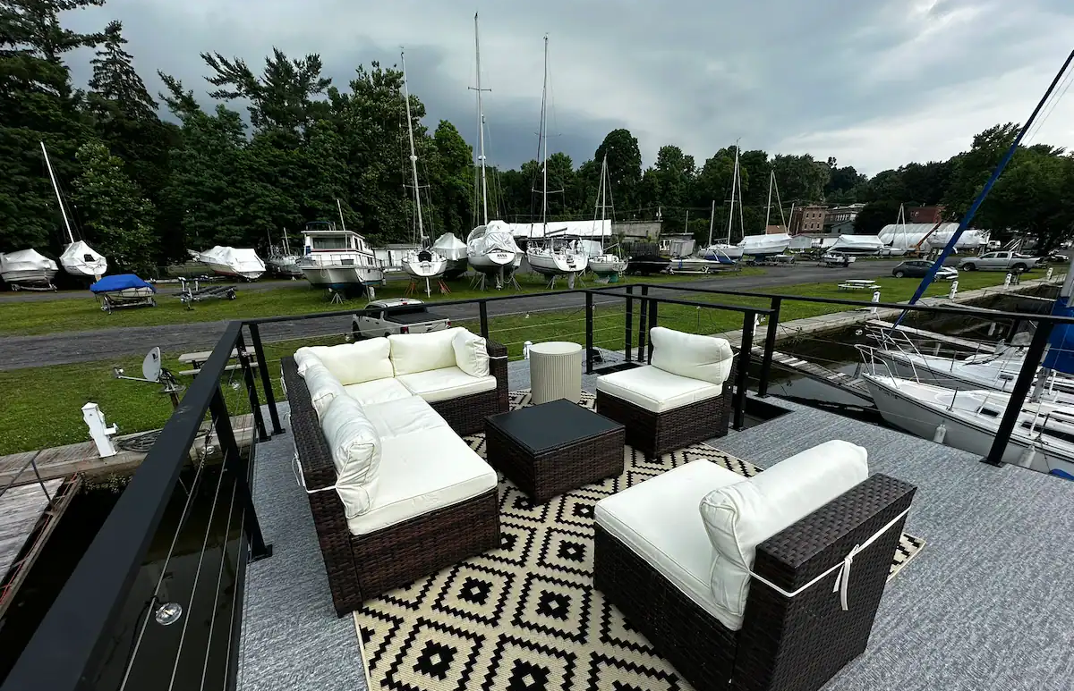
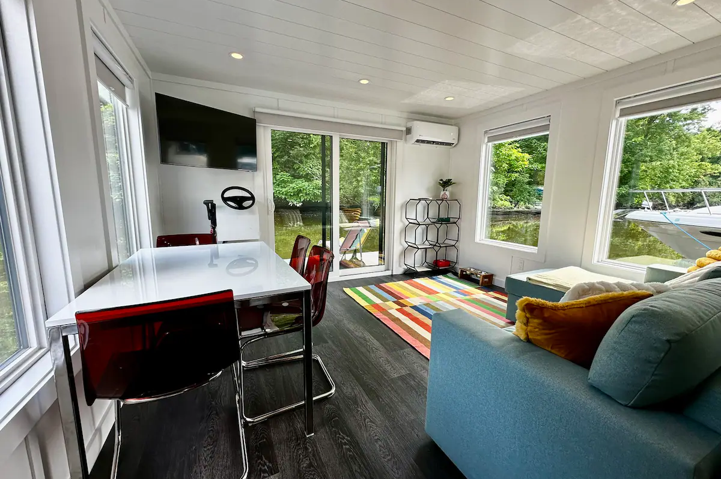
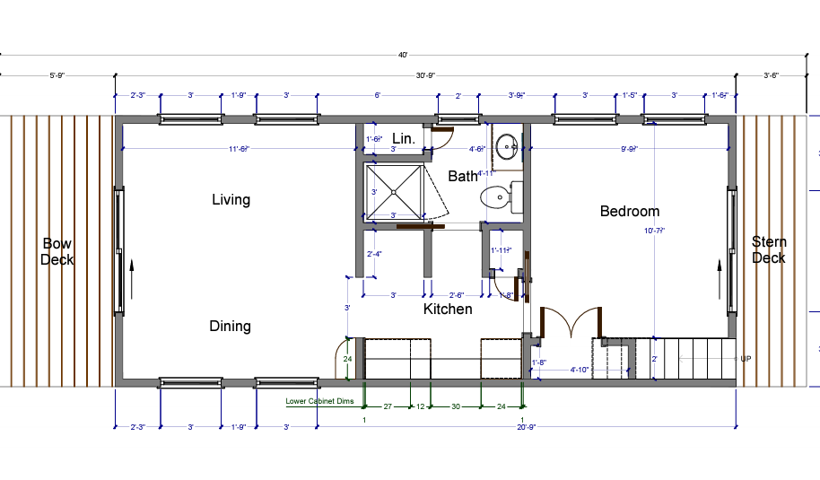
The Freedom 40 x 14
Also available as a
2 stateroom model

Slide 8
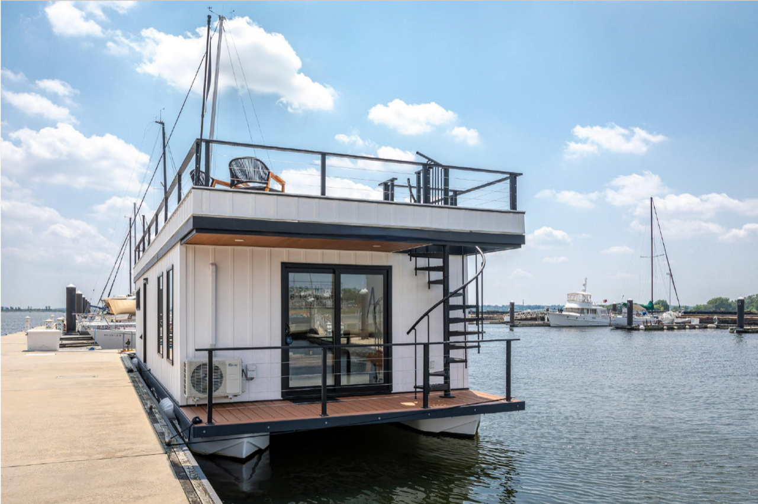
45’ 2 bedroom / 2 bath

Slide 9
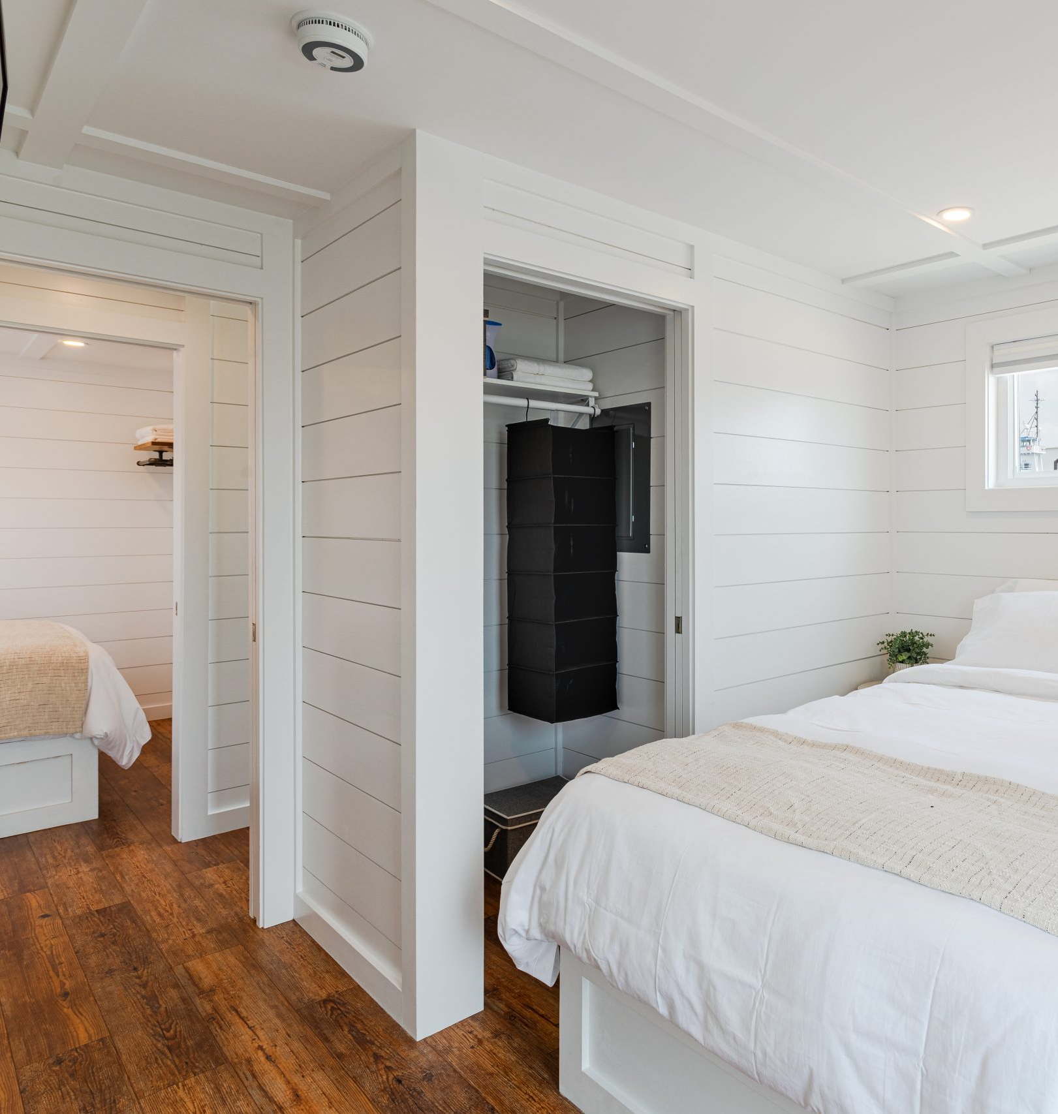

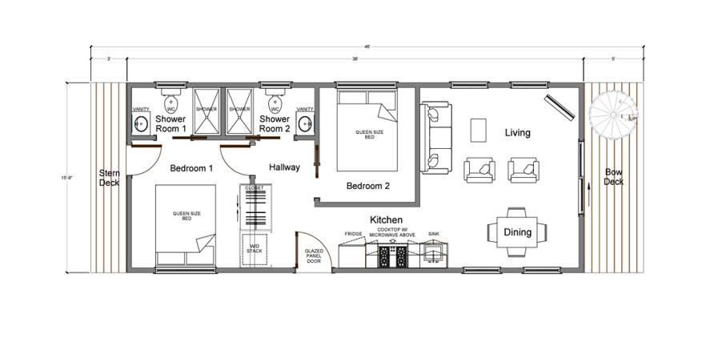

Slide 10
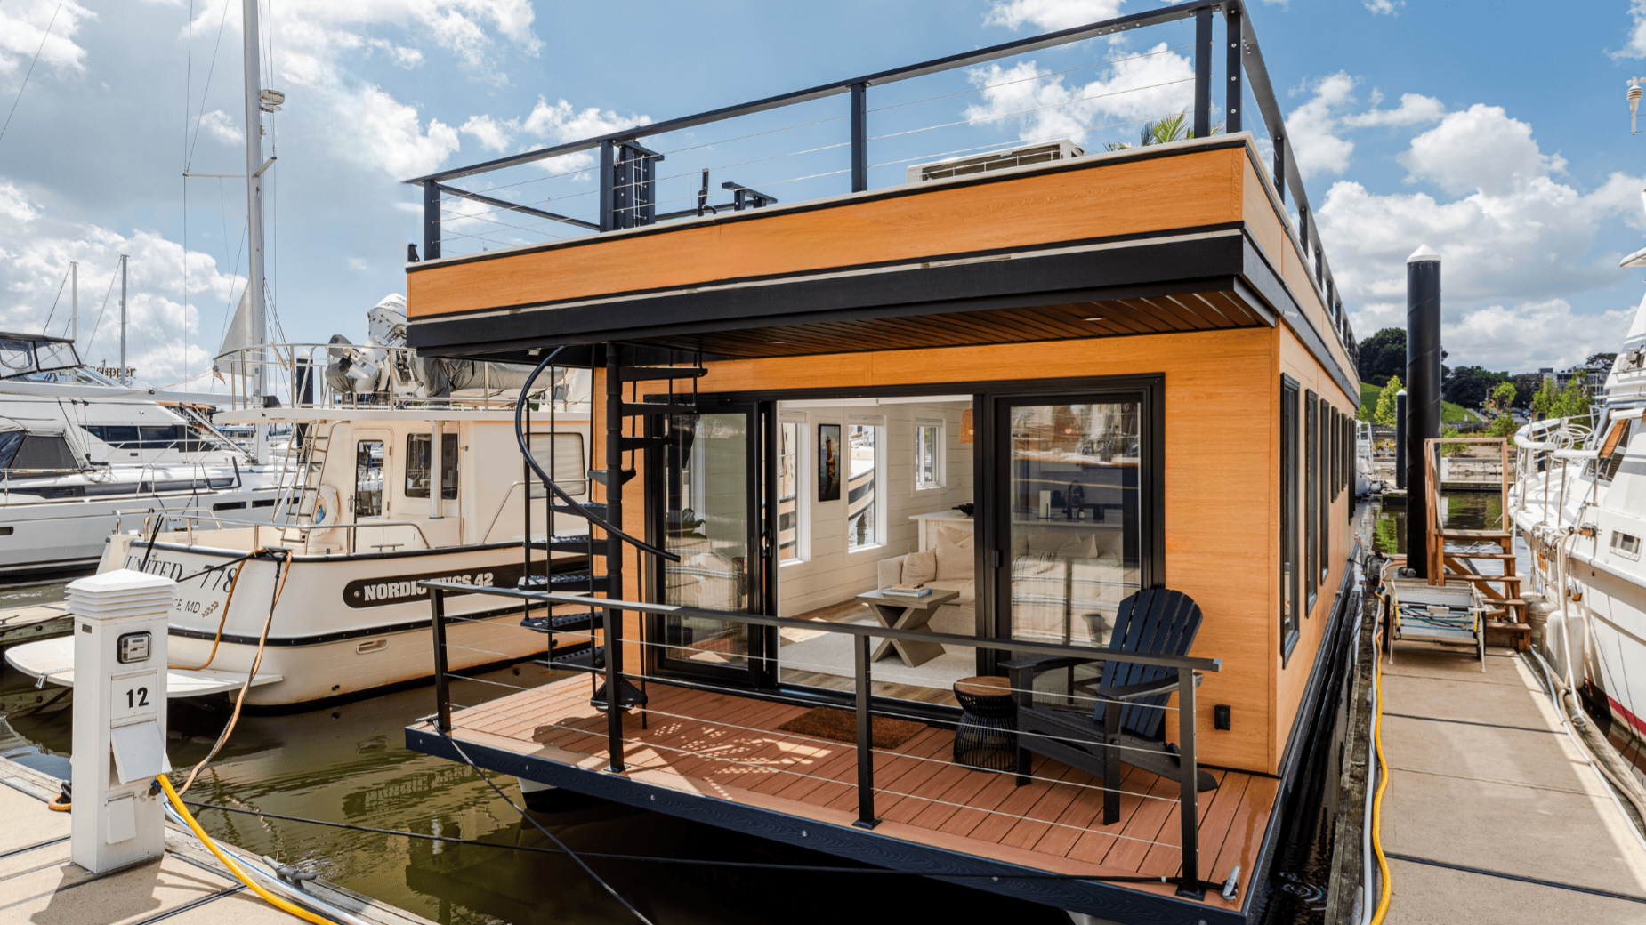

Slide 11
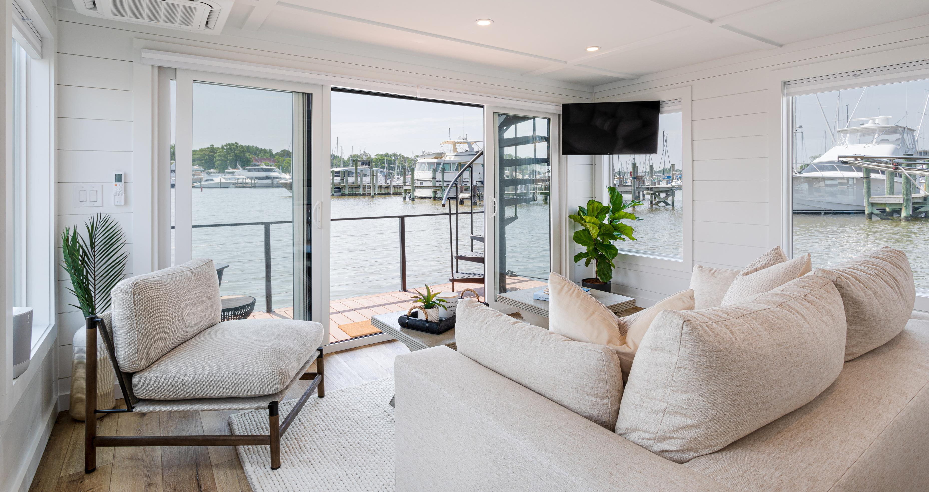
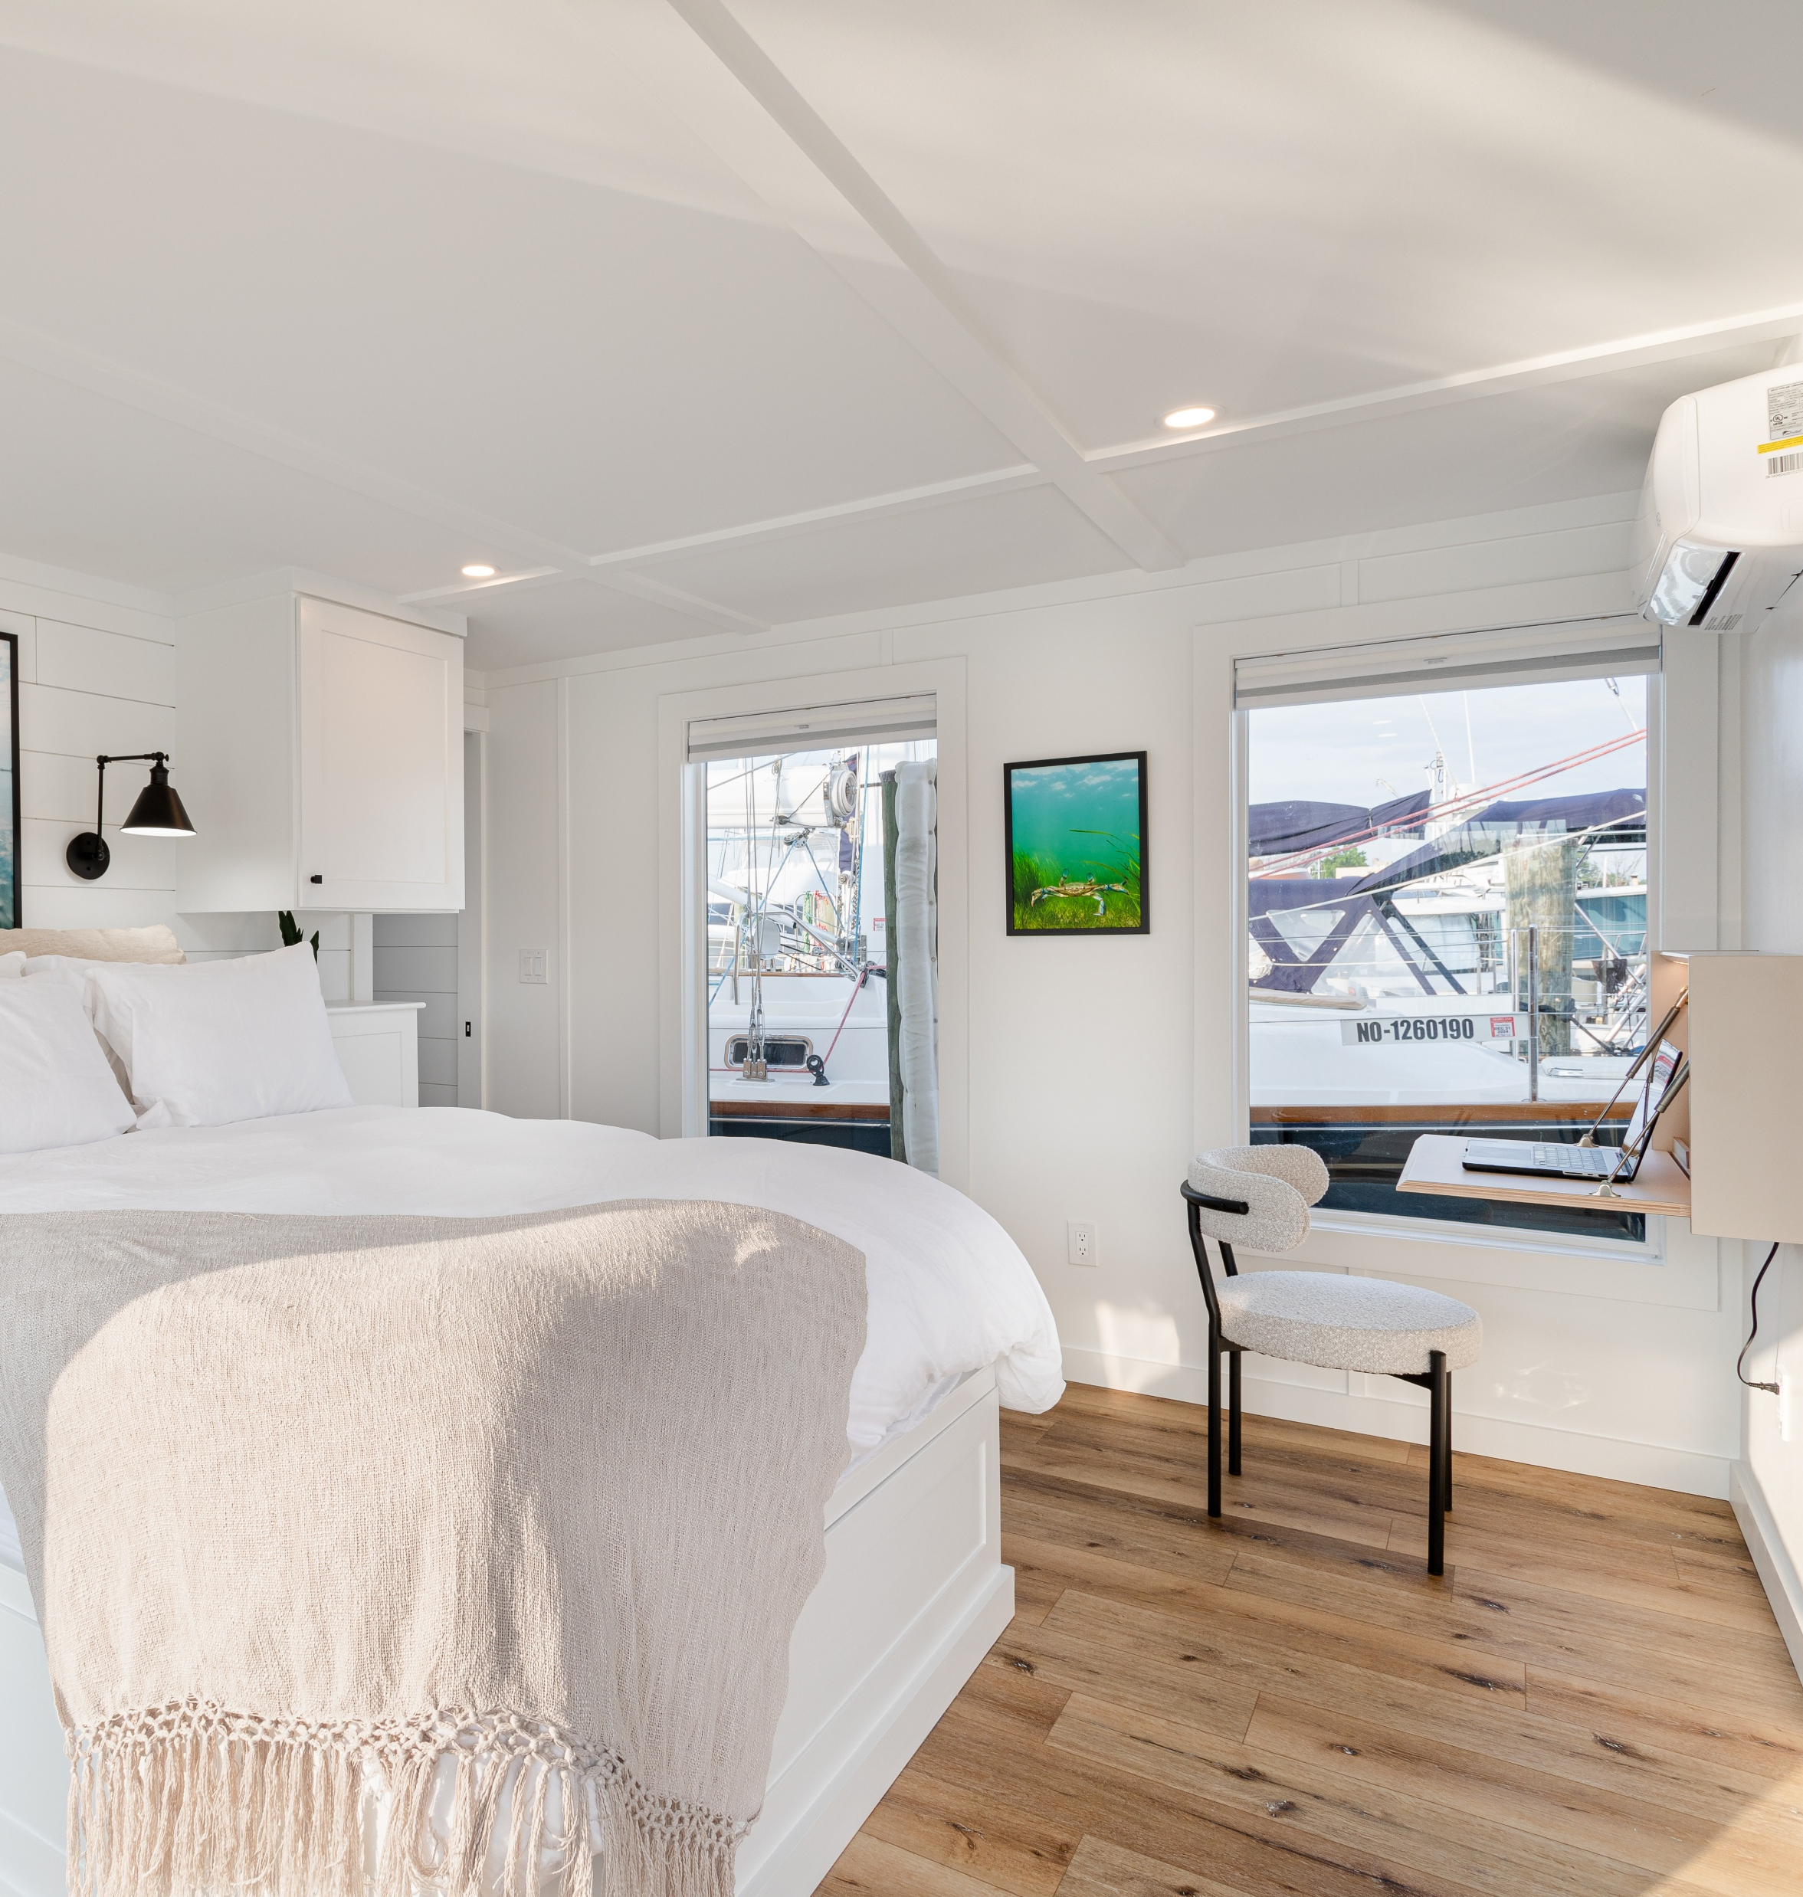
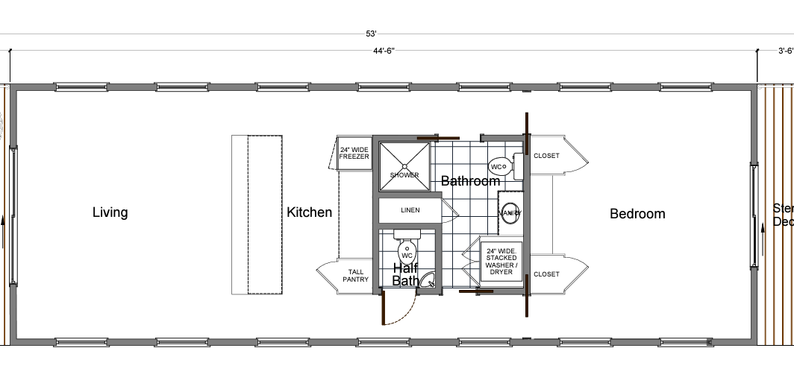

Slide 12
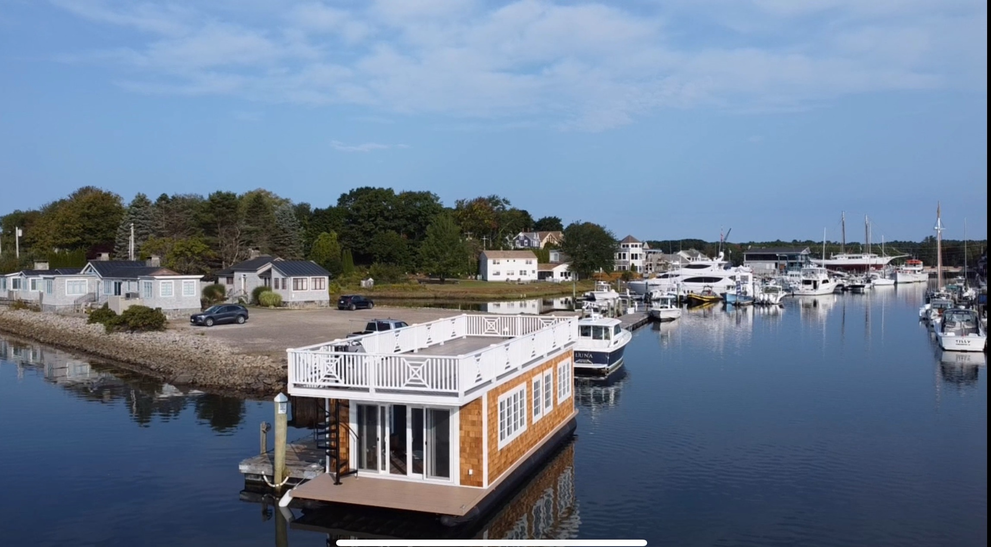
Cora the Houseboat, White Barn Inn Kennebunkport Me

Slide 13
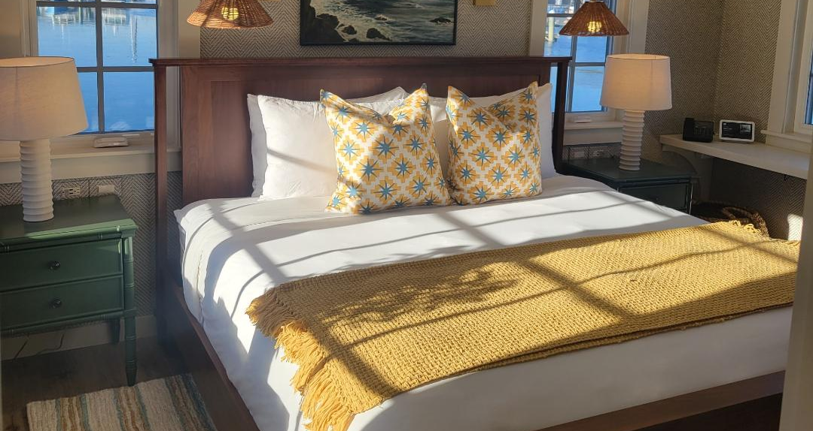
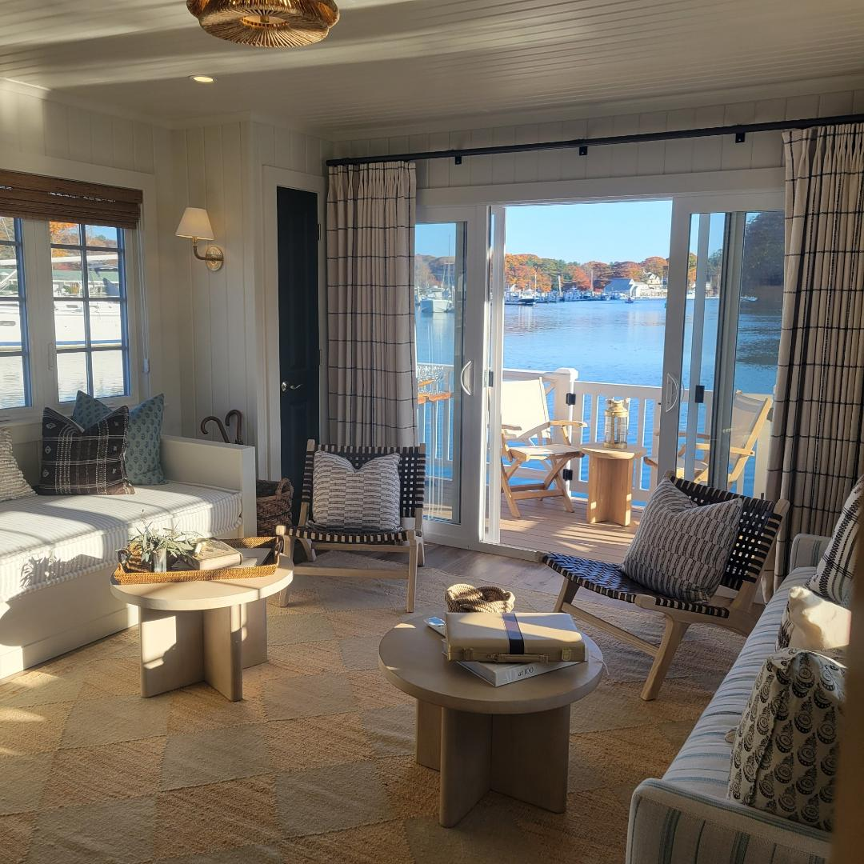
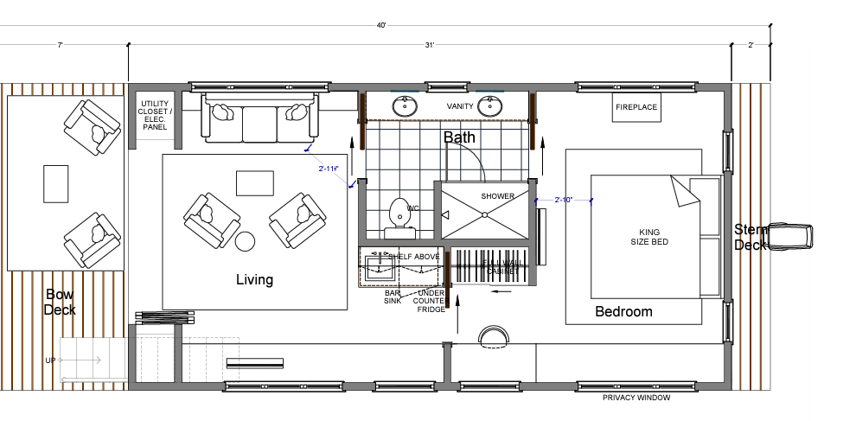

Slide 14
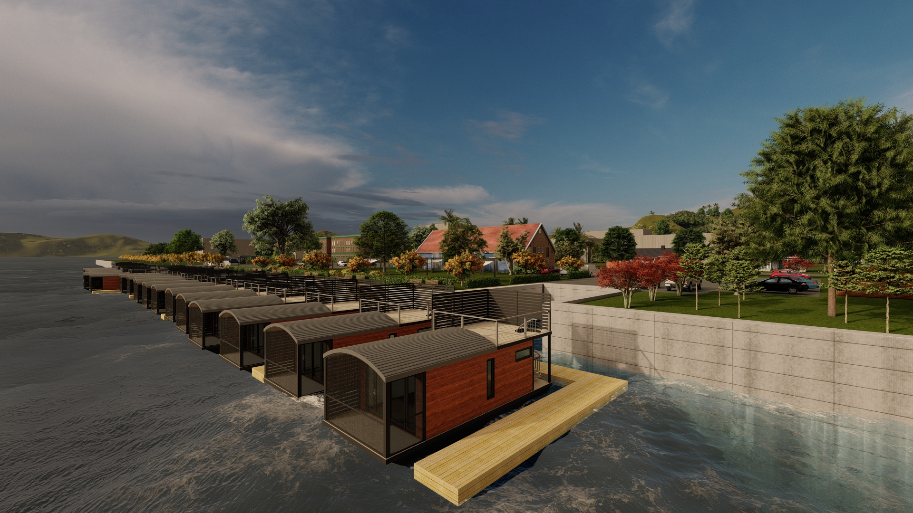
Catskill NY Houseboat Resort

Slide 15
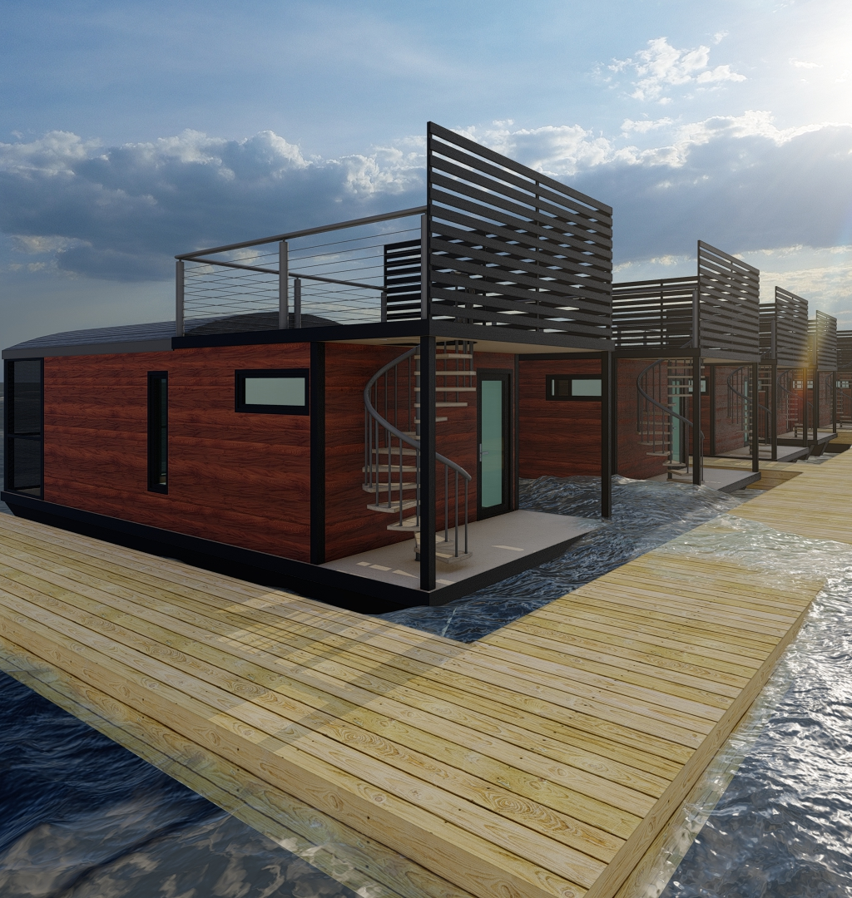
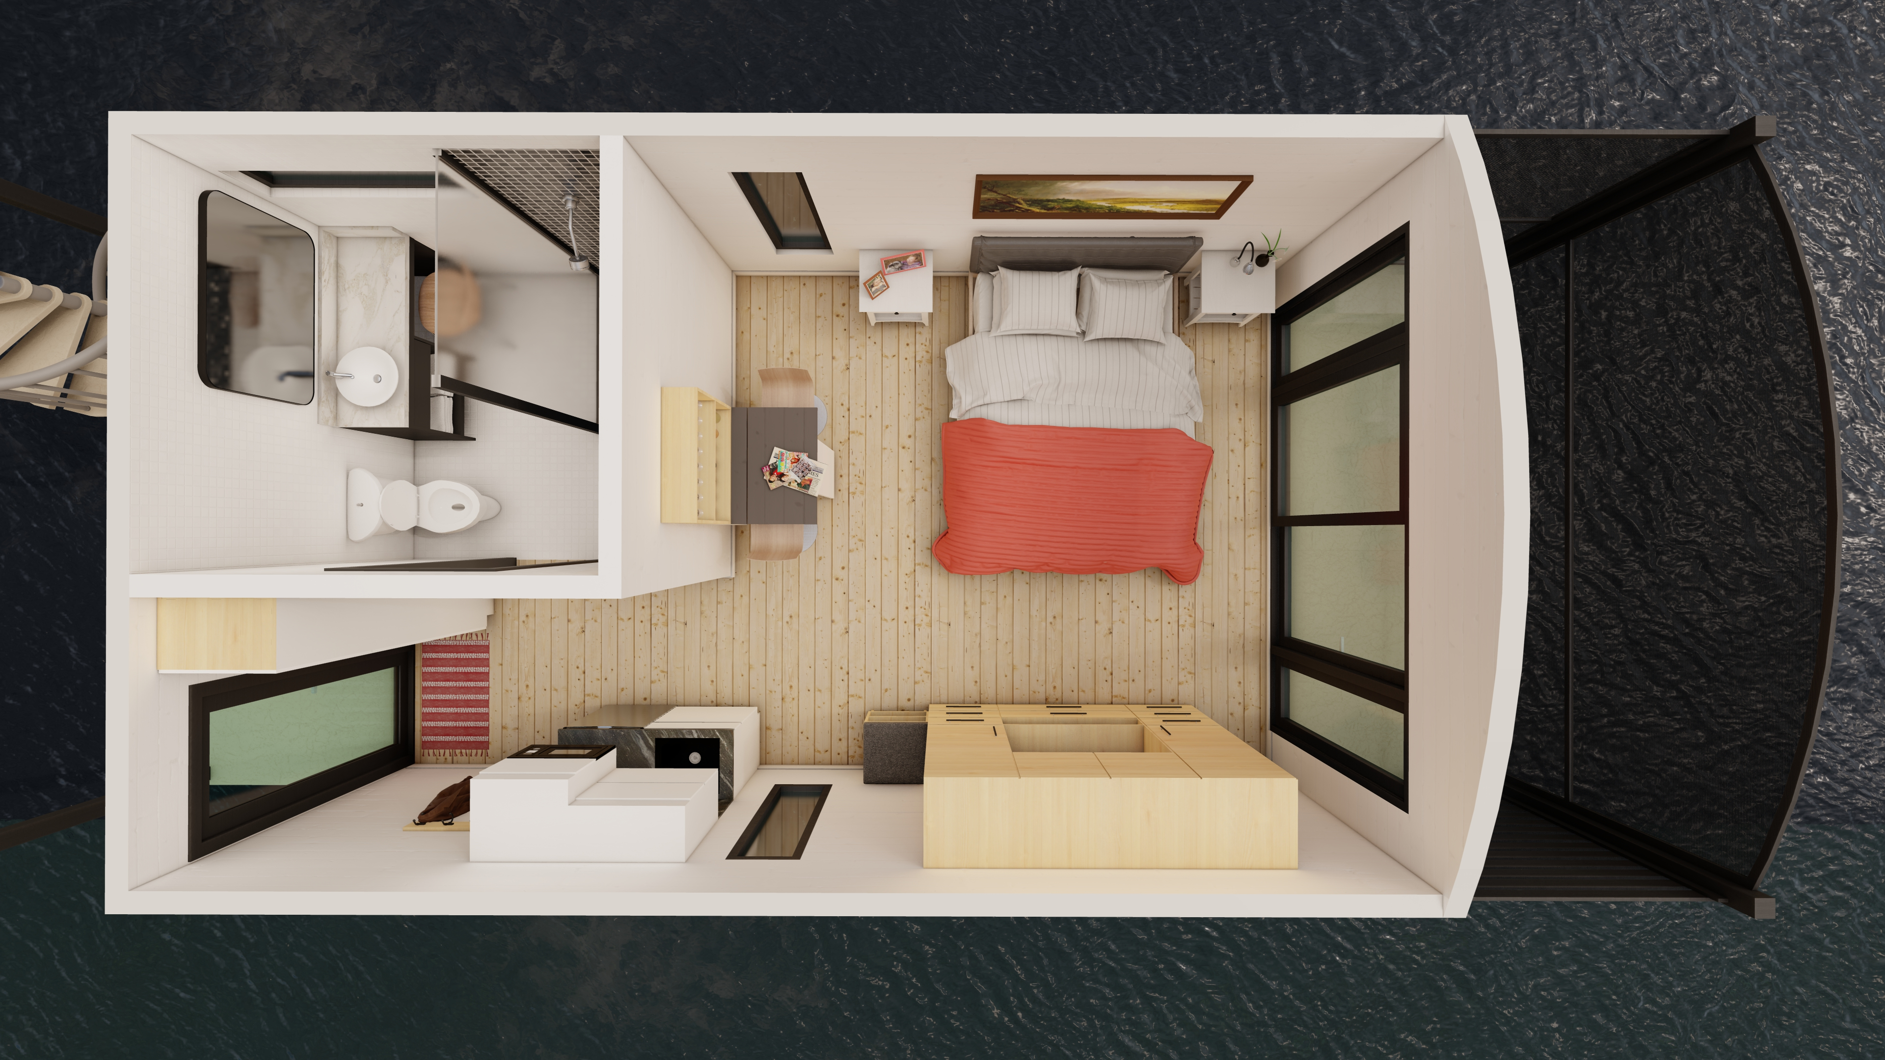
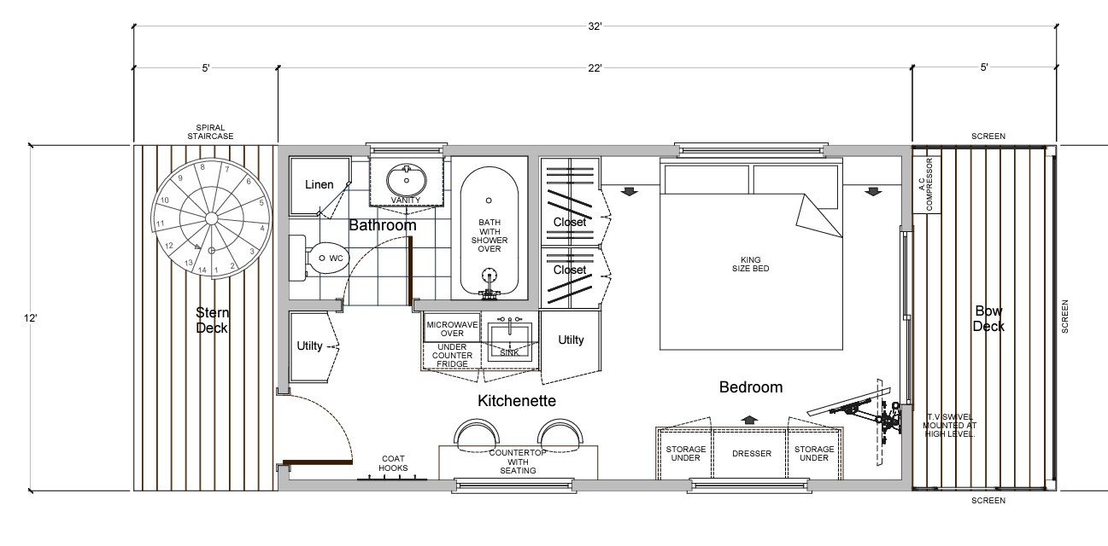

Slide 16
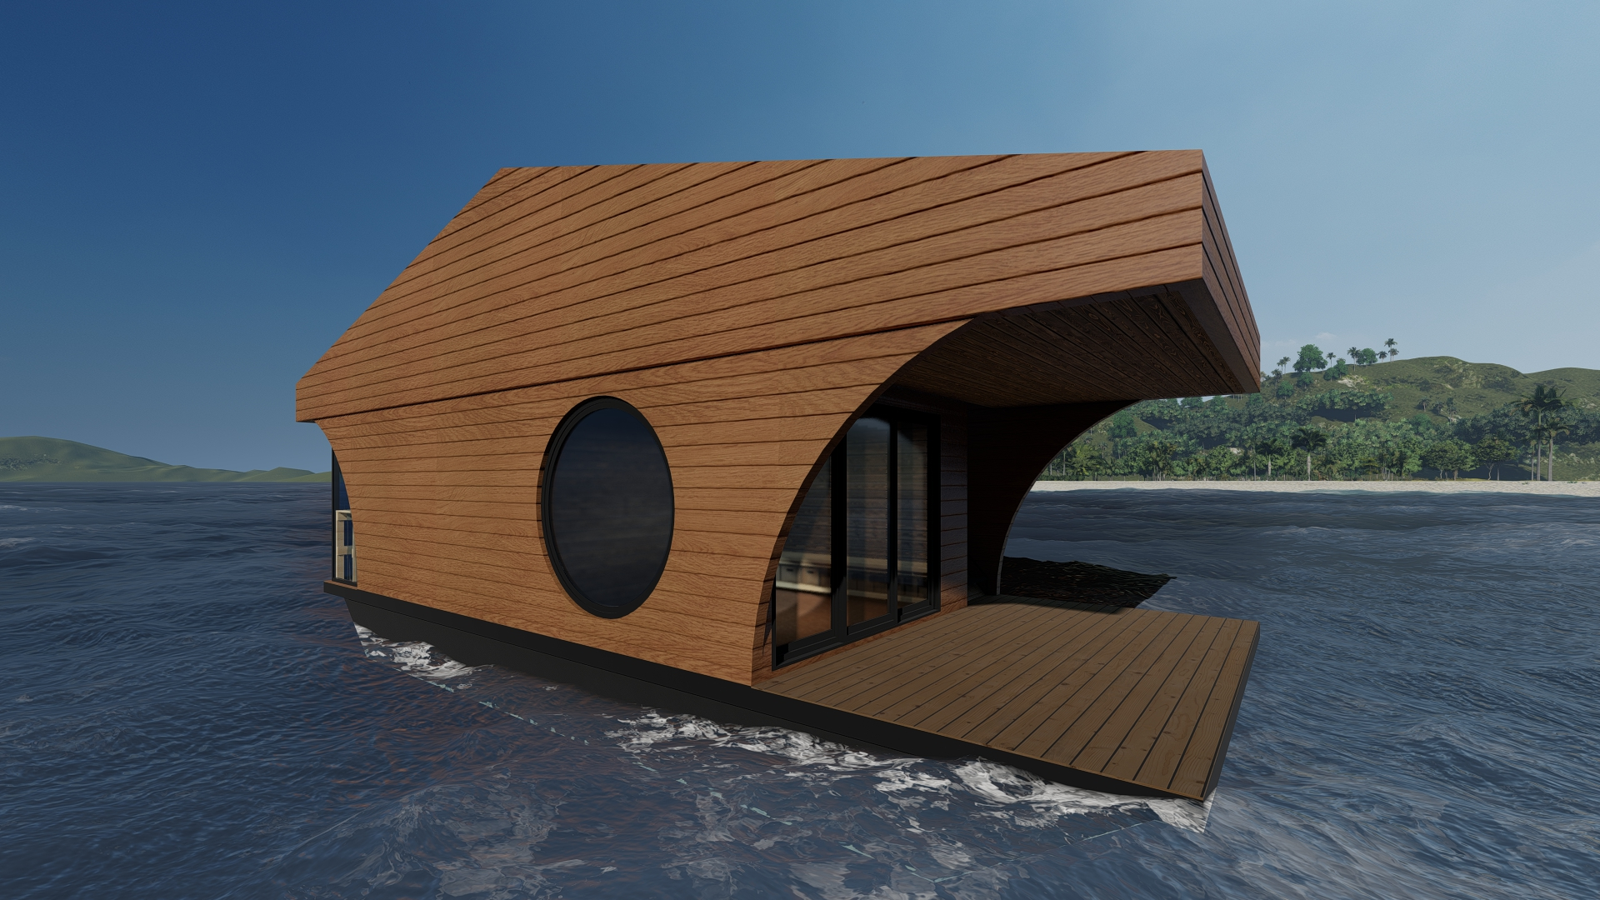
Floating Sauna

Slide 17
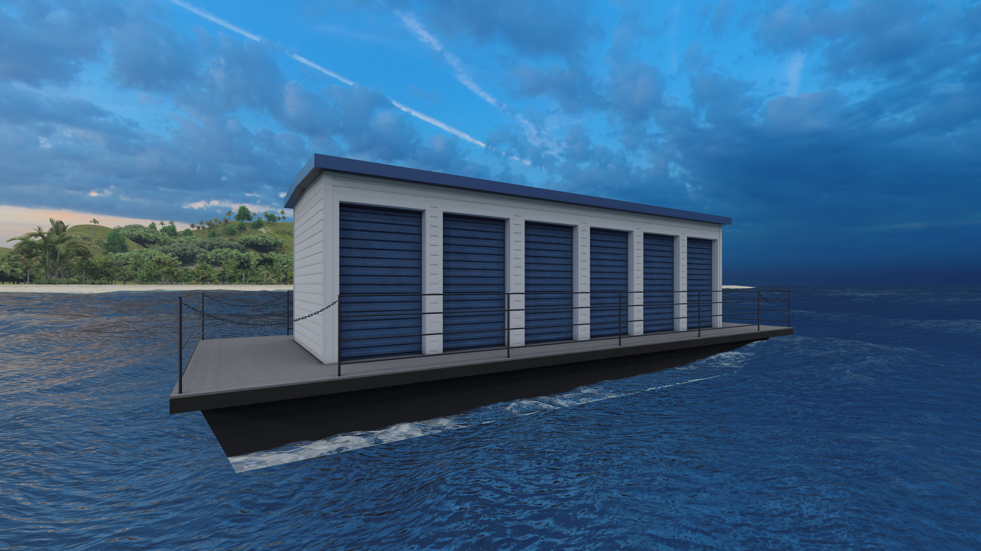
Floating Storage Buildings

Slide 18
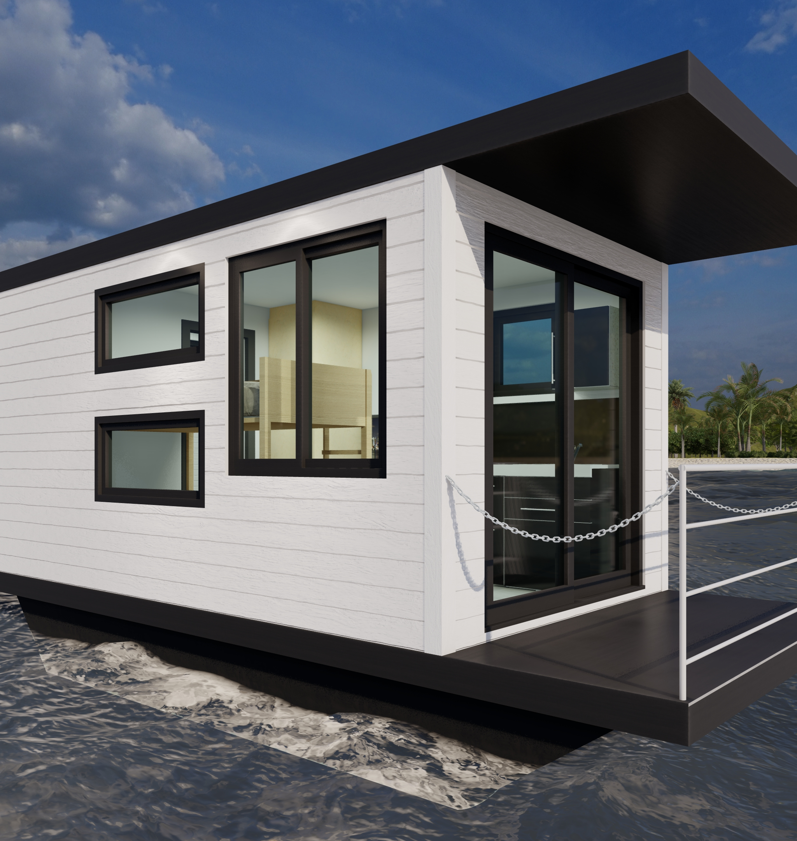

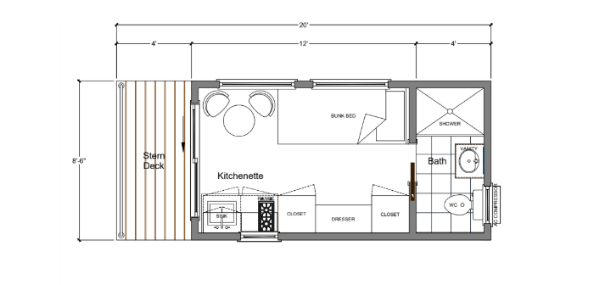
Workforce Housing

Slide 19
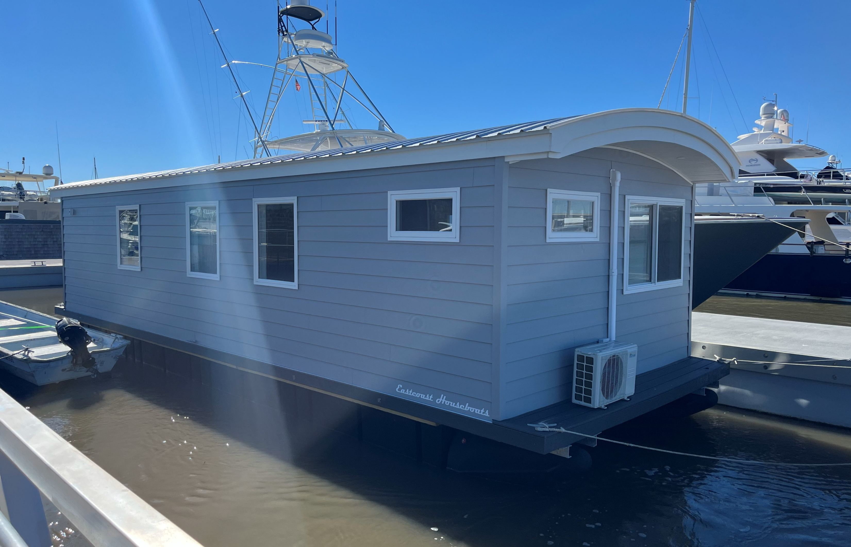
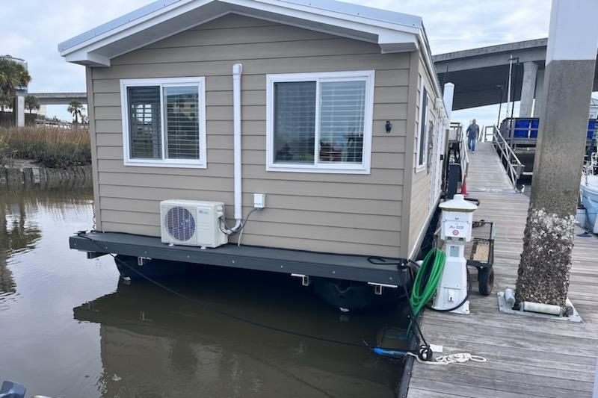
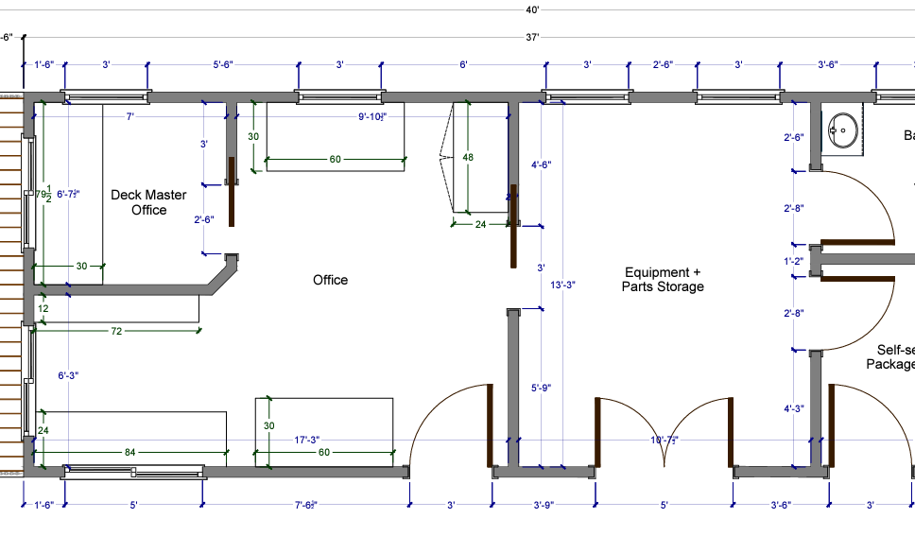
Floating offices designed to your
Specific needs and infrastructure
Requirements.

Slide 20
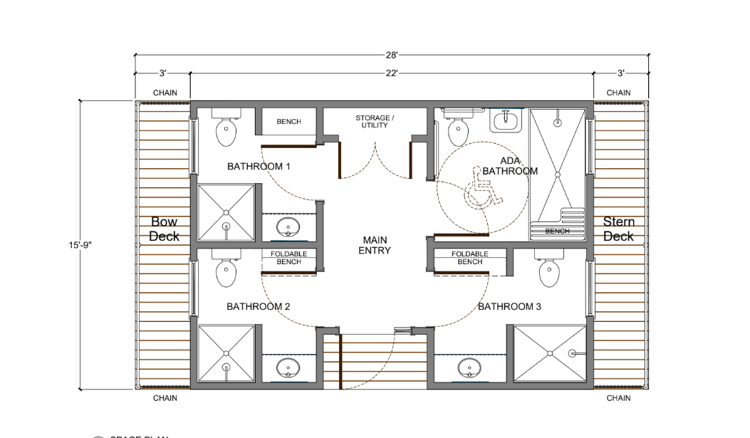
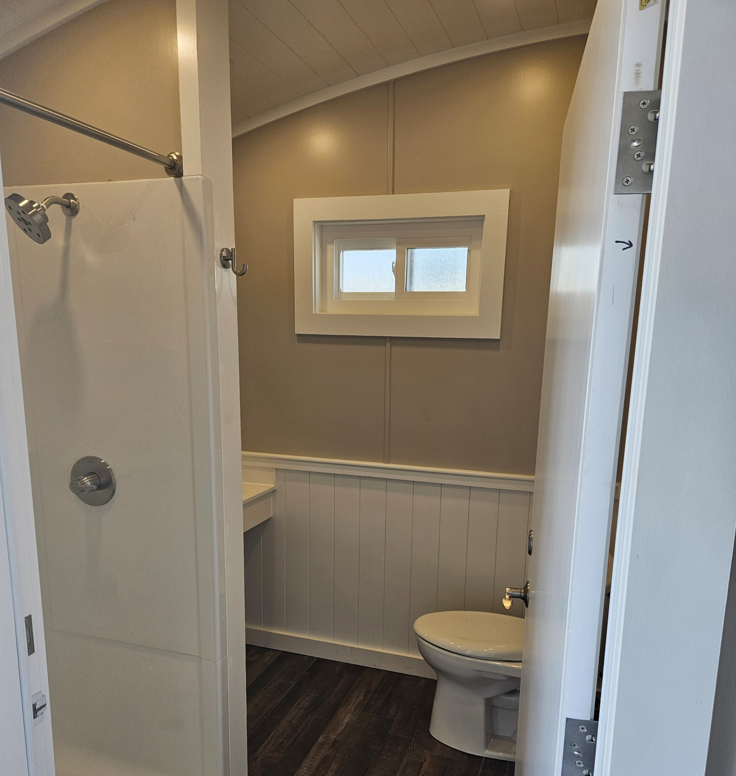
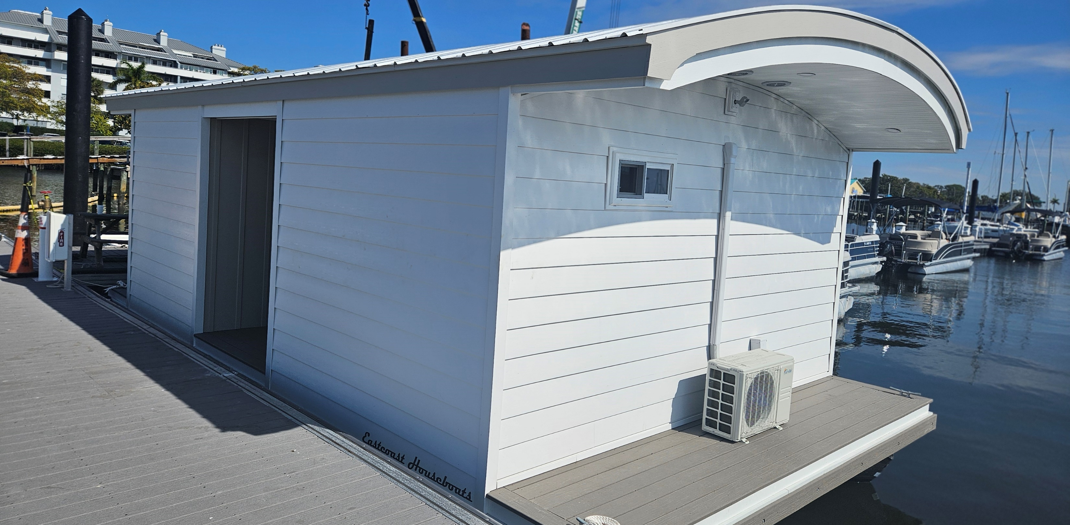
Shower Houseboats, all custom designed and
Built to your locations' needs.

Slide 21
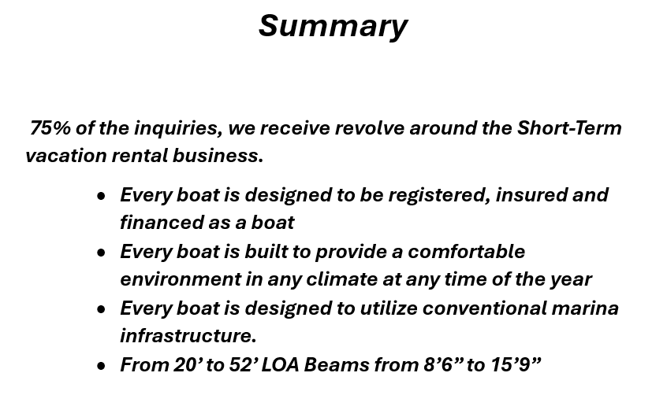
The leader in on-the-water lodging

Slide 22
Marina Profit Center Trends – Boatlifts and PWC Docking Platforms
Thursday December 12, 2024
Ron Martin, Director of distribution centers & marina sales

Slide 23
Introduction
Ron Martin –
Director of Distribution Centers and Marina sales at Waterfront Brands
Over 34 years experience in the industry.

Slide 24
Why you should consider boat lifts at your marina.
Increase your revenue and strengthen your customer base

Slide 25
Raise Your Profits Today
Lifts can be sold or leased to customers
Slips with lifts can be rented at a premium
Lifts strengthen your customer base by reducing customer turn-over
“Marinas are using Waterfront Brands products to maximize their revenues, increase their customer satisfaction, and lift their bottom line.”

Slide 26
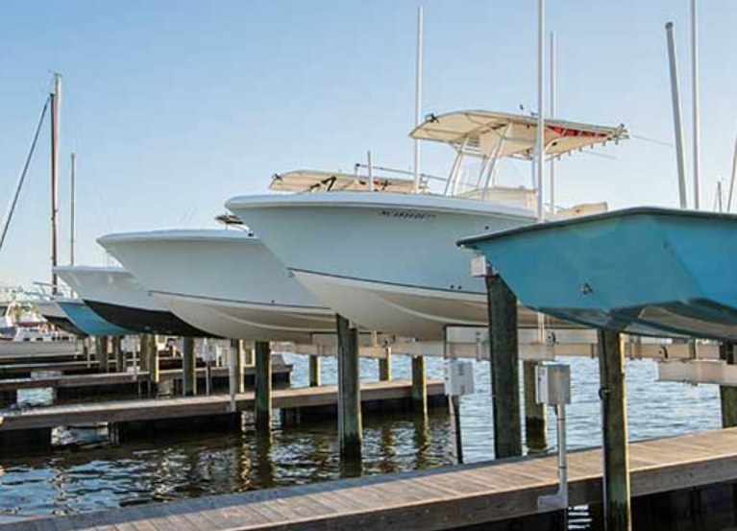
Raise Your Profits Today
Boats on lifts are used more – thus increasing revenues for marina facilities, fuel dock, and ship store
Lifts can be repurchased by the marina and resold as used at a premium

Slide 27
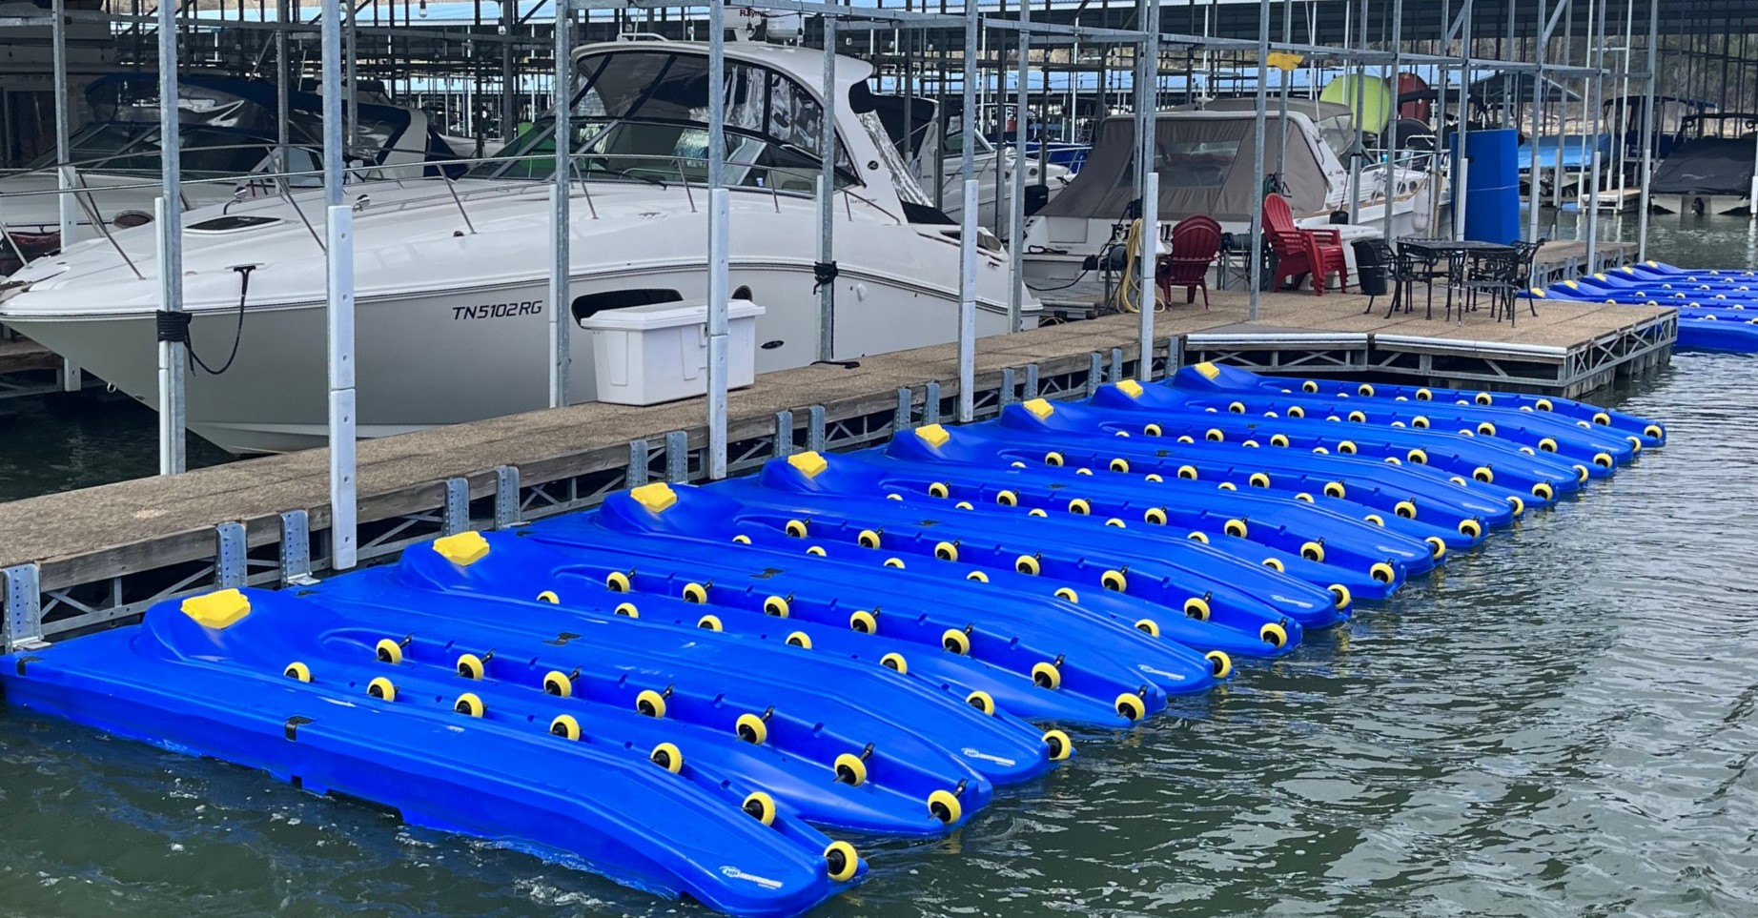
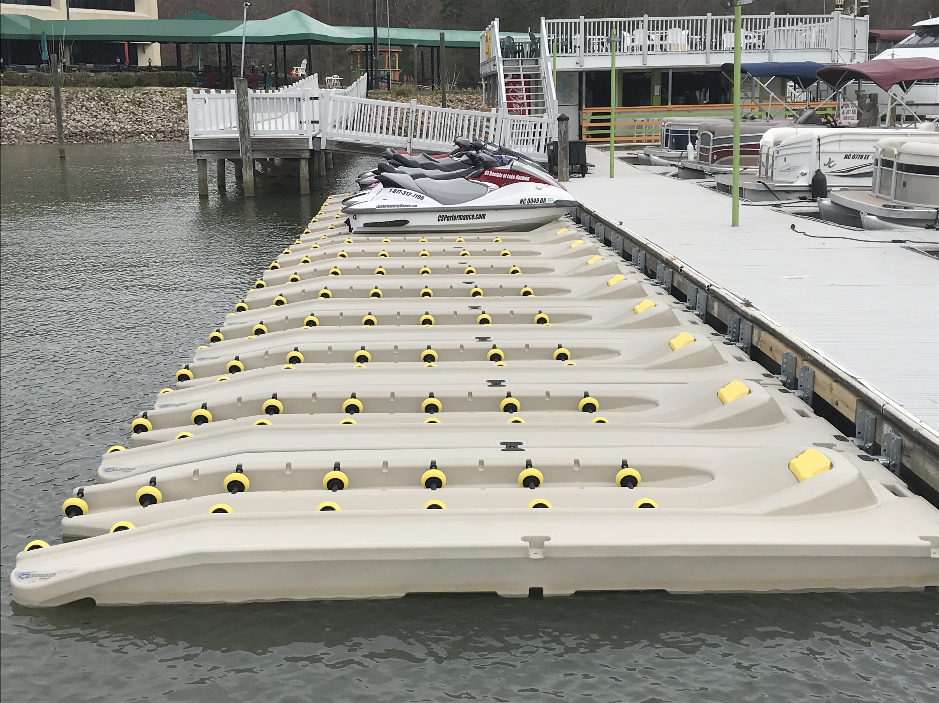
Raise Your Profits Today
HydroPorts can be installed at the marina to turn dead space into revenue generating space or used for PWC rental fleet.

Slide 28
Why your customers need to consider a boat lift.
Educate your customer

Slide 29
Selling Points
Protects their investment
Reduces maintenance and lowers operating costs
Immediate access to the water = more time boating
Maximum value – increase the value of the slip
“A Waterfront Brands Boat Lift is just like having a garage for their car – protecting their boat while they have it ready to use.”

Slide 30
Leads
Identify and qualify leads

Slide 31
Identify and Qualify Leads
Direct customer inquires
All new slip lease customers
Current customers that do not have a lift
Current customers who have upgraded or changed boats

Slide 32
What you need to know.
WHAT LIFT OPTIONS ARE AVAILABLE?
What’s required?

Slide 33
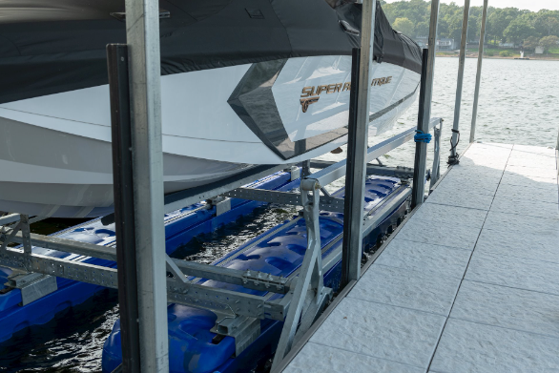
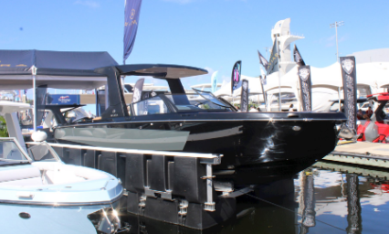
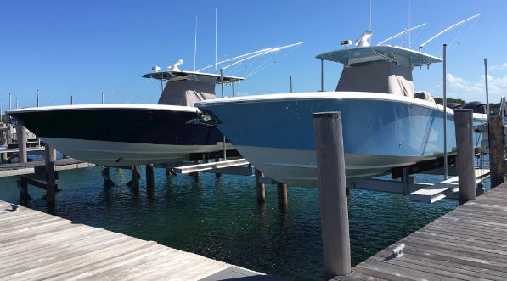
What Lift Options Are Available?
Depends on your dock application –
  Floating U-Shape
  Floating Double Wide
  Fixed
  Fresh or Saltwater
  There are lift options available for all applications.

Slide 34
What’s required?
Minimal Capital Required
  You can start off small with only one or two units at a time, or one dock section at a time.
  Standard installation normally does not require any additional work or modifications to the dock.
Installation and Service
  Local dealers and/or contractors available for installation and service.
  Marina personnel can be trained on installation and service, provides additional revenue source for the marina.

Slide 35
What’s required?
Prior to offering –
  Select a vendor and establish pricing model
  Train Staff –
    Set-up a team/focus leader
    Establish spiff and/or sales contests
    Installation and service model
    Ship store area has brochures and other support materials
    Signage at the marina
    Set-up a demo lift – dryland or in the slip to create attention

Slide 36
What’s required?
Year One –
  Market boat lift benefits
    Promote in newsletters and other communications
    Events and other promotions
  Continue staff training
  Get your vendor involved

Slide 37
What’s required?
Year Two-Three –
  Plan for increased sales as awareness expands
  Continue strong sales, training, and service focus with marketing to support
Year Four+ –
  Between years four and five the market will become more sustaining with a focus on service, upgrades with new boats and customer replacements as lifts age and new products are maintained. It is important to not lose focus to maintain this extra revenue stream.

Slide 38
Contact Information
Ron Martin
Waterfront Brands
Director of Distribution Centers and Marina Sales
Office Direct: 918-283-4226
Mobile: 918-906-8890
Email: ron@waterfrontbrands.com

Slide 39
Thank you!

Slide 40
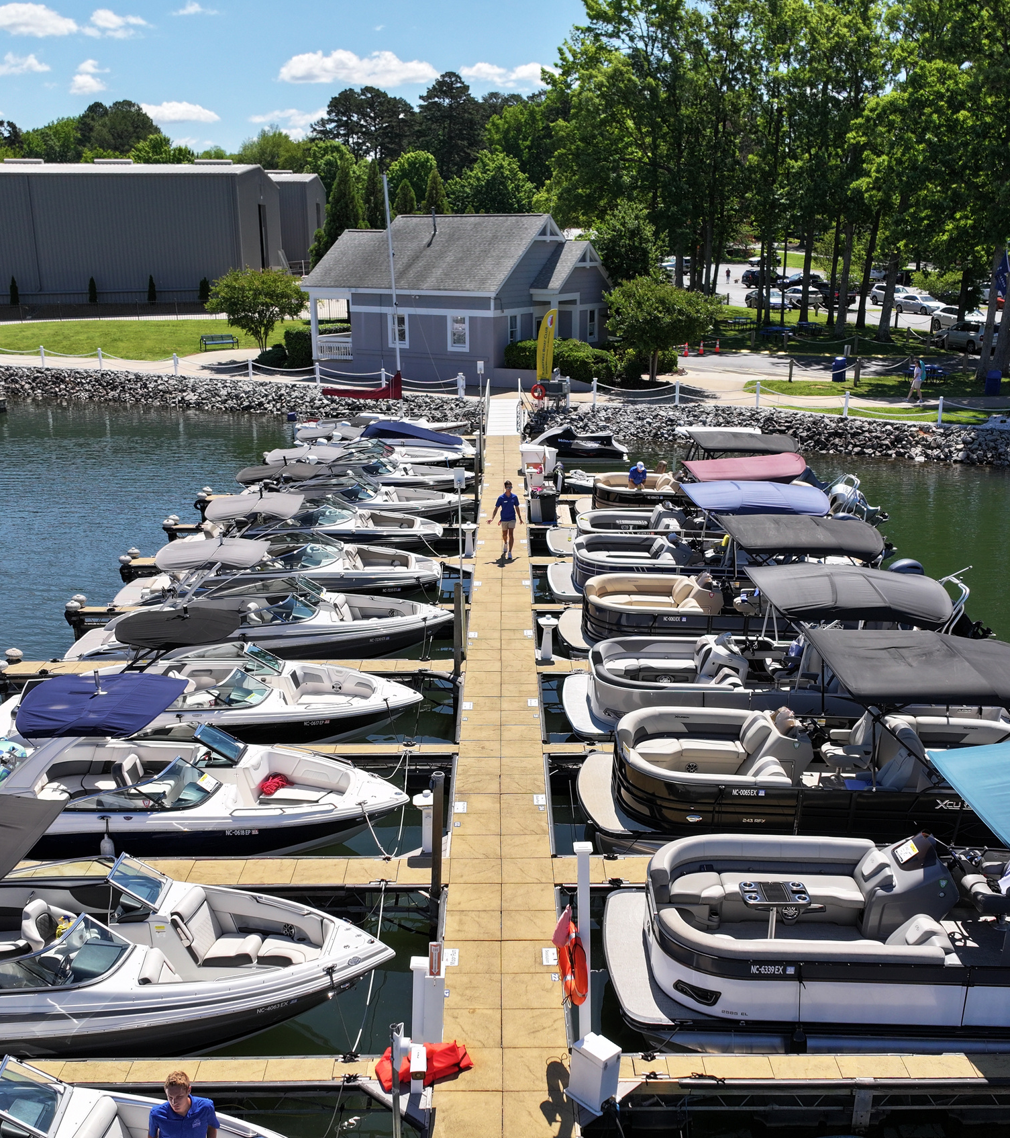



Profit Center Trends: Boosting the Bottom Line with Carefree Boat Club
How Boat Clubs Transform Marinas
Nicholas A. Mastroianni III
CEO, Carefree Boat Club
1.
Notes:
Good morning!
My name is Nick Mastroianni, and I am the CEO of Carefree Boat Club.
I am also the CEO of Summit Ventures, a multi-faceted hospitality and real estate holdings company that happens to include three marinas. So I am here as a marina-owner as much as a boat club CEO.
I’m thrilled to be here today to talk about profit center trends and how marinas can create new opportunities to boost their bottom line.
Whether you’re an independent marina operator, a family-owned business, or part of a larger marina organization, I am confident you will be excited to learn about the potential revenue growth you could realise through the introduction of a Carefree Boat Club in your marina.

Slide 41























Carefree Boat Club
  150+ locations globally.
  12,000+ members.
  22+ years of continuous growth.
  Leading proprietary tech stack.
  Exclusive partnership programs with OEMS, Financiers & Insurers.
Notes:
A little about Carefree Boat Club:
We are the second largest membership-based boat club in the world, with over 150 locations worldwide, most of which are here in the United States.
Unlike boat rental clubs, we have members who sign up for 3 to 5 year contracts paying a one-time initiation fee and monthly dues for the duration of their contract. This is sustainable, recurring revenue.
Technology
A key difference betwen us and other boat clubs is the exclusive partnerships we have brokered with OEMS, financiers and insurers that give our clubs significantly discounted

Slide 42







The Boating Lifestyle
is Changing...
Experiences over Ownership
  Multiple Boat Types
  Full Training for all Members
  No Cleaning or Maintenance
  Boat Fueled and Ready to go
  No Insurance Costs
  Access to Locations Globally
Notes:
Carefree Boat Club was founded to make boating more accessible, affordable, and enjoyable without the hassle of ownership. Members simply sign up, choose their times, and head out on the water. The demand is high, and the growth we’ve seen is proof of that.

Slide 43
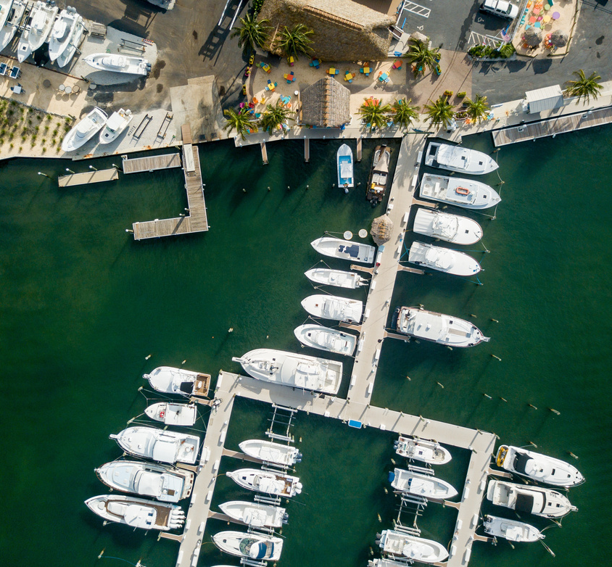
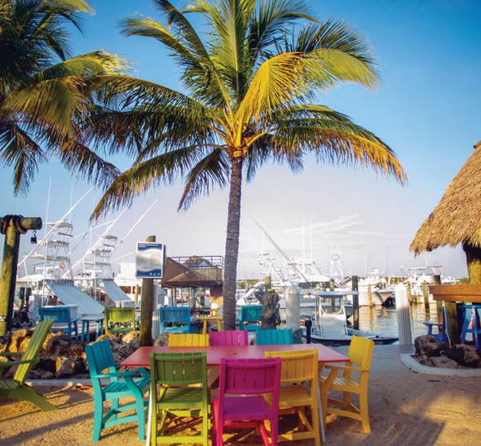
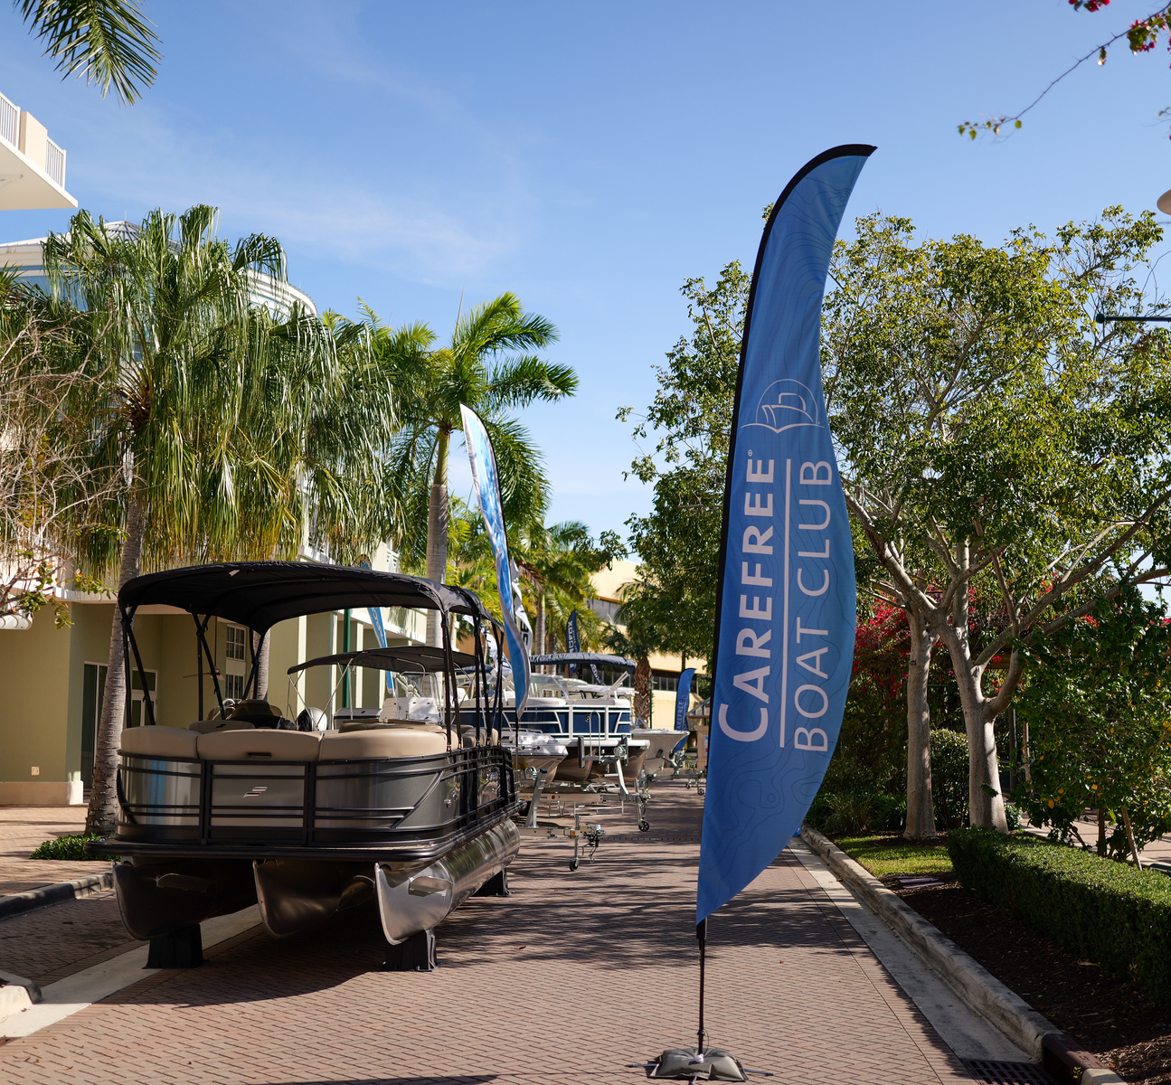
The Ideal Marina
for a Boat Club
Slips
Family-Friendly
Ambitious
Notes:
On or near water is obviously ideal

Slide 44

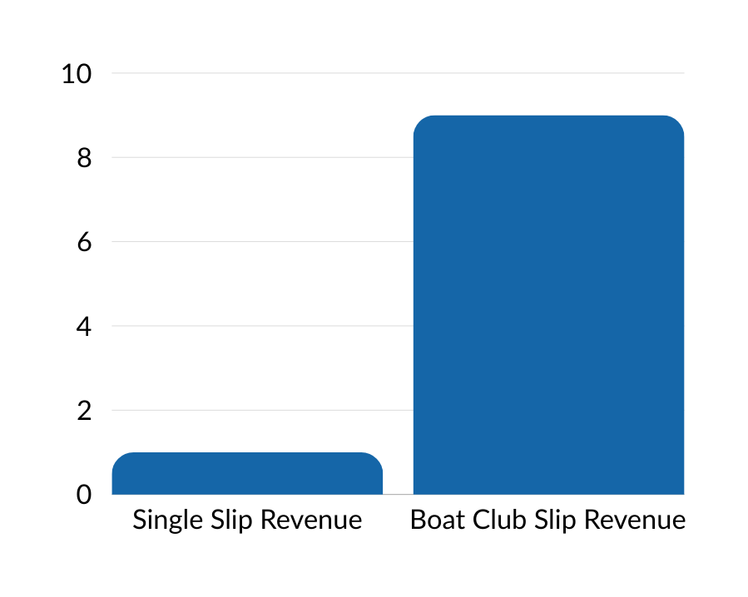
Revenue per Slip
e.g.
Single Slip Rental:
One slip leased to one owner = $4,000 a year.
Boat Club Slip Rental:
One slip occupied by one boat club boat with 8-10 members per boat = c. $42,000 a year in recurring dues.
Five slips leased to one boat club with five boats and 8-10 members per boat = c. $200,000 a year in recurring dues.
8-10x
x

Slide 45
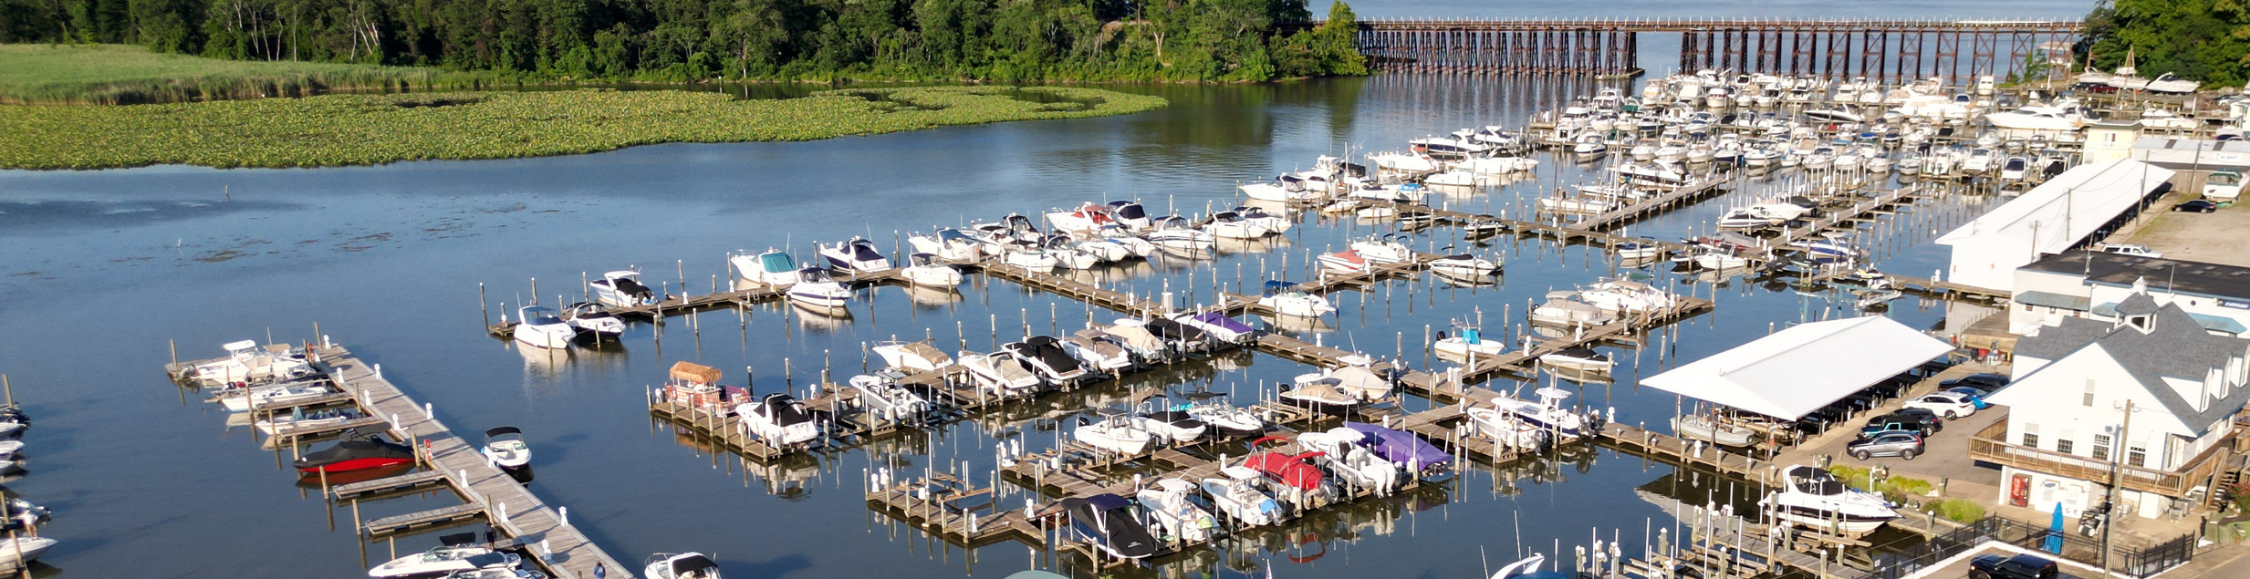
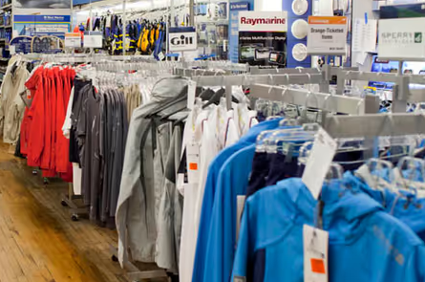





Additional Foot Traffic
Additional Revenue Streams
=

Slide 46


Minimal Investment
Maximum Return
What do Marinas need to open a Carefree Boat Club?
Slips
Boats
Adequate Parking
Clean Amenities

Slide 47

Dispelling
The
Myths
MYTH
Boat Club members are careless or dangerous.
FACT
Carefree Boat Club Members must complete 12 hours of close-quarters/open-water training before taking a boat out.
MYTH
Boat Clubs need additional staff.
FACT
Many marinas use existing marina staff to help run their Carefree Boat Club, up until about 150 members.
MYTH
Boat Clubs require a lot of up-front investment.
FACT
There are no sign-up fees. Initial investments are for marketing, staffing, and insurance. This can be as low as $200k.
7

Slide 48
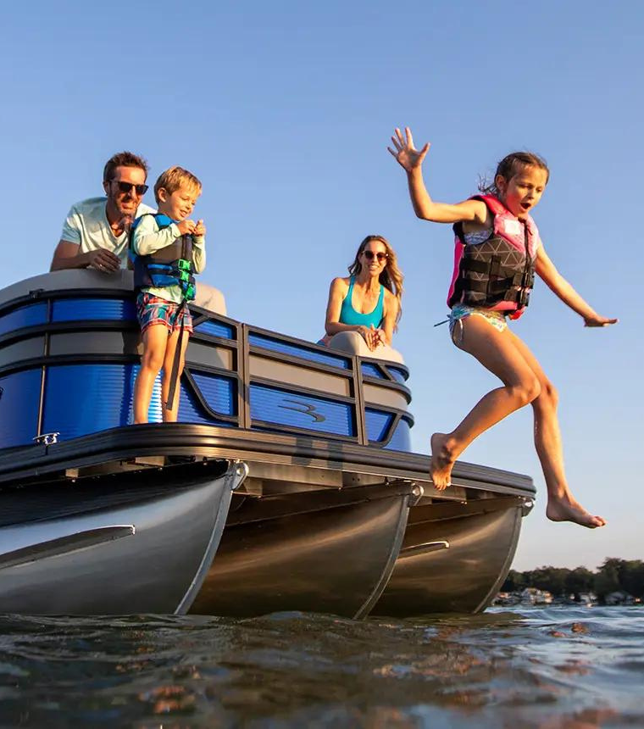

Learn more:
Nicholas@carefreeboats.com
855-236-2337 ext. 701
CarefreeBoats.com/marina-owners

