Slide 1
Insurance Bootcamp Is your marine facility properly insured ?
Lori J Sousa, Sea-Land Insurance Corp
Docks Expo – December 11, 2024

Slide 2
Let’s Start at the beginning with the basics.
Marina Operators Legal Liability (MOLL)
Marine General Liability (MGL)
Protection & Indemnity (P&I)
Jones Act
Property Including Tools & Equipment
Auto Coverage
Workers Compensation

Slide 3
Insurance Basics
MOLL – Coverage for boats you don’t own in your care, custody and control.
MGL – Coverage for your work and slip and falls.
P & I – On water liability – coverage for anyone or anything you hit while navigating on the water. (Sea Trials or moving vessels)
Jones Act – On water work comp.

Slide 4
Insurance Basics
Tools & Equipment – Coverage for hand tools, and mobile equipment (including forklifts and golf carts)
Property – Coverage for buildings and business personal property – could include Stock
Workers Compensation – Standard work comp for on land operations

Slide 5
Do you have coverage for these claims?

Slide 6
The forgotten coverages
Employment Practices Liability (EPLI)
Crime
Pollution Liability
Business Income Coverage
Dock Coverage
Trailer Coverage
Cyber Liability

Slide 7
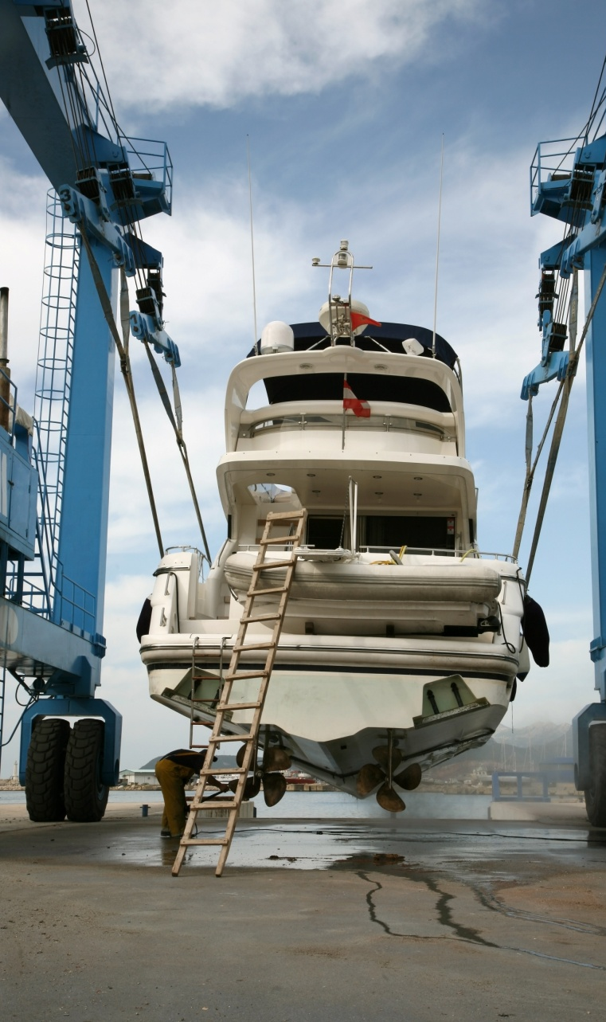
Did you remember to cover equipment?

Slide 8
The forgotten coverages
Employment Practices Liability (EPLI) - is coverage designed to protect you from lawsuits filed (justly or unjustly) by anyone in your employ now, formerly employed by you and even people whom you considered employing.
Crime Coverage protects organizations from loss of money, securities, or inventory resulting from crime. Common Fidelity/Crime insurance claims allege employee dishonesty, embezzlement, forgery, robbery, safe burglary, computer fraud, wire transfer fraud, counterfeiting, and other criminal acts.
Notes:
These schemes involve every possible angle, taking advantage of any potential weakness in your company’s financial controls. From fictitious employees, dummy accounts payable, non-existent suppliers to outright theft of money, securities and property. Fraud and embezzlement in the workplace is on the rise, occurring in even the best work environments.

Slide 9
the forgotten coverages
Pollution - The purpose of this type of insurance policy is to mitigate the risk that comes with accidentally polluting the environment. If a company is found guilty of polluting the environment in some capacity, they could be faced with large costs.
Cyber liability insurance helps cover costs associated with data breaches and cyberattacks on your business. Those costs can include such things as lost income due to a cyber event, costs associated with notifying customers affected by a breach, costs for recovering compromised data, costs for repairing damaged computer systems and more.
Carriers offer customized insurance solutions depending on your business’s level of risk, with coverage options available to address: Forensic investigations / Litigation expenses /Regulatory defense expenses/fines / Crisis management expenses /Business Interruption / Cyber extortion.

Slide 10
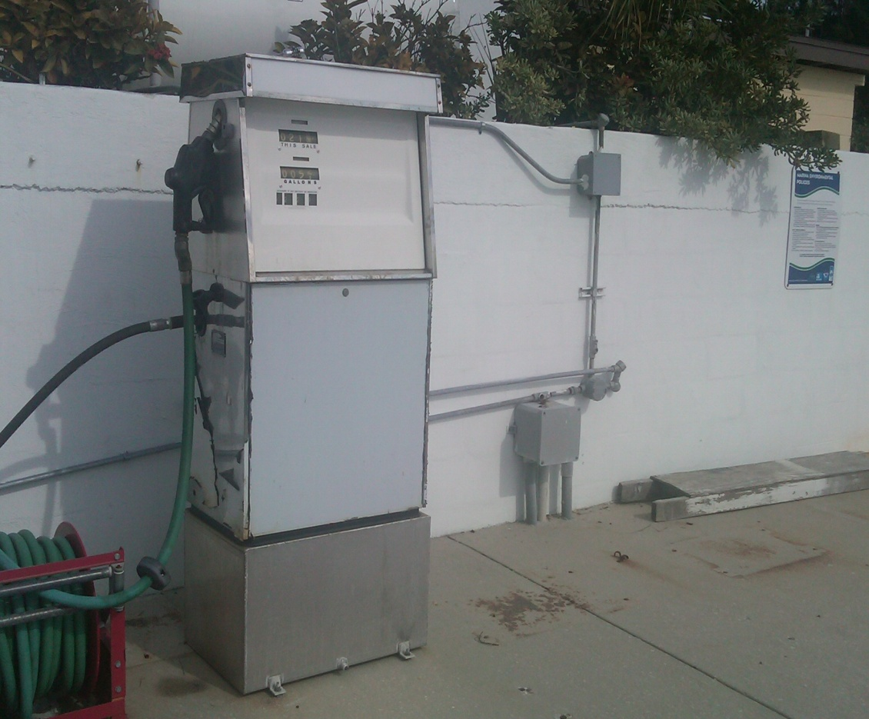
Pollution is cradle to grave

Slide 11
the forgotten coverages
Business Income covers the loss of income that a business suffers after a disaster while its facility is either closed because of the disaster or in the process of being rebuilt after it.
A property insurance policy only covers the physical damage to the business, while the additional coverage allotted by the business interruption policy covers the profits that would have been earned.

Slide 12
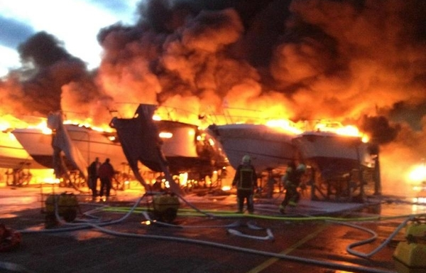
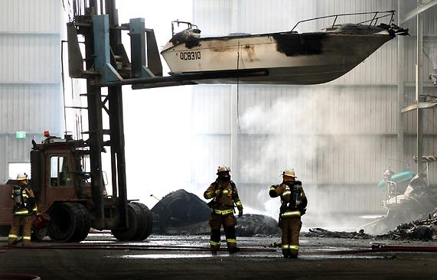
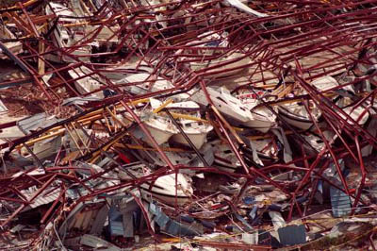
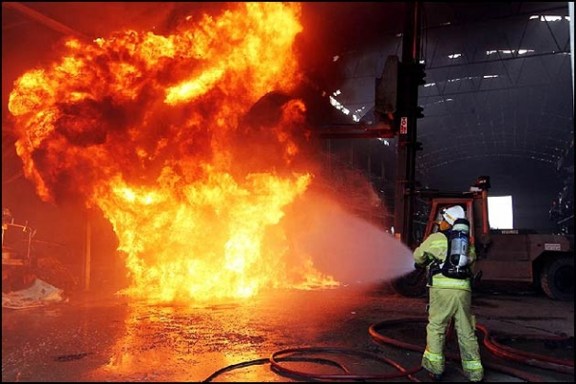

Slide 13
the forgotten coverages
Dock Coverage is self explanatory, this covers the docks you own and can include infrastructure (plumbing, electrical, satellite TV, etc). You may also be able to purchase loss of income on your docks.
Trailer Coverage – these should be added to your auto policy. They are not covered unless they are scheduled.

Slide 14
What coverage did you purchase?

Slide 15
Conclusion
It is imperative that you have an open and HONEST relationship with your insurance agent, which includes a walk thru annually. If your agent hasn’t been to your facility – you have the wrong agent.
Always get a quote on every coverage available. It then becomes a business decision looking at the risk and deciding where you want to spend your money.
NEVER assume something is covered. The time to find out there’s no coverage should never be after a claim.

Slide 16
Questions ??? This is a lot of information Contact me with any questions.
Lori Sousa- lsousa@sealandins.com

