Slide 3
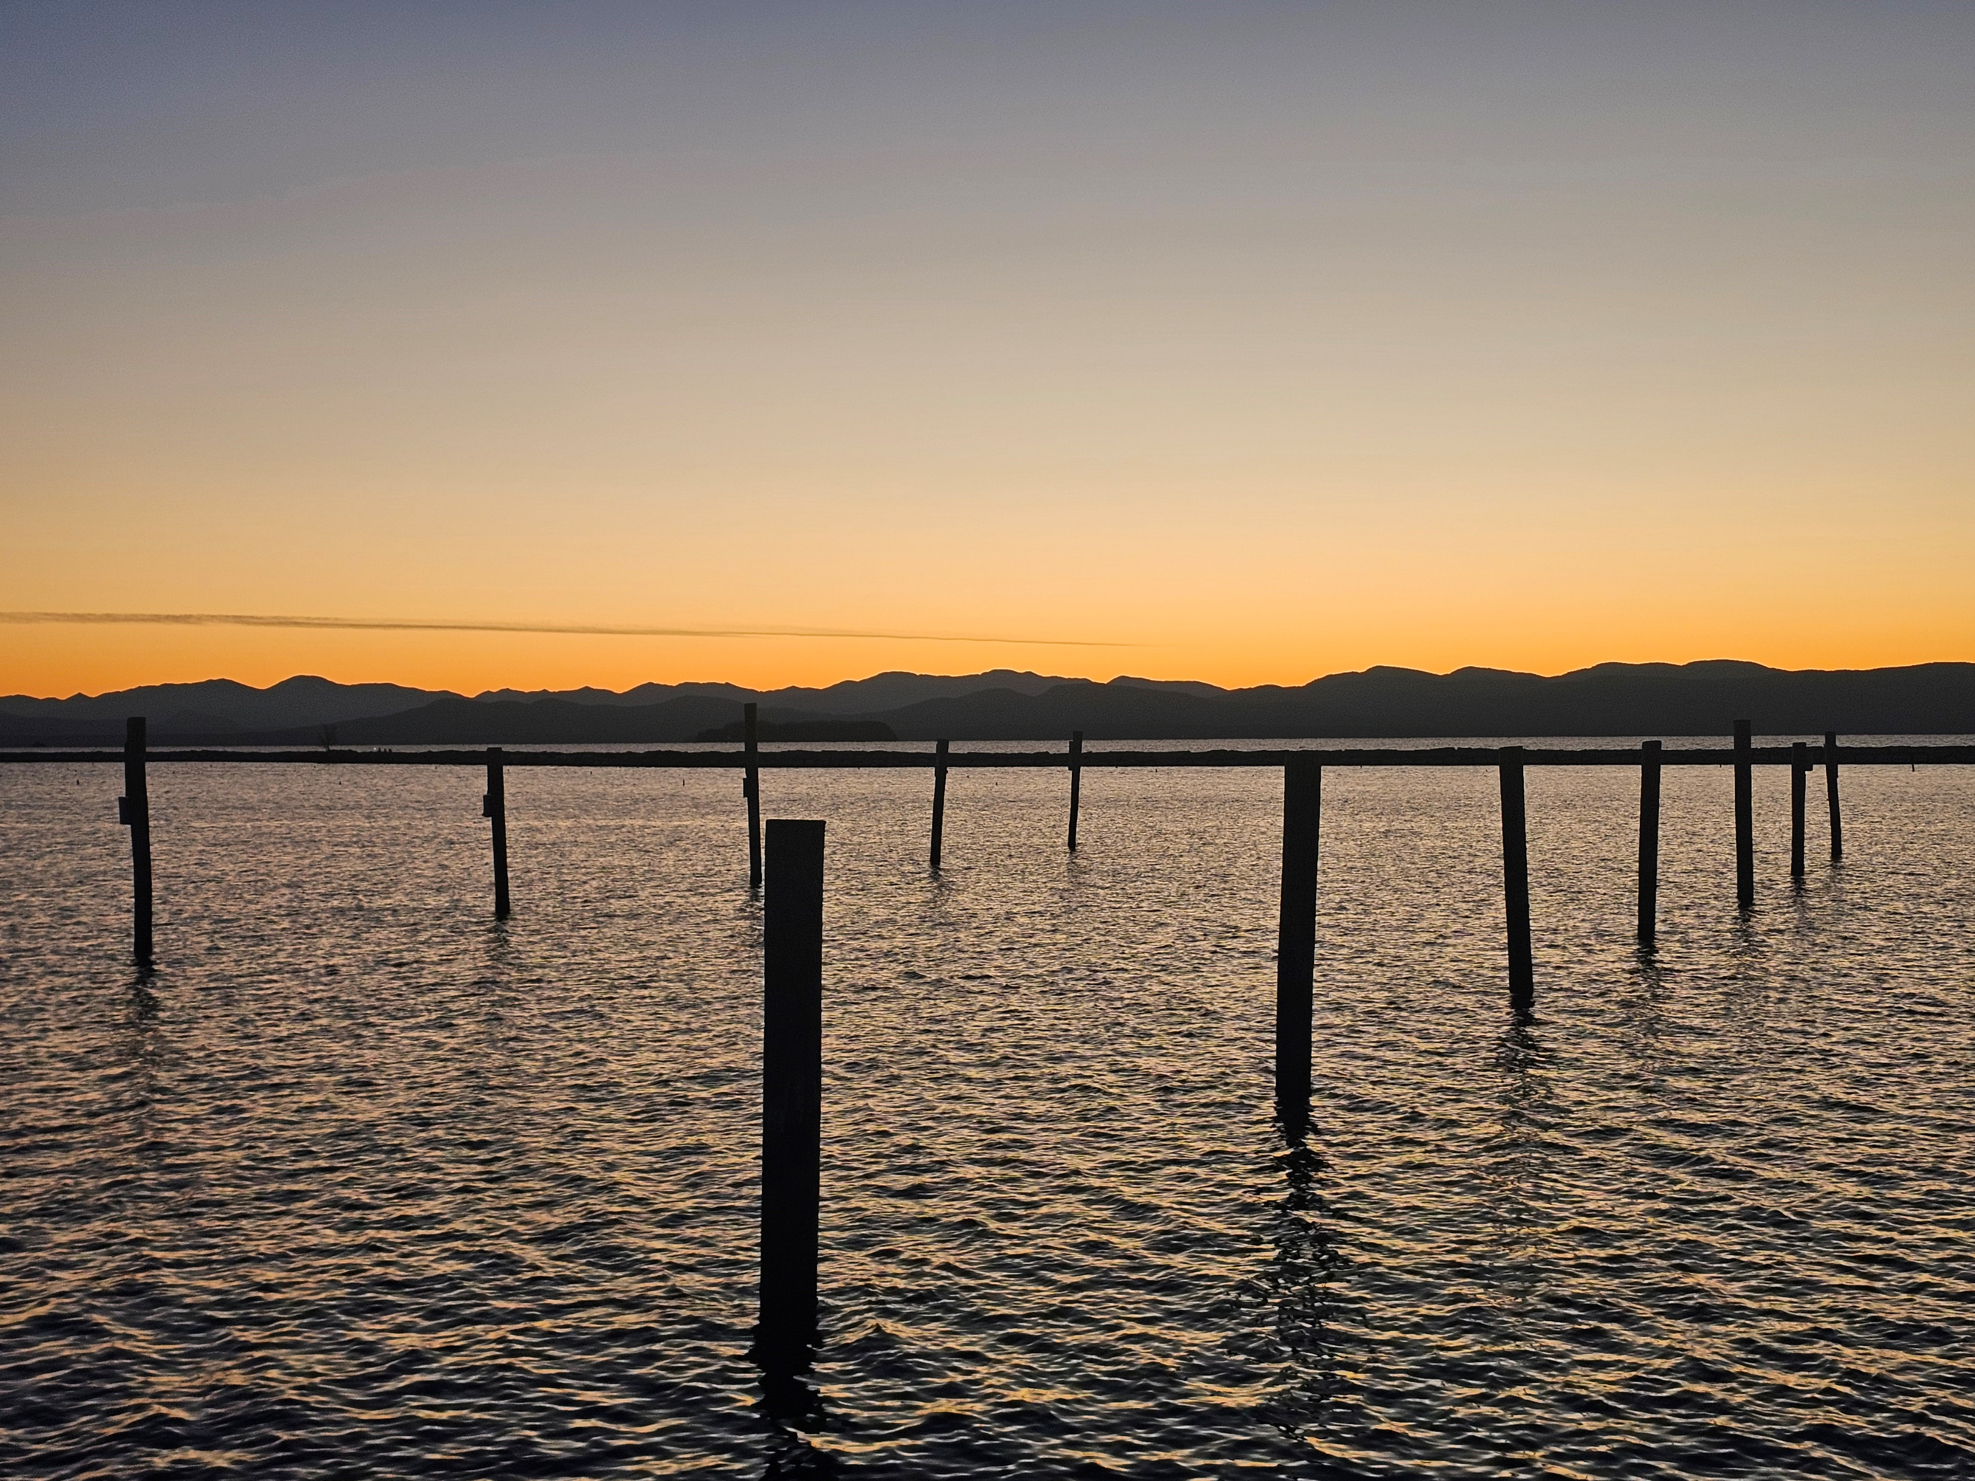

Slide 6
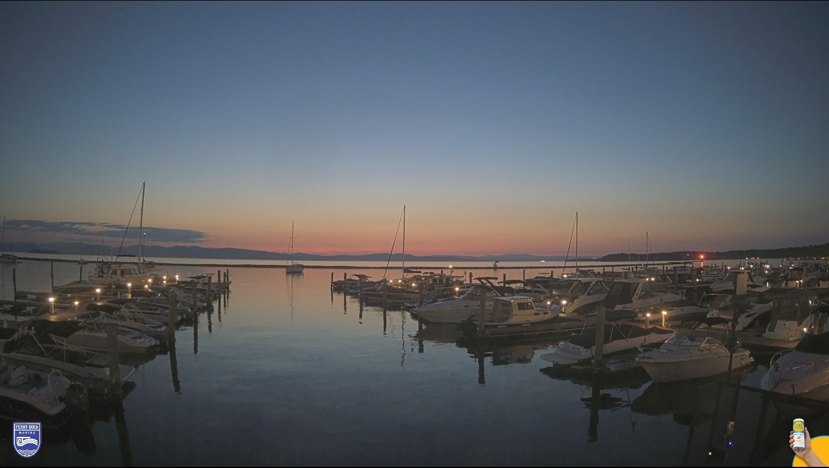

Slide 7
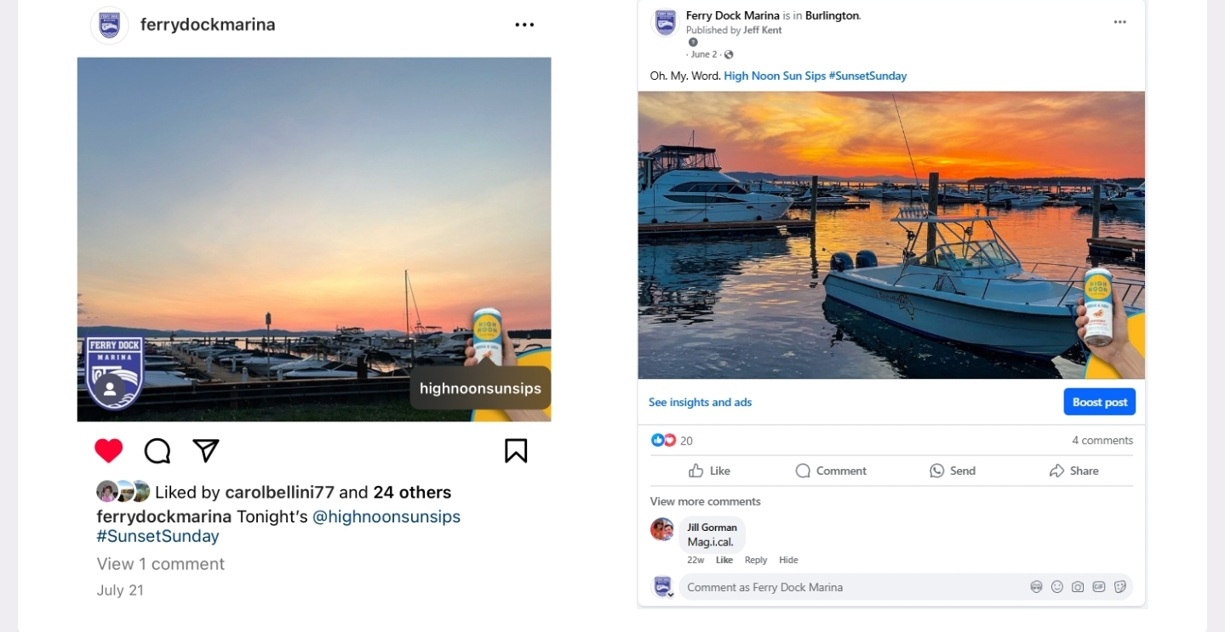

Slide 8
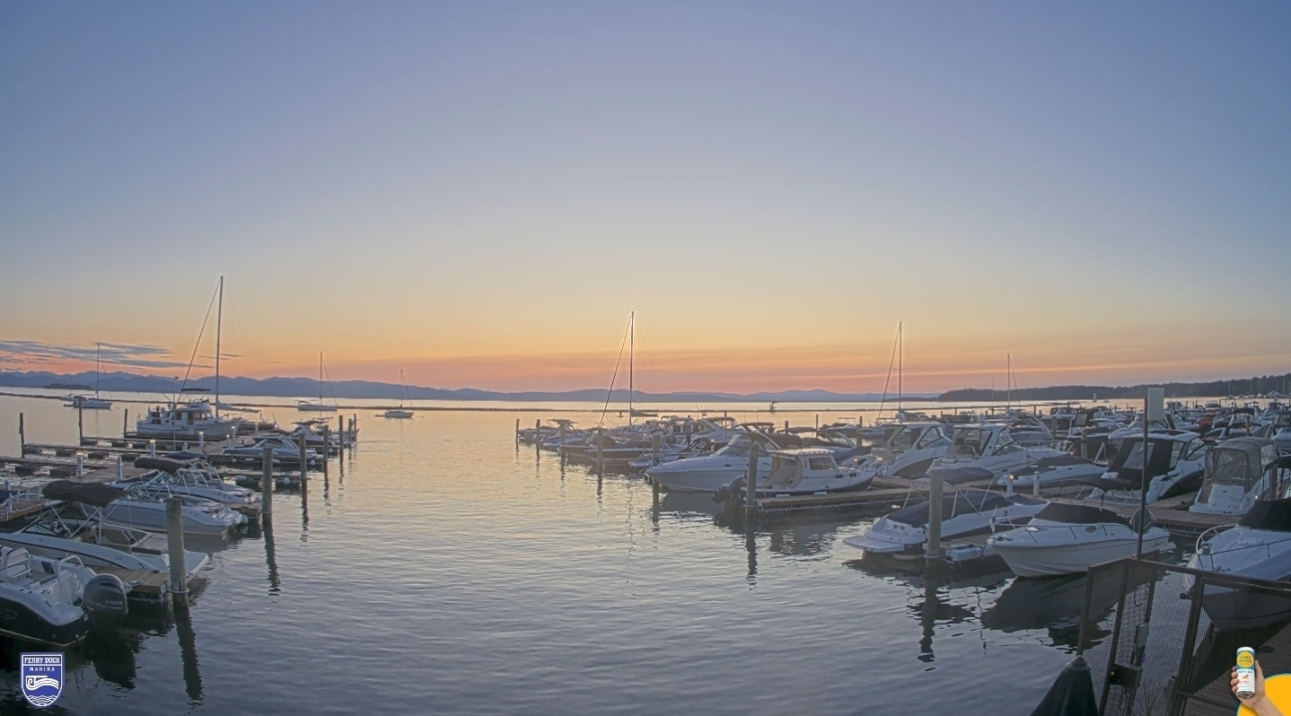

Slide 10
Marina Revenue Generating Ideas
Presenter – Ken Robinson

Slide 11
Traditional Offerings
Wet and Dry Storage
Rental Boats
Fuel Sales
Ship Store
Upland Cabins
Camping
Restaurant

Slide 12
Let’s think out of the Box!
Vacant slips – If the market changed resulting in open slips, add a patio changing the size and offering an entertainment area for the day boater.
Upselling - Create a “sticky” Customer by upselling a boat lift with the slip pointing out the benefits of the lift.
Dock boxes/Spider nets – Create a standard look at your facility by offering standard dock boxes for sale or rent as well as spider nets.
3rd Party Partnerships - Focus on your core business which is generally storage, and partner with 3rd party business aliances for complimentary lines of business. (Boat rentals, Restaurant, Service, Boat Club, Merchandise, Specialty Services).
Boat detailing – Clean, shrink wrap and storage for off season.
Hire Happy Staff – Hire Associates that exemplify your Culture of putting the Customer first. Happy Employees equal Happy Customers!

Slide 13
What is the Goal?
Become a destination rather than a quick stop.
1
Differentiate your Marina as more than a place to float your boat.
2
Create that long term Customer that enjoys becoming a part of your Marina Community.
3

