Slide 1
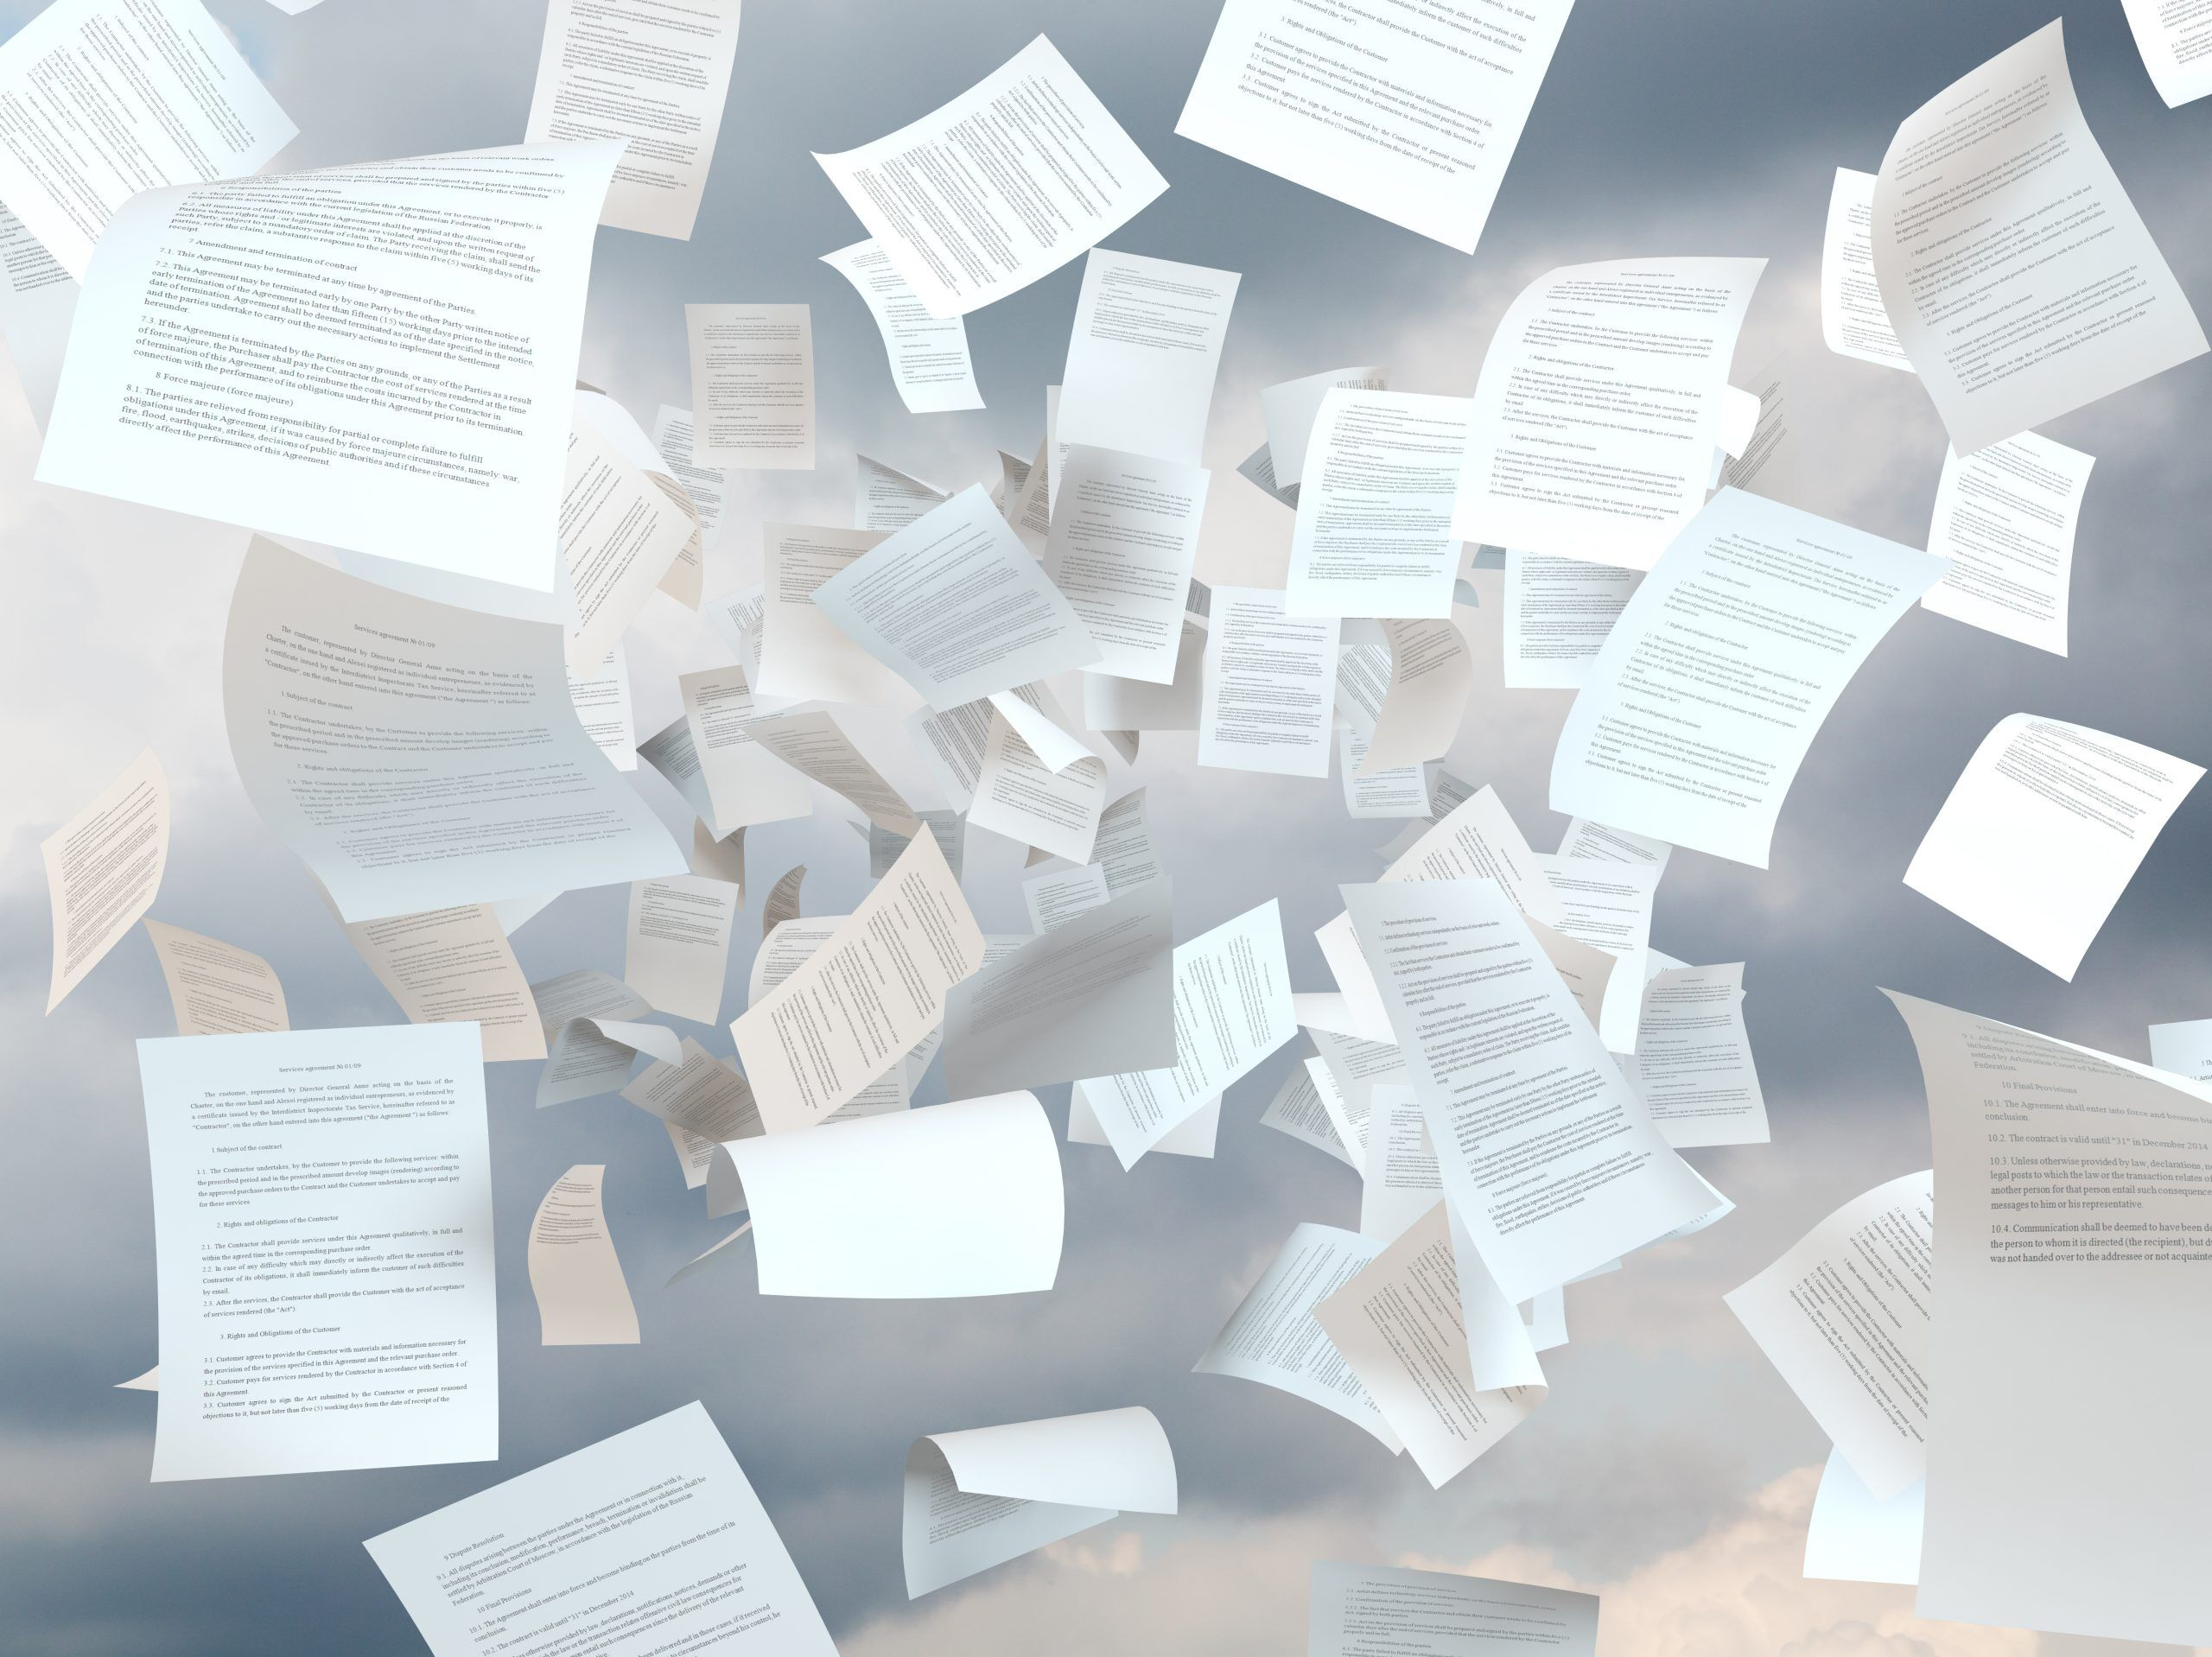
Keeping Afloat with Marina Regulations and Codes

Slide 2
Presenters
Dan Williams, PLA
Principal Landscape Architect
Marcus Rue, PE
Team Leader - Civil Engineer
Notes:
Introductions
Introduce MSA where located and work

Slide 3
Codes and Compliance
Codes are created by legislative bodies
Codes are a systematic collection of rules, laws and regulations by subject matters.
Designed to ensure safety, health and welfare.
Typically have to be created and enforced by a legislative body – village, city, state, federal…etc.
Enforce by inspections and permits.
Regulation are typically developed by governmental agencies
Are rules or directives made and maintained by an authority to enforce the laws
Typically broader and more encompassing than codes, focusing on a wide range of operational and environmental considerations.
Enforced by ongoing compliance checks that can involve multiple agencies.

Slide 4
Codes and Compliance

Slide 5
Codes and Compliance
Wisconsin State Laws that Affect Marinas *Wisconsin Clean Marina Program www.wisconsincleanmarina.org
Marine Sanitation Devices – Federal Clean Water Act and State Statute Sec. 30.71
Pollution Discharge Elimination – National Pollutant Discharge Elimination System (NPDES)
Pump-Out Stations – State Statute Sec. 30.71 (3)
Wisconsin Litter and Recycling Laws – State Statute Sec 287 and NR 544 WI Adm. Code
Navigable Waters, Harbors and Navigation – Chapter 30 Wis State Statutes
Water Quality Standards for Wetlands – NR 103, WI Adm. Code
Aquatic Plant Management – NR 107, WI Adm. Code
Criteria for Dredging Projects – Sediment Sampling and Analysis, Monitoring Protocol and Disposal – NR 347 WI Adm. Code
General Solid Waste Management – NR 500, WI Adm. Code
Hazardous Waste Management: General – NR 600, WI Adm. Code
Environmental Protection, Investigation and Remediation (Spills) – NR 700-750 WI Adm. Code
Deleterious Substances – Chapter 29.601 (3), WI State Statutes
The National Pollutant Discharge Elimination System (NPDES)
The Wisconsin Pollutant Discharge Elimination System (WPDES) Stormwater Discharge Permit Program
The General Permit for Wastewater from the Outside Washing of Vehicles, Equipment, and Other Objects (WI-0059153-2) from the WDNR
The General Permit for Wastewater from Carriage and Interstitial Water from Dredging Operations (WI-0046558-5) from the WDNR
Soil Erosion and Stormwater Management
Pesticide Application Business License from Wisconsin DATCP
Pesticide Applicator License from Wisconsin DATCP

Slide 6
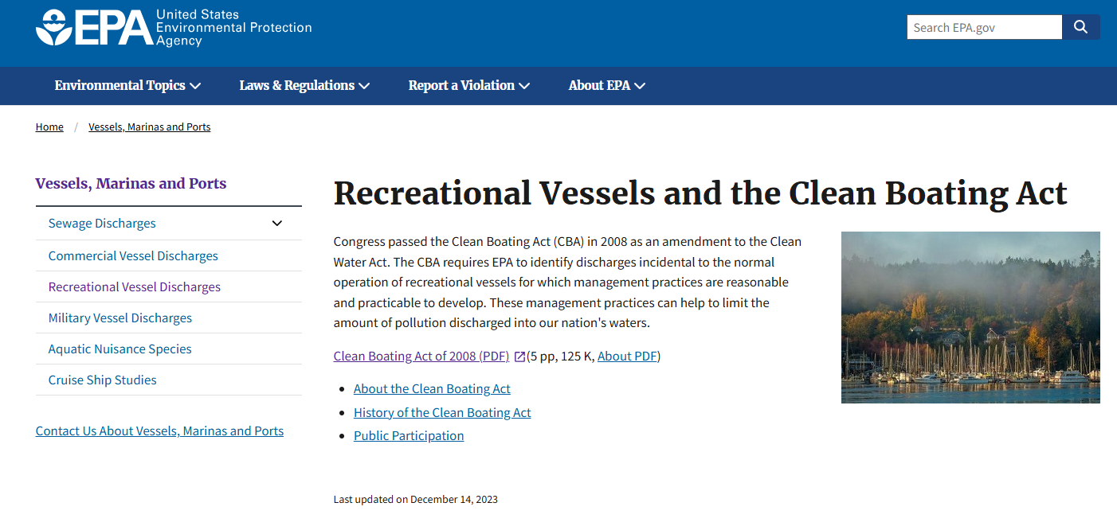
Codes and Compliance
EPA Clean Boating Act of 2008 www.epa.gov/vessels-marinas-and-ports/recreational-vessels-and-clean-boating-act
Notes:
It applies to all recreational vessels, which include boats used primarily for pleasure and not for commercial purposes. This includes everything from canoes and kayaks to motorboats and yachts
Boaters are required to follow the management practices established by the EPA to minimize pollution. This includes using environmentally friendly cleaning products, proper disposal of waste, and maintenance practices to prevent leaks and spills

Slide 7
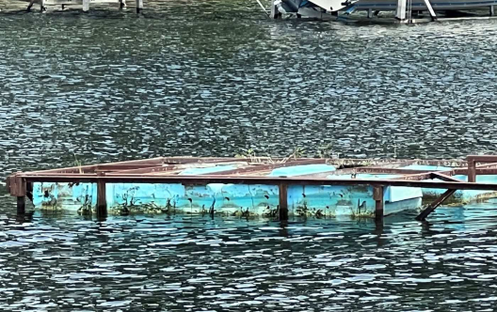
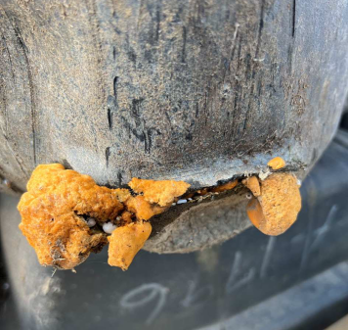
Codes and Compliance
Notes:
The CBA emphasizes minimizing pollution from recreational boating activities.
Styrofoam docks, if not encapsulated, can contribute to environmental pollution through the release of small plastic particles into the water.

Slide 8
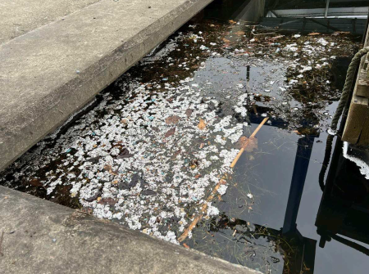
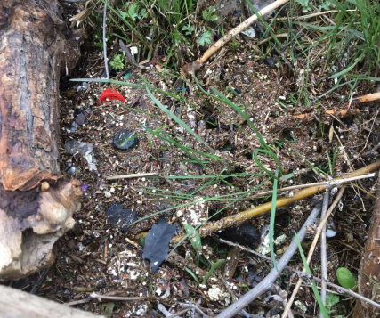
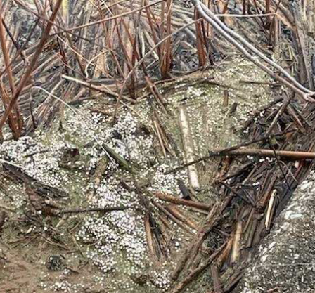
Codes and Compliance
Unencapsulated Floats
Notes:
Prevention, Regular inspection checking for damage and making necessary repairs.

Slide 9
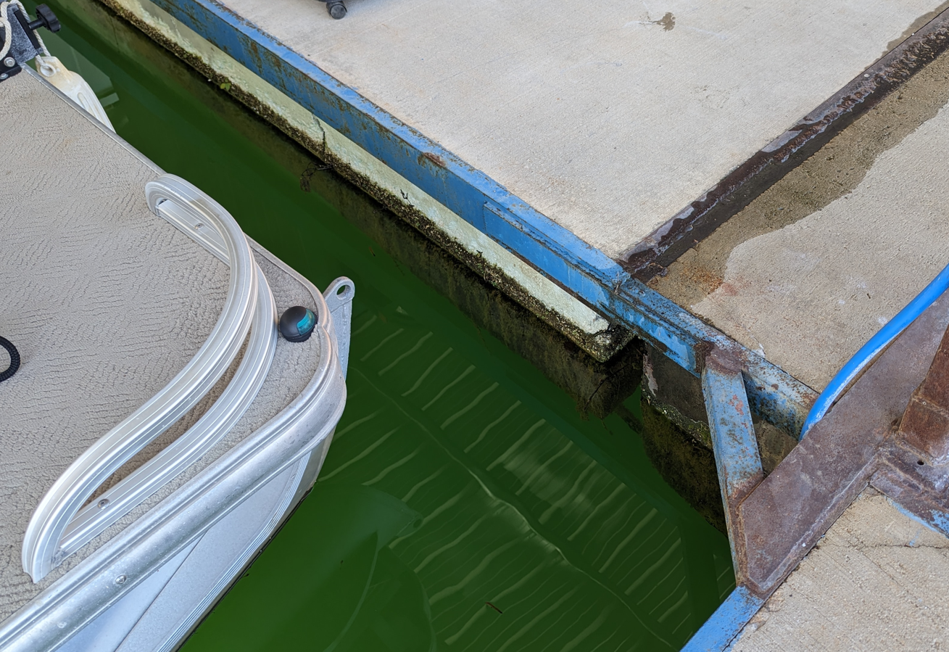
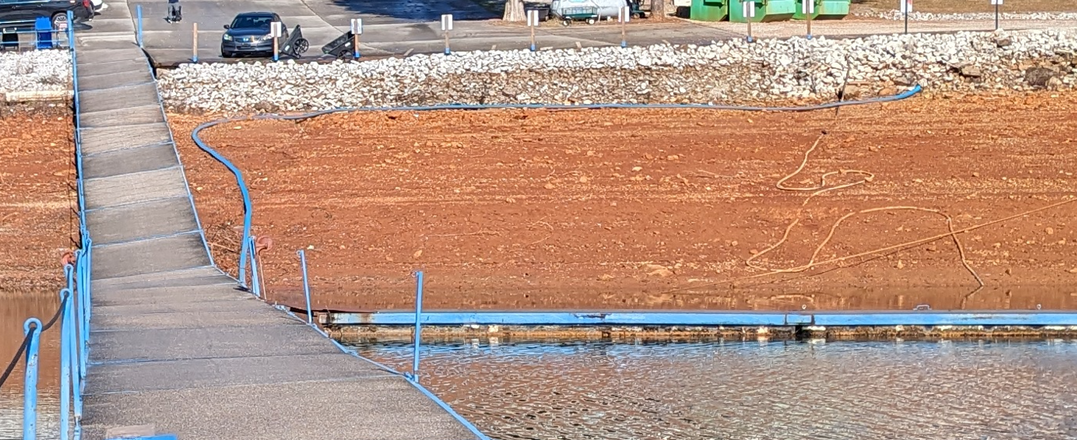
Codes and Compliance
Unencapsulated Floats

Slide 10
Codes and Compliance
Unencapsulated floats Bans and Moratoriums
Tennessee Valley Authority (TVA) Section 26 18 CRF 1304.400
This final rule requires the removal and replacement of all unencased flotation no later than December 31, 2031. If TVA determines that the existing unencased flotation is no longer serviceable prior to December 31, 2031, owners will have 24 months from notification from TVA to remove and replace it. These changes will apply to all Section 26a permits, including those authorizing floating cabins.
2022 Topsail Island towns barrier islands NC ban unencapsulated floats first in NC www.coastalreview.org
Section 6-98. General construction, repair, etc., requirements. (by adding the following new subsection:) (6) Using unencapsulated polystyrene material. This includes new construction as well as repair or modification of an existing structure. 3. Section 6-100. Structural specifications. (by adding the following new subsection:) (f) The use of unencapsulated polystyrene on any flotation device in prohibited.
Dept of Ecology State of Washington www.ecology.wa.gov
New environmental protections will reduce plastic pollution in Washington’s waters. Beginning in 2024, polystyrene foam used in docks, floating blocks, or overwater structures must be fully enclosed in a shell made of plastic (at least 0.15-inches thick), concrete, aluminum, or steel.
Polystyrene foam must be fully enclosed in a shell made of plastic (0.15 inches), concrete, aluminum, or steel.
Exposed polystyrene foam and foam wrapped in plastic film is prohibited in new dock repairs and construction
Lake Texoma – Denison Dam Shoreline Management Plan February 2021
5 year moratorium (2026) on removal of unencapsulated floats www.swt.usace.army.mil

Slide 11
Codes and Compliance
Unencapsulated floats Bans and Moratoriums
New York Bill S4974A www.nysenate.gov
Title 34 Unencapsulated Expanded or Extruded Polystyrene Foam Ban – State of New York, Feb 17, 2023
Beginning January first, two thousand twenty-five, any person who8 constructs a floating dock or floating platform in this state shall9 ensure that any expanded polystyrene foam or extruded polystyrene foam10 in such floating dock or floating platform is fully encapsulated.11 § 2. This act shall take effect immediately
Camden, Maine - In November 2017, Camden residents passed an Unencapsulated Polystyrene Ordinance
Designed to eliminate the use of unencapsulated polystyrene in dock floats and buoys on Camden’s lakes, rivers, harbors and waterways.
Camden’s polystyrene ordinance bans the use of unencapsulated polystyrene in new docks and dock repairs. By the end of 2022, all unencapsulated polystyrene must be removed from existing docks.
Rockport Maine – December 14, 2017 – 5 year moratorium ban (2022) on unencapsulated floats. www.camdenparksandrec.com
Lower Colorado River Authority (LCRA). May 24, 2023 Highland Lakes Marina Ordinance
First change in 22 years
Unencapsulated floats to be replaced in 2 years (2025). Owners objected. In 2023 – 19 of the 147 marinas in the system had unencapsulated floats. LCRA agreed to allow owners the opportunity to make a case that replacing foam in 2 years would result in unreasonable hardship, therefore giving them the options of entering a replacement plan with LCRA. www.lcra.org

Slide 12
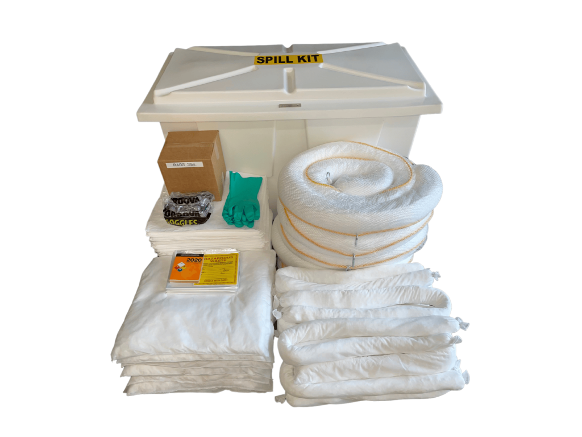
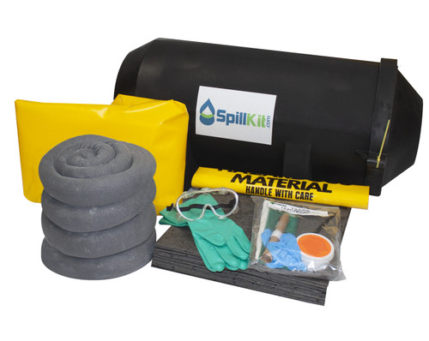
Codes and Compliance
Spill Kits
Non Compliant Spill Kit – Service Station
Compliant – Marine Grade Spill Kit
Notes:
Oil only kits:
Specifically for Hydrocarbons
Gas
Oil
Diesel
Universal Kits:
Water based liquids,
Coolants
Solvents
Oils
Hazmat Kits
Chemical spills
Acids
Base
what happens when these kits fall off a dock? Do they float? Are they damaged?

Slide 13
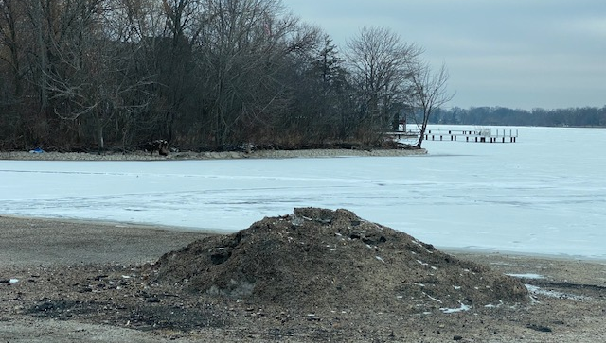
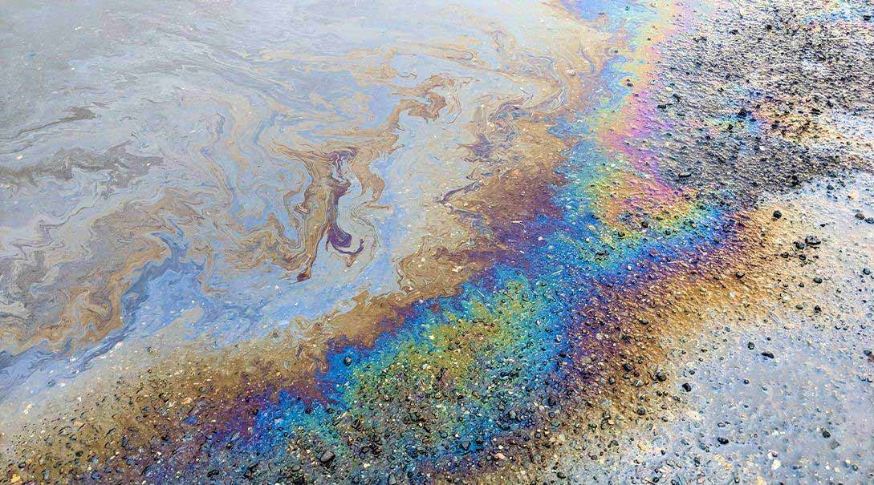
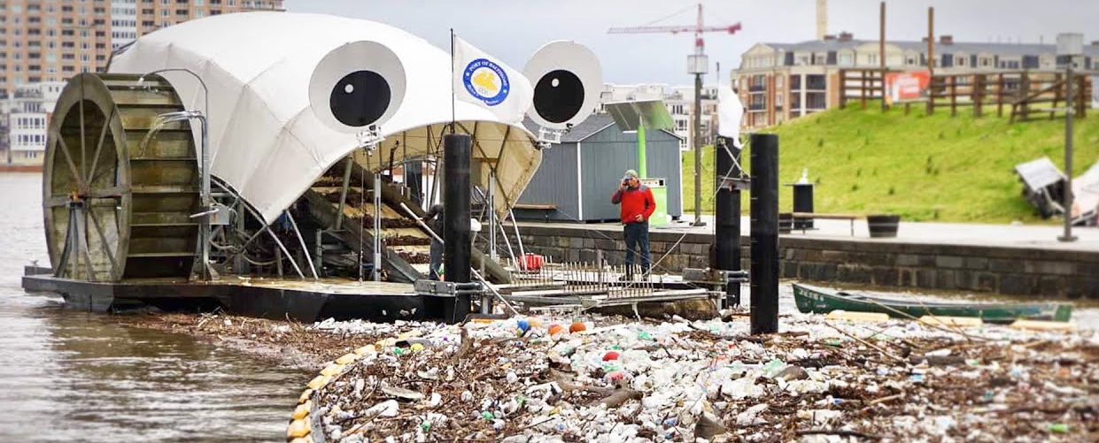
Codes and Compliance
Stormwater
Total Suspended Solids (TSS)
Conventional Pollutant by U.S. Clean Water Act
High TSS can decrease water’s natural dissolved oxygen, increase water temperature, affect turbidity or cloudiness of water
Sources
Runoff along rivers/lakes,
Runoff from impervious hardscape – buildings, roofs, roads and parking lots
Trash
Notes:
Keeping debris off the docks and out of the water
Placing proper trash receptacles
Handling of waste oil
Community salt snow storage
Employee training on maintaince
Storm water traps

Slide 14
Codes and Compliance
Navigation
Notes:
Lights, buoys and beacons

Slide 15
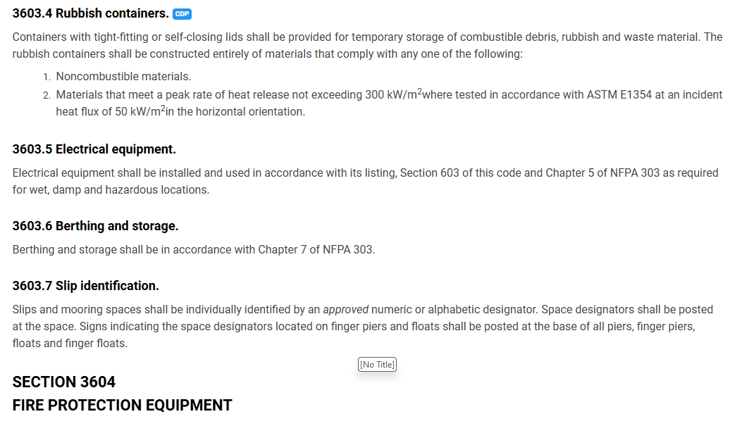
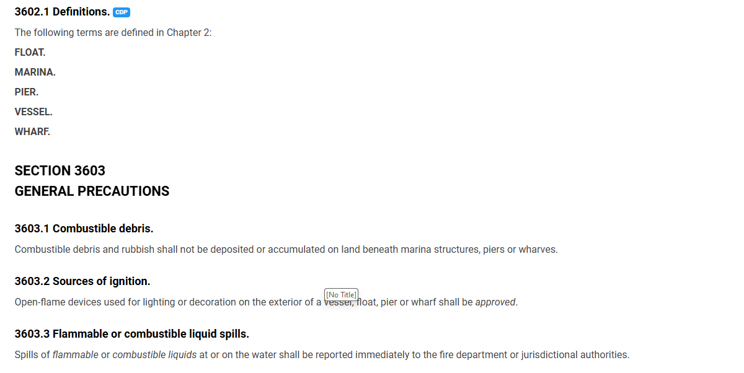
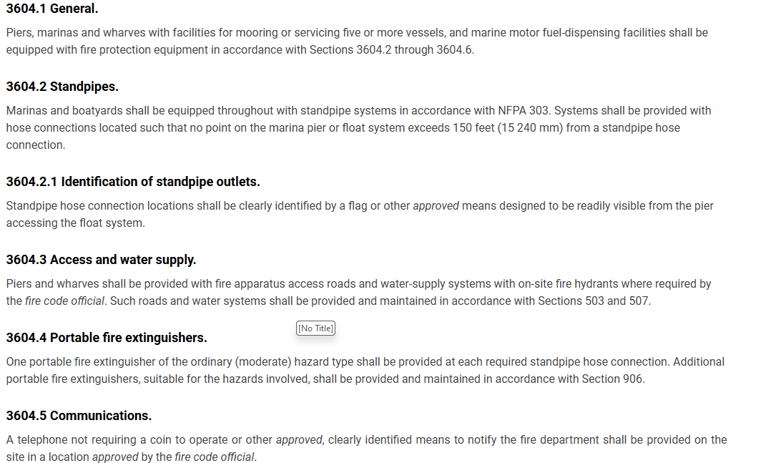
Codes and Compliance
International Fire Code (IFC)
Notes:
Removing Combustible Debris
Cleaning up flammable or Combustible liquids and spills
Approval of local fire regulations
Fire extinguishers (portable and fire suppression system)
Emergency communication

Slide 16
Codes and Compliance
Fire Suppression System
Notes:
Location of Standpipes so that no point is more than 150 feet from a hose connection
Types of Standpipes:
Class I: Designed for use by fire departments. These systems have 2.5-inch hose connections.
Class II: Intended for use by building occupants and first responders. These systems have 1.5-inch hose connections and are equipped with hoses.
Class III: A combination of Class I and II, providing both 1.5-inch and 2.5-inch hose connections.

Slide 17
Codes and Compliance
Fire Suppression System
Notes:
Water supply
Reliable source, constant supply
Are they dry standpipes can a pump truck connect? Connect to a hydrant?
Inspections and testing
Records
Repairs and tested

Slide 18
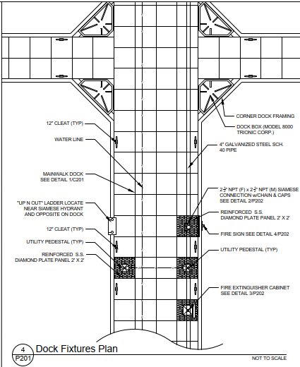
Codes and Compliance
Fire Suppression System
Notes:
Fixed Fire Suppression Systems
Does a building need a sprinkler system?
Cabinets for extinguishers
Protected from elements and other items
Inspected for compliance

Slide 19
Rules and Regulations
Notes:
Next, let’s focus on stormwater and runoff which is critical to protecting our main resource, the water body of the marina.

Slide 20
Rules and Regulations
Examples of Regulations
Accessibility – Americans with Disabilities Act (ADA)
Safety Equipment – fire extinguishers, safety ladders, lifesaving devices
Fuel Cutoff Systems – in case of spills or equipment malfunctions
Security Systems – fencing, lighting, locking gates
Environmental Protection – no discharge of sewage, oil or other harmful substances
Fuel Dock – located in a protected aera, have emergency fuel shutoff and fire extinguishers
Ladders – should be at least 16 inches wide and reach the lowest anticipated water level.
Boat Storage – rules on how long a boat can be stored on land, or whether they can be occupied overnight after being put into storage.
“Wisconsin law (s. 30.71(3)) requires marinas that provide berths of moorings to five or more boats equipped with toilets and that are located on any outlying water to provide pump-out stations.”

Slide 21
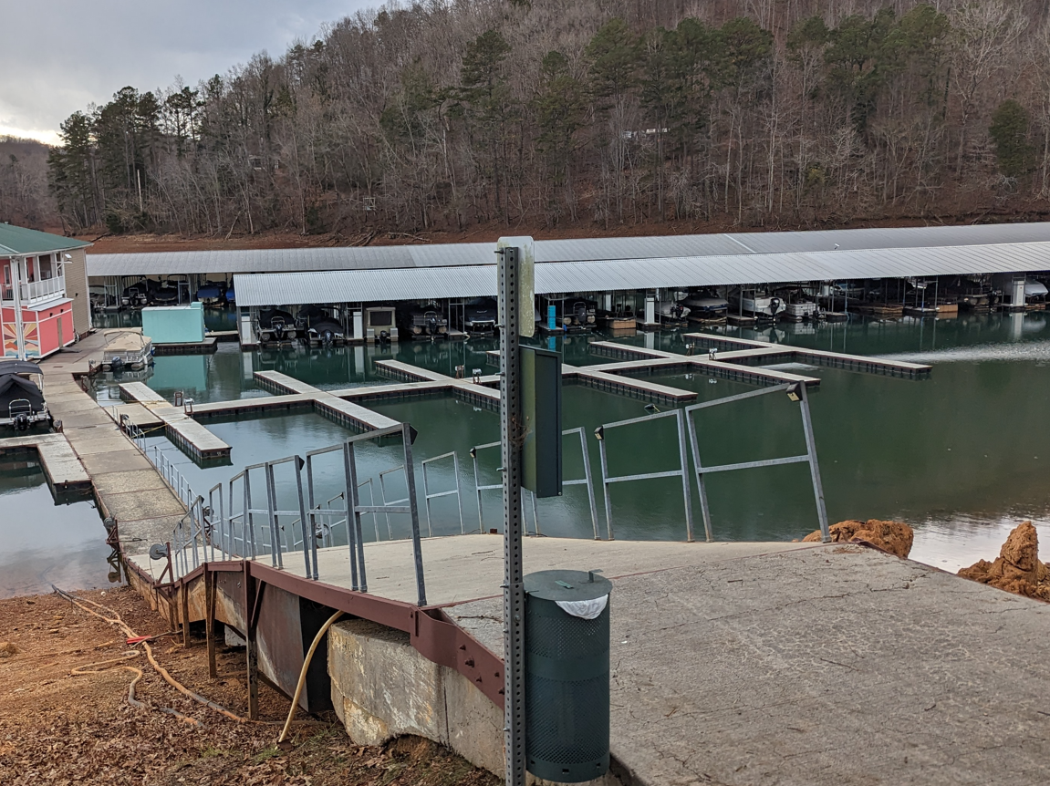
Rules and Regulations
American with Disabilities Act (ADA)
Gangways for Accessible Boating Facilities
Slope: The maximum slope for gangways is 1:12 (8.33%) but are not required is the gangway is longer than 80 feet. However, there is no max slope requirement in smaller marinas (less than 25 slips) for gangways that are 30 feet or longer.
Cross Slope: not to exceed 2 percent
Handrail Height: The handrail should be 36 inches high and extend 12 inches past the end of the gangway.
Lighting: Gangways should be well-lit at night or low-visibility conditions
Grate: Gangways should have grates to allow precipitation to pass through and prevent slippery conditions
Non-Skid Surface: Gangways should have a non-skid surface.
https://www.access-board.gov/ada/guides/chapter-10-boating-facilities/
Notes:
ADAAG (Americans with Disabilities Act Accessibility Guidelines.

Slide 22
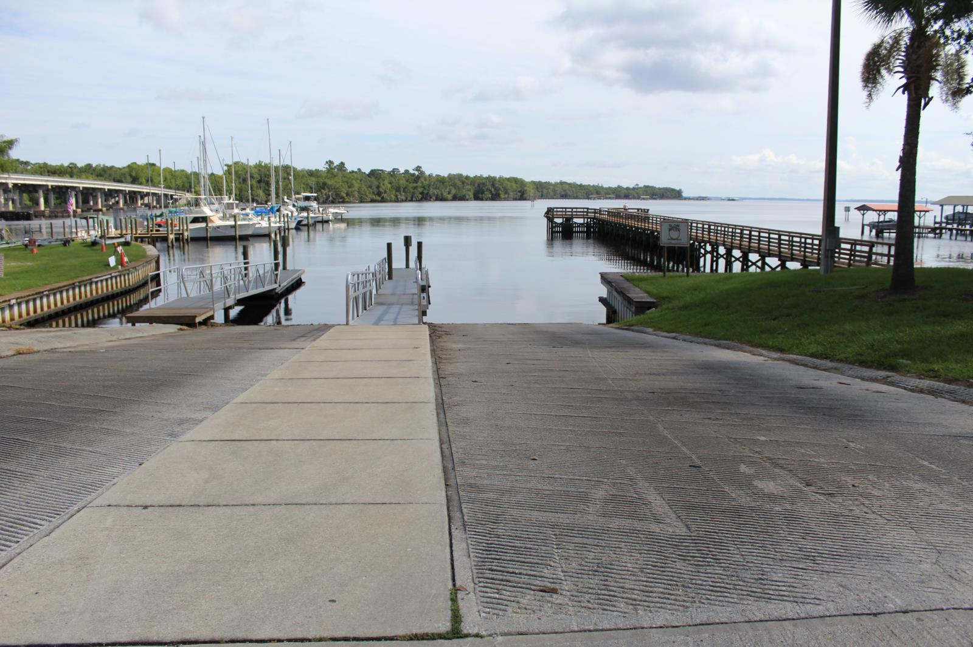
Rules and Regulations
Florida NPDES Stormwater Permitting
Sector Q Marinas
Coverage under the Multi-Sector Generic Permit is effective for 5 years.
Discharge Monitoring Reports must be submitted to DEP in years 2 & 4 (where applicable).
Quarterly visual assessment is required for all sectors.
Noncompliance can result in enforcement actions such as fines and other penalties.

Slide 23
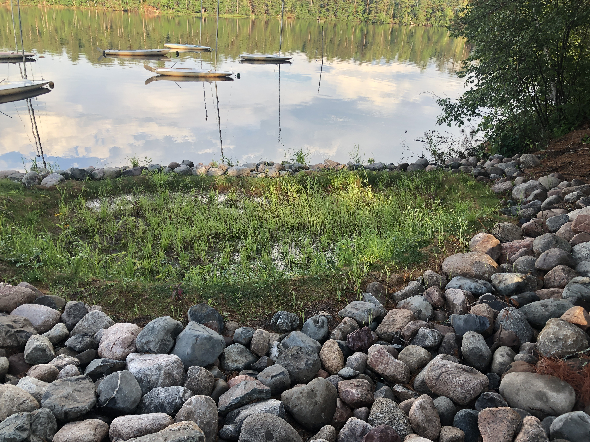
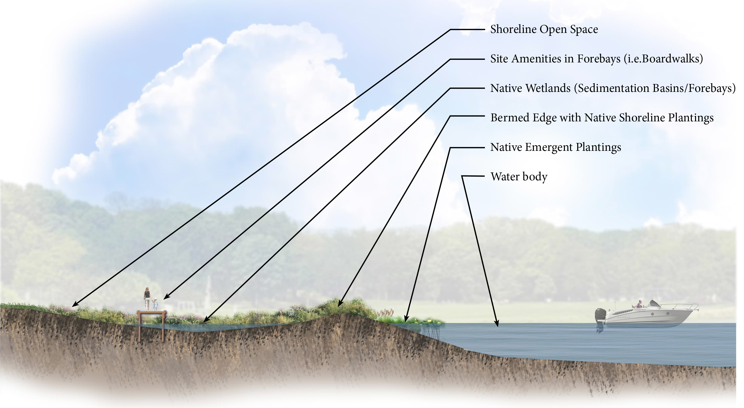
Rules and Regulations
Stormwater Enhancements
Sediment Basins
Forebays
Rain Gardens
Overland Conveyance
Green Infrastructure Zones
Notes:
Green Infrastructure Zones / Water Quality Enhancement Areas
Sustainable Design
Biodiversity Support
Adds to Aesthetic Value
Pollution Reduction
Nutrient Management: Reduces nutrient loads, preventing issues like algal blooms
Erosion Control
Regulatory Compliance

Slide 24
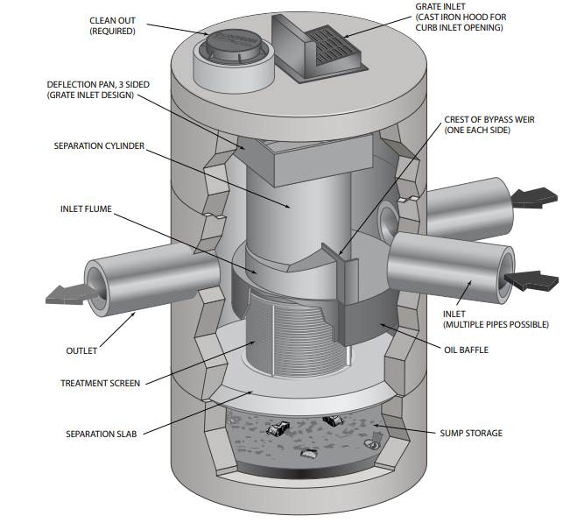
Rules and Regulations
Stormwater Enhancements
Vortex Sediment Cleanout System
Notes:
Swirl Concentration: The system uses a swirling motion to separate and capture sediment, debris, and pollutants from stormwater runoff
Flow Control: It includes flow control mechanisms to manage both high and low flow conditions, ensuring efficient treatment during various storm events
Sediment Storage: Captured sediments settle at the bottom of the chamber, providing stable storage and preventing re-suspension
Easy Maintenance: The system is designed for easy maintenance, typically requiring a vacuum truck to remove accumulated pollutants without needing to enter the unit
Pollutant Removal: Effectively removes fine particles, trash, and hydrocarbons, improving water quality before discharge

Slide 25
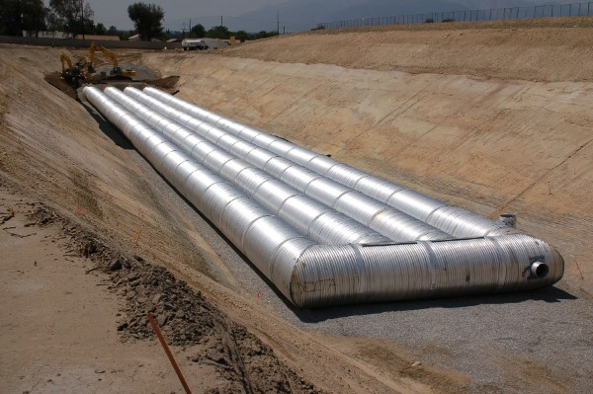
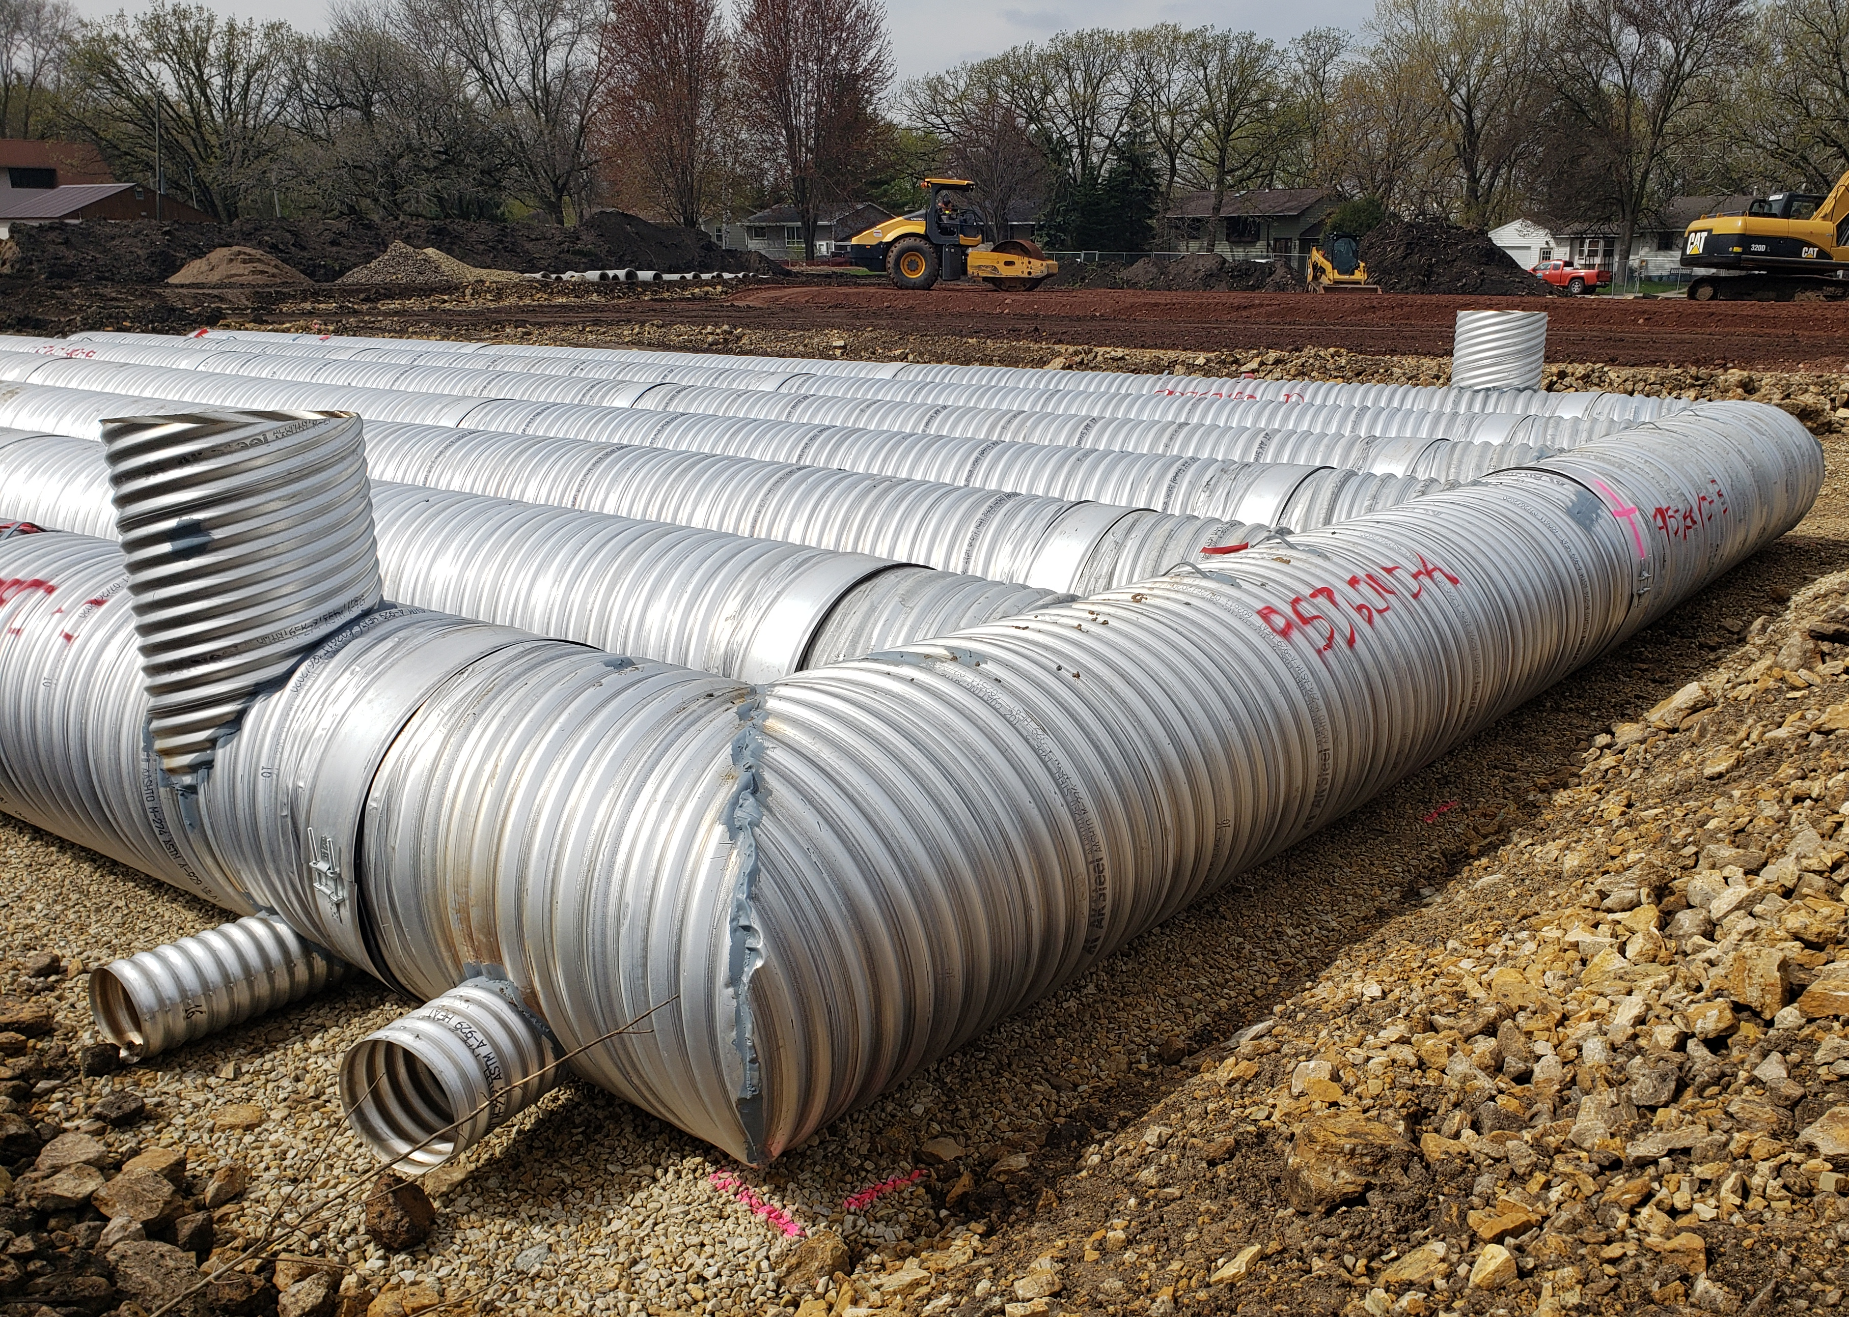
Rules and Regulations
Stormwater Enhancements
On Site Underground Storage
Notes:
Underground storage
Flood control/storage
Efficient use of limited space
Sediments settle out to improve water quality, pretreatment can be effective.
Modular design east to preorder based on sizing and parts

Slide 26
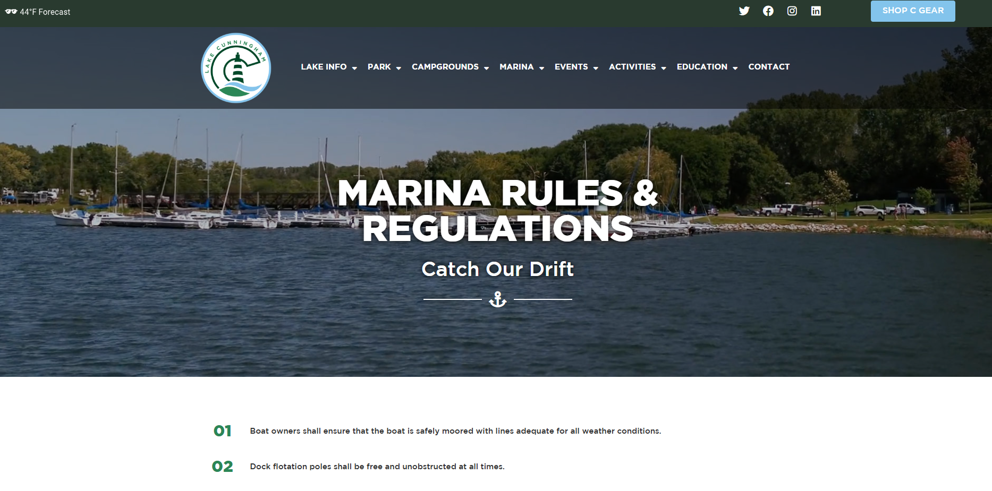
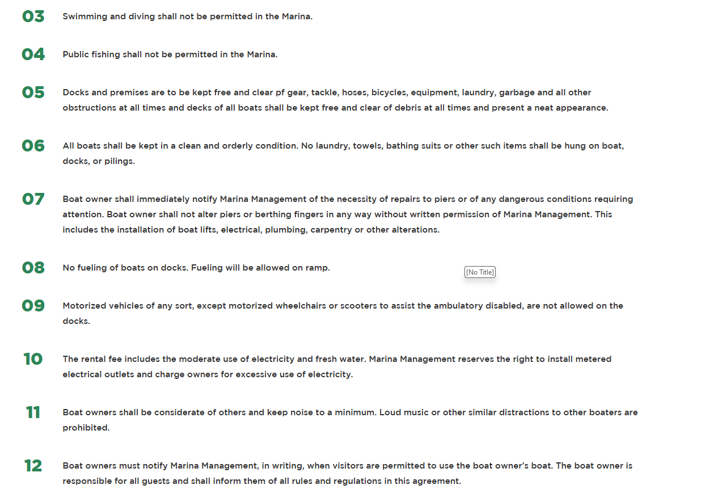
Rules and Regulations
Notes:
Example of marina rules and regulations for Lake Cunningham in Omaha, NE as found on their website.

Slide 27
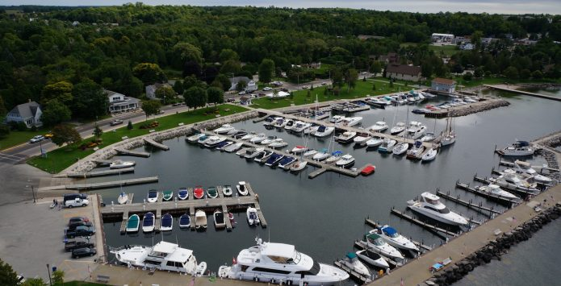
Rules and Regulations
Sister Bay Marina 2025 Rules and Regulations
Dockage/Slip Fees
Adequacy of Water Levels
Space Availability
Transient Use
Severe Weather
Speed Limit
Fueling
Children
Pets
Quiet Enjoyment
Vehicle Parking
Garbage and Recycling
Overboard Discharge/Hazardous Materials
Use of Electricity
End of Season
Bottom Cleaning
Dinghies
Recreation Areas
Other General Rules
Notes:
Here another example from a Wisconsin marina in Door County.

Slide 28
Key Takeaways
Notes:
At what stage do you begin the permitting process for a marina?

Slide 29
Key Takeaways
Code and Regulations
Vary from state to state or even withing a district or community
Cover your bases and check with agencies or work with professionals who deal with codes and regulations
Plan ahead for future project to better understand compliancy
Establish your marina rules and regulation to provide a safe and enjoyable facility

Slide 30
Thank You
Dan Williams, PLA
Principal Landscape Architect
dwilliams@msa-ps.com
(608) 216-2066
Marcus Rue, PE
Team Leader – Civil Engineer
mrue@msa-ps.com
(608) 355-8917
msa-ps.com

