Slide 1
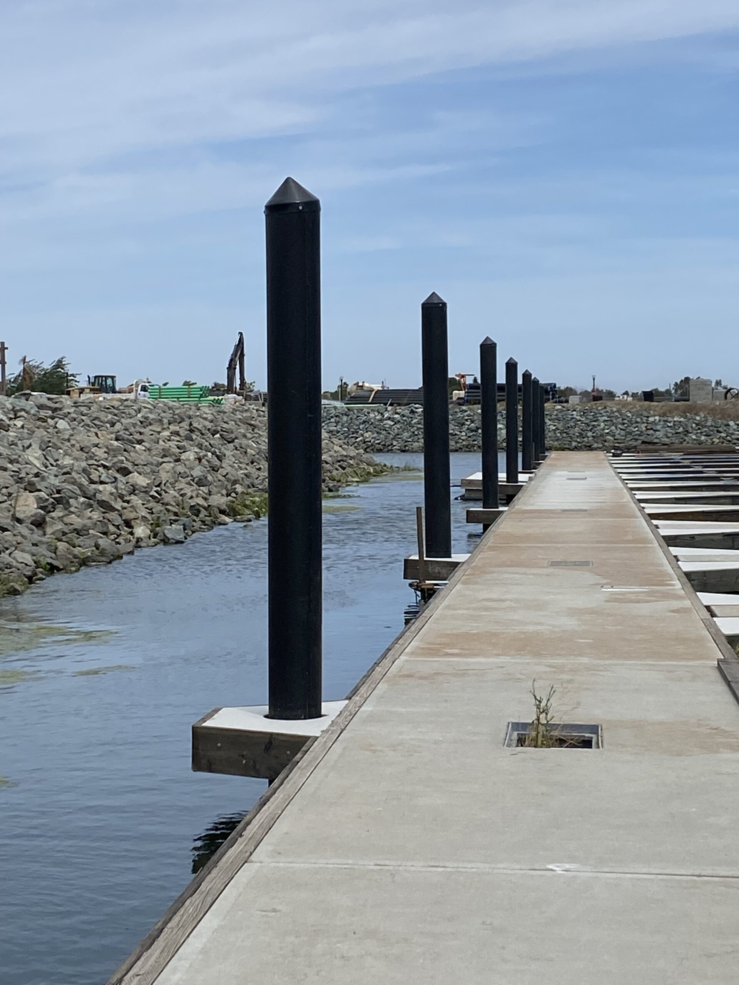
DOCK ANCHORS:
WHAT REALLY IS THEIR HOLDING CAPACITY?
December 12, 2024
Presentation By:

Slide 2
MOTIVATION
Anchoring of floating docks is one of the most critical elements of any marina:
Dock Stability
Safety & Security
Structural Integrity
Protect Utilities
Unfortunately, our experience has shown that many existing marinas and new facilities know very little about the actual capacity and holding power of their dock anchors. This is often due to a combination of:
Limited/nonexistent geotechnical data of the lakebed/seabed
Perception that engineered anchoring studies are not required
Reality that permitting agencies do not require such studies, or no such agency exists to review such studies
No insurance incentive
The “grandfather” mindset of many marina owners and dock builders…“it’s how we have always done it, and it hasn’t moved so they must work!”
Nevertheless, without knowledge of the capacities of the facilities anchors, the marina is potentially at risk during the design event.
Worst yet, as the frequency and intensity of storms are projected to increase in the future, these risks and probabilities will worsen.

Slide 3
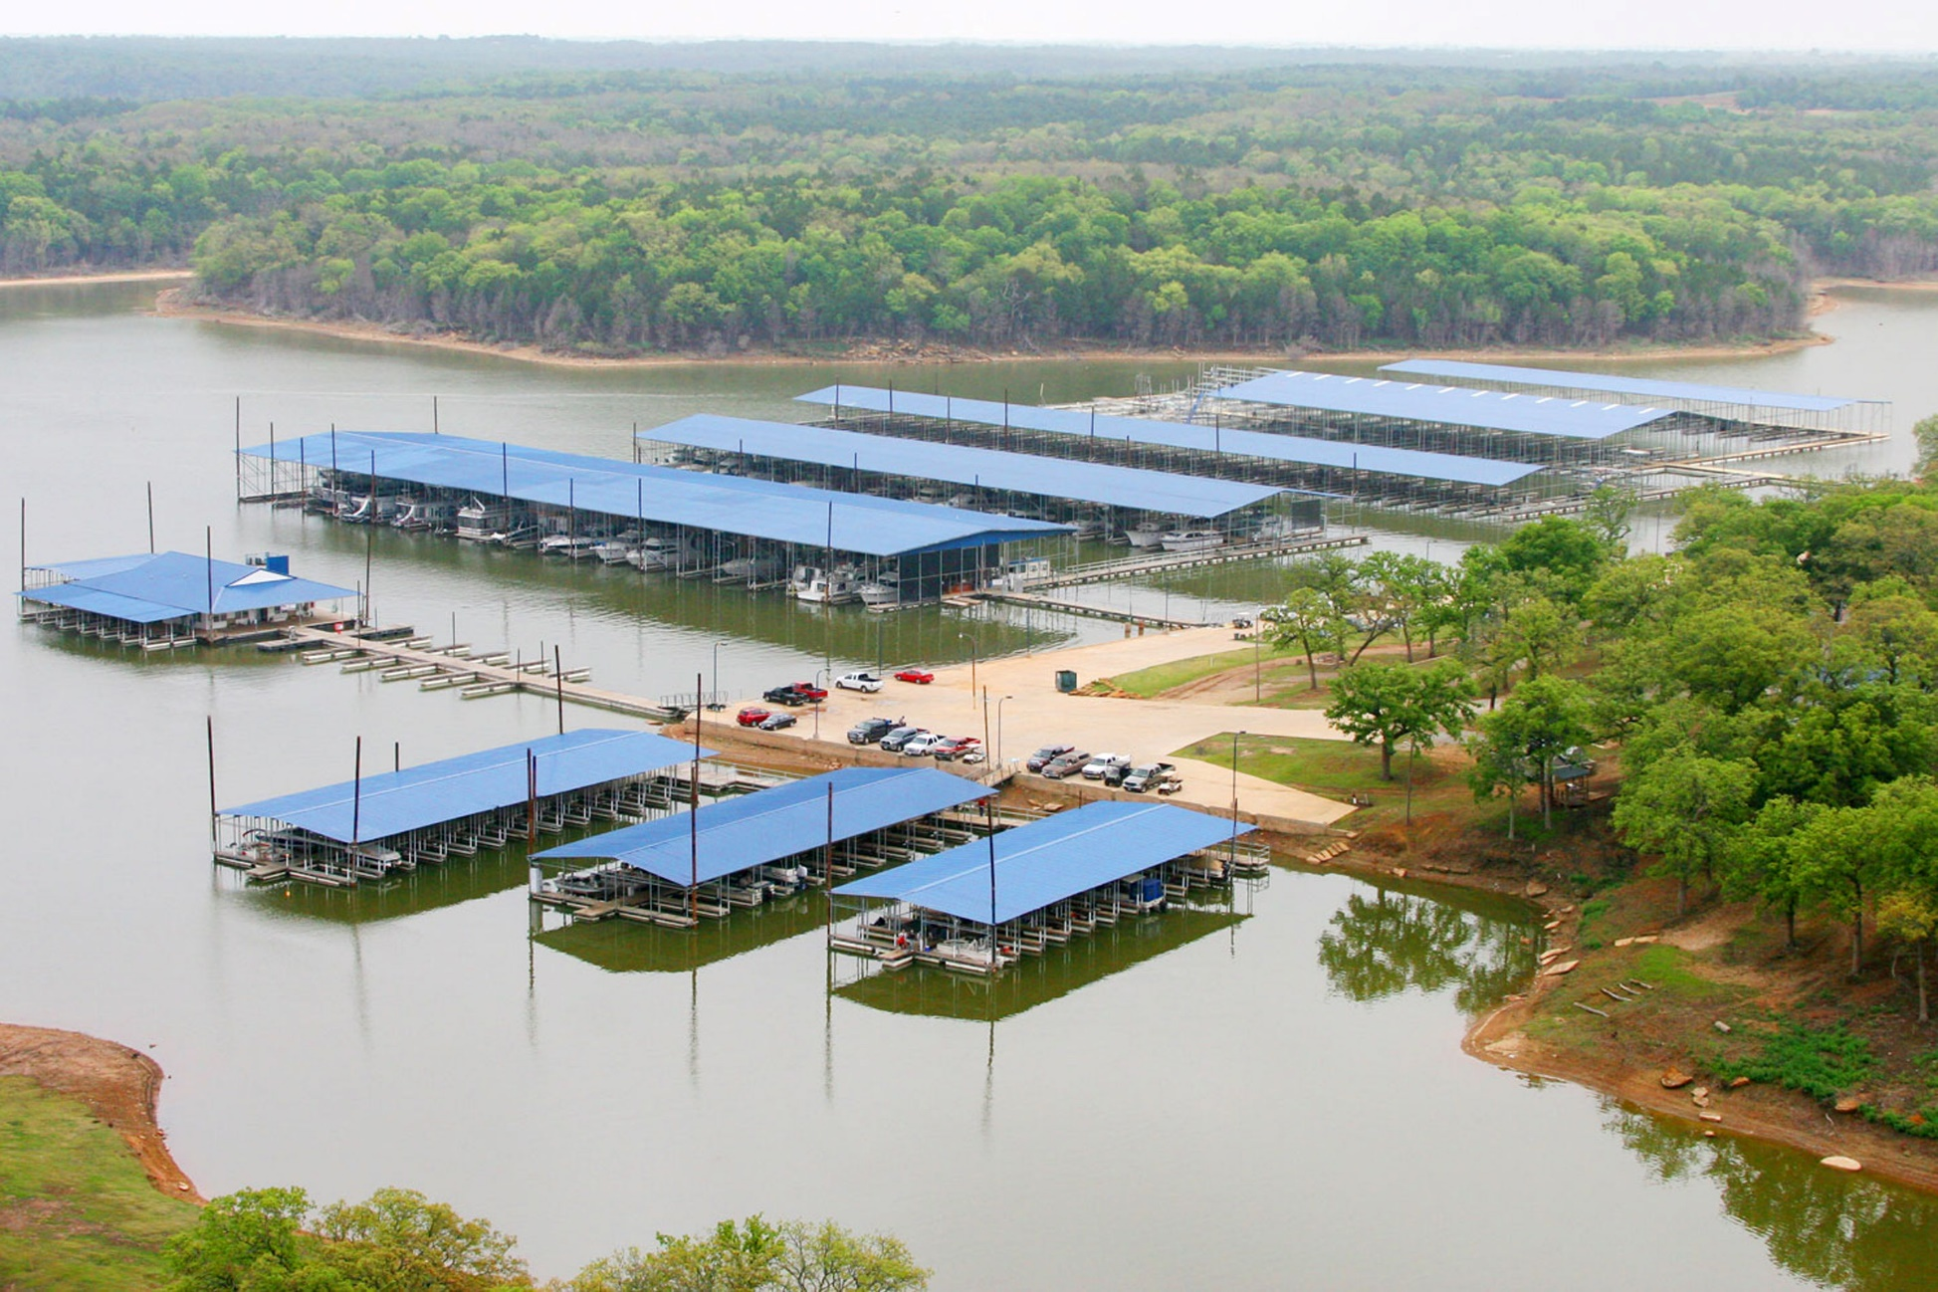
MOTIVATION (CONTINUED)
TIME TO ADDRESS THE ELEPHANT IN THE ROOM!
Perception that anchoring for inland lake marinas are somehow different than coastal marinas.
Truth is, the design parameters and forcing conditions are largely the same…in fact, in many instances, inland lake marinas are exposed to more challenging anchoring conditions.

Slide 4
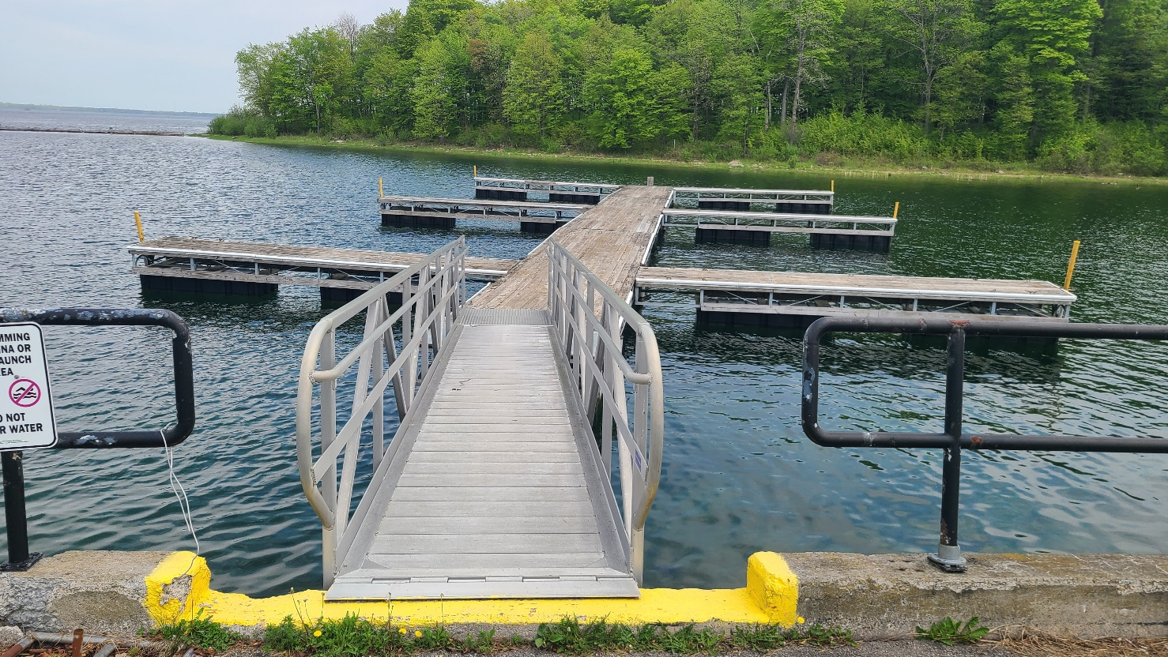
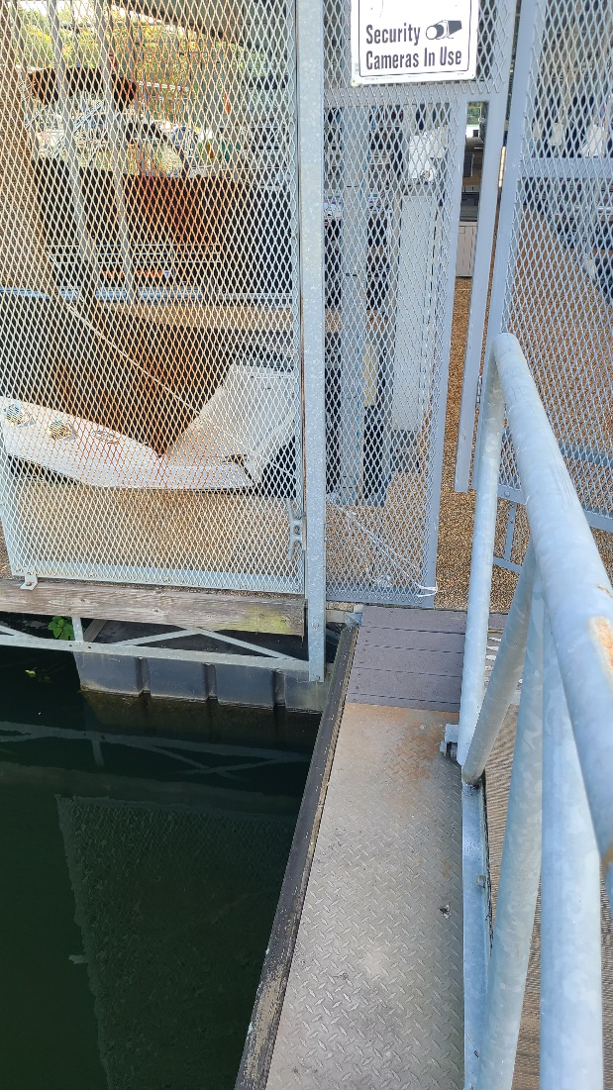
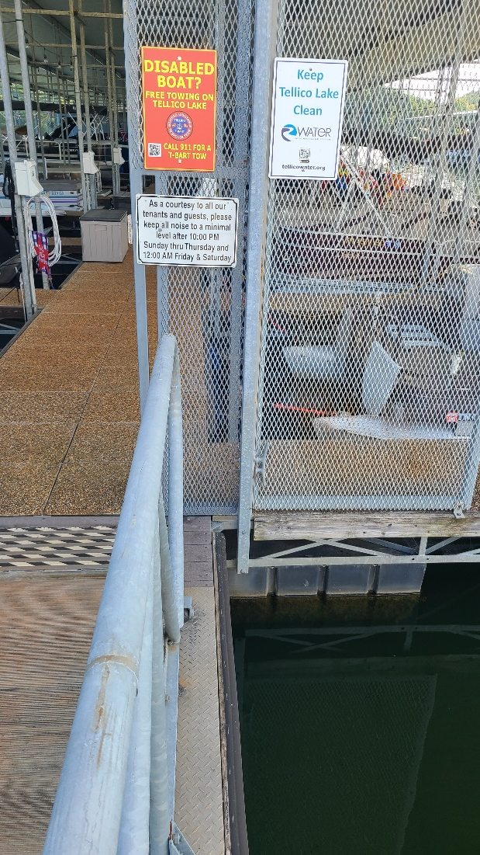
PRESENTATION OBJECTIVES
This presentation will provide an overview of the various types of dock anchors commonly utilized in coastal and inland/lake marinas including:
Piles: Guide Piles, Spud Piles (aka Pole & Sleeve)
Deadweight & Deadweight/Drag Anchors
Embedment Anchors: Helical Screws, Embedded Plates
The design philosophies, typical capacities, issues/concerns and recent advances with various anchoring options will be presented.
This presentation will conclude with recommendations to test and validate the capacity of dock anchors on existing and new installations.

Slide 5
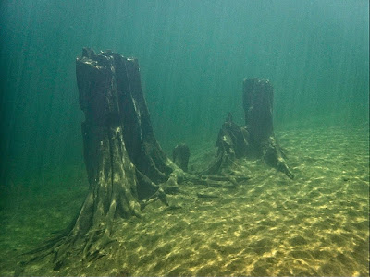
FACTORS AFFECTING ANCHORING OPTIONS
Water Level Variations:
Daily tidal, seasonal, and/or episodic water level fluctuations
Water Depth:
Deep water obviously rules out piling options
Winds, Waves & Currents:
Type and severity of environmental conditions may dictate certain anchoring options
Dock Design:
Covered Docks & Boat Lifts Add to Windage
Soil Conditions:
Critical factor that is most often ignored
Seabed/lakebed is the strata which is relied upon to counter the lateral loads imposed on the floating docks
“Driven to Refusal” terminology often misused with piles
Construction Logistics:
Accessibility of construction plant & equipment

Slide 6
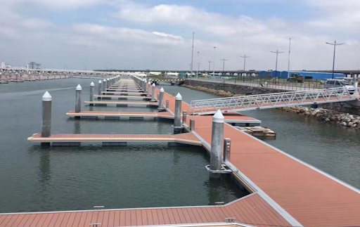
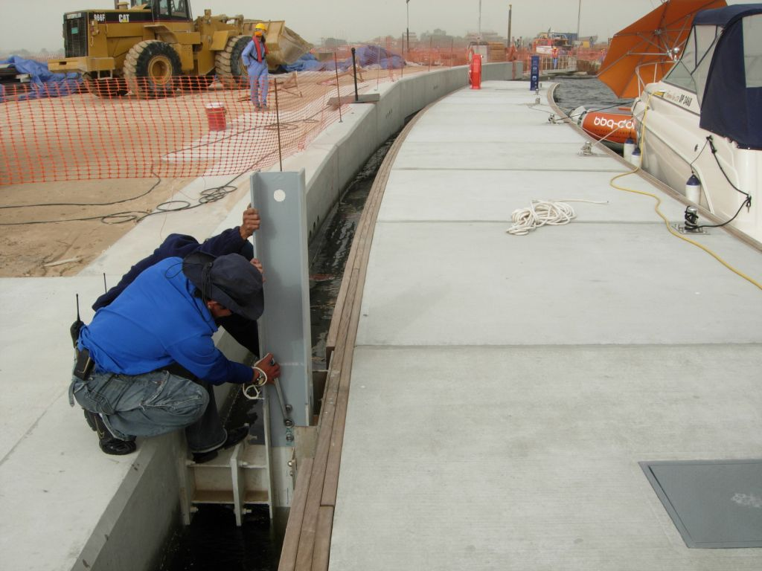
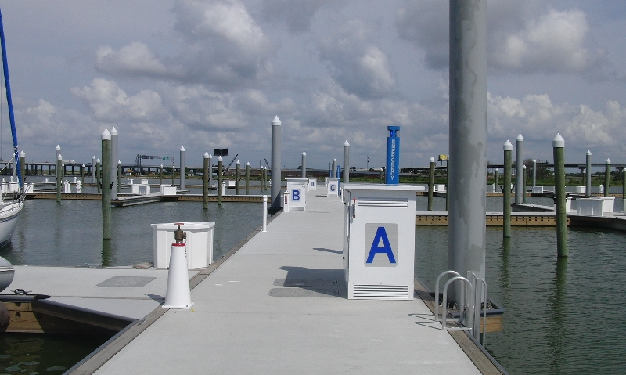
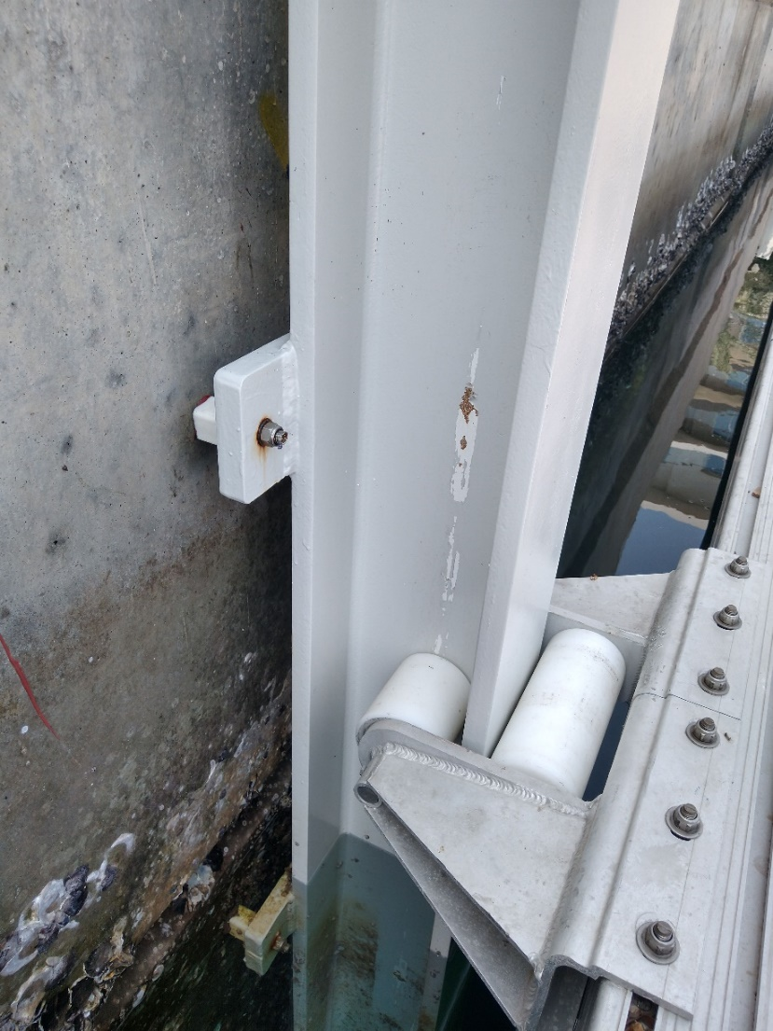
GUIDE PILE ANCHORING SYSTEMS

Slide 7
GUIDE PILE ANCHORING SYSTEMS
Guide Piles
Steel tubular pile, steel H-piles, concrete piles, wood piles, etc ranging from 10 in – 24 in with pile guides
Typical installations range from shallow water up to 20 ft+ depth
Doesn’t interfere with navigation
Restrain lateral movement with unrestricted vertical movement
Purely lateral force imposed on piled anchors
Excluding H-piles, lateral restraint solely a function of the soil/ground conditions
Behaves as a free-headed pile
Typically designed on assumption of linearly elastic response from embedment into soil
Common installation methods involve vibratory methods, hammering and/or augering
Requires larger type construction equipment
Permanent installation so resetting anchors to shift plan location not possible
Pile capacities able to handle up to 15,000 lb+ lateral force per pile depending on specifics (no way to really know site specific capacity unless tested on site)
22,500 lb
FRESHWATER
GRAVEL & SAND
Sufficiently deep so soil restrains pile, and pile fails from bending stress
Warning – Do Not Design From This Example
With a FOS=1.5, a 20 in OD steel pipe pile in gravel & sand can restrain 15,000 lb force.

Slide 8
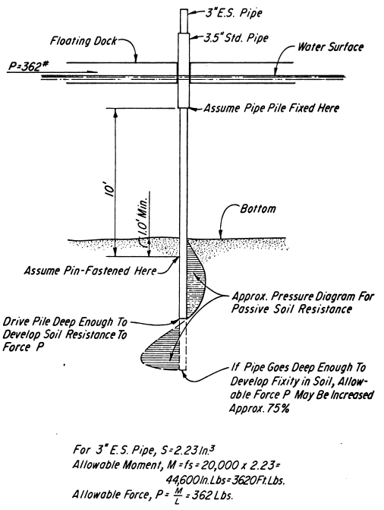
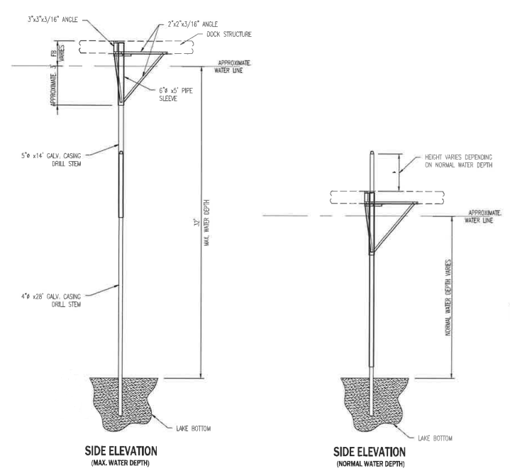
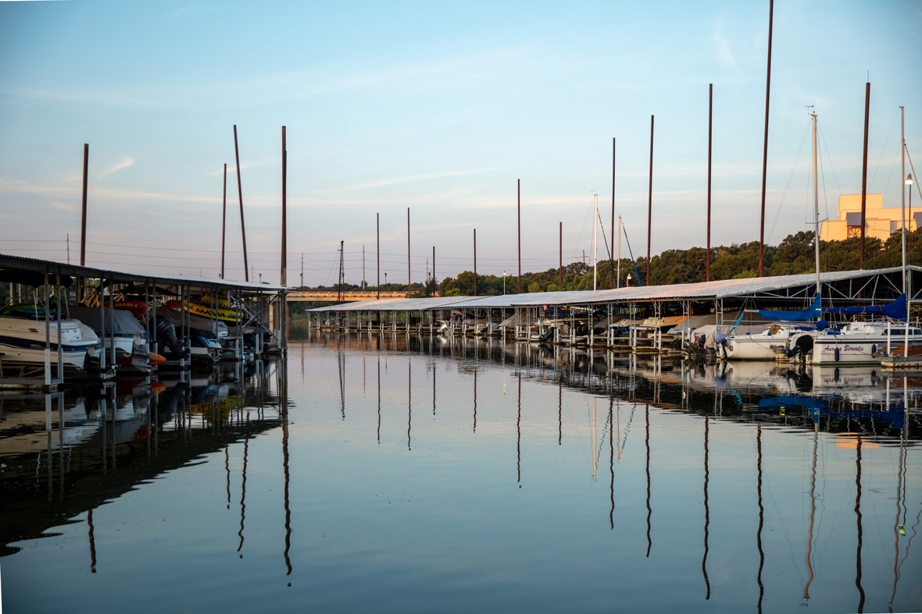
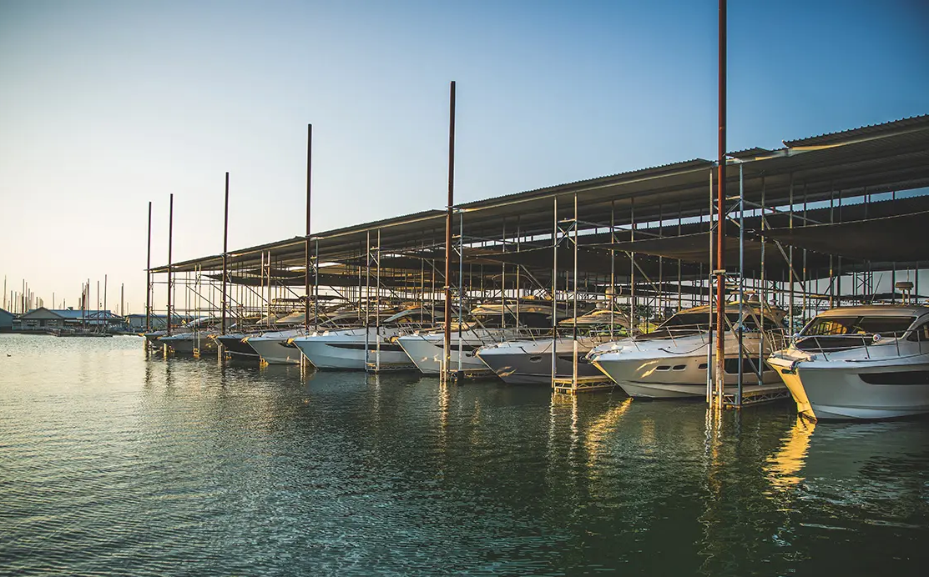
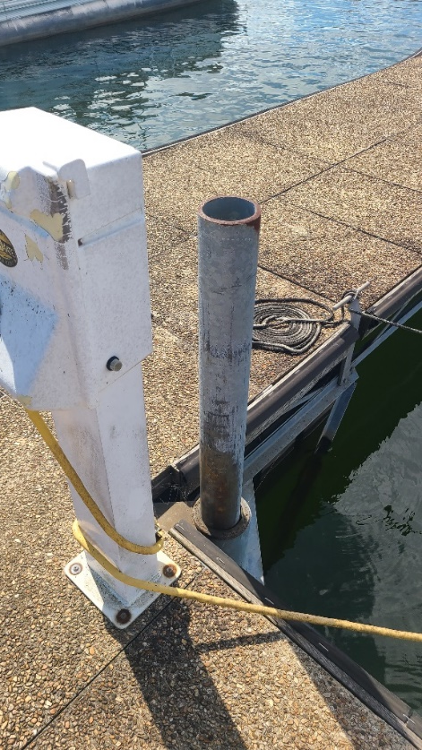
SPUD PILE ANCHORING SYSTEMS
MAXIMUM WATER DEPTH
MINIMUM WATER DEPTH
SIDE ELEVATION
(High Water Level)
SIDE ELEVATION
(Low Water Level)

Slide 9
SPUD PILE ANCHORING SYSTEMS
Spud Piles
Typically steel pipe 3 in – 8 in range with pile sleeves as guides (pole and sleeve)
Installed in shallow water up to 20 ft+ depth
Doesn’t interfere with navigation
Restrain lateral movement with unrestricted vertical movement
Purely lateral force imposed on piled anchors
Design philosophy is a whole lot of small piles in shallower soil (rather than a limited number of larger piles deep in soil)
Spud pile behaves as a fixed-headed pile (sleeve is designed to keep pile vertical at water level)
Typically only installed on its own self-weight which severely limits the extent of soil restraint imposed on the pile
“Quasi” permanent installation so possible to shift plan location and reset
Self-weight installations limit capacities of spuds to about 500 lb – 1000 lb force per pile depending on specifics (no way to really know site specific capacity unless tested on site)
1,000 lb
FRESHWATER
GRAVEL & SAND
Insufficient depth in soil, and pile fails from “knifing” through soil
Warning – Do Not Design From This Example
With a FOS=1.5, a 4.5 in OD steel pipe pile in gravel & sand can restrain 667 lb force.

Slide 10
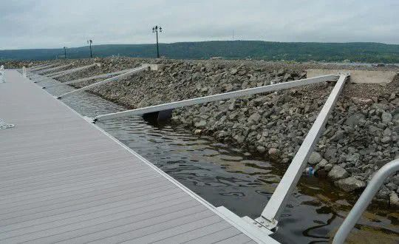
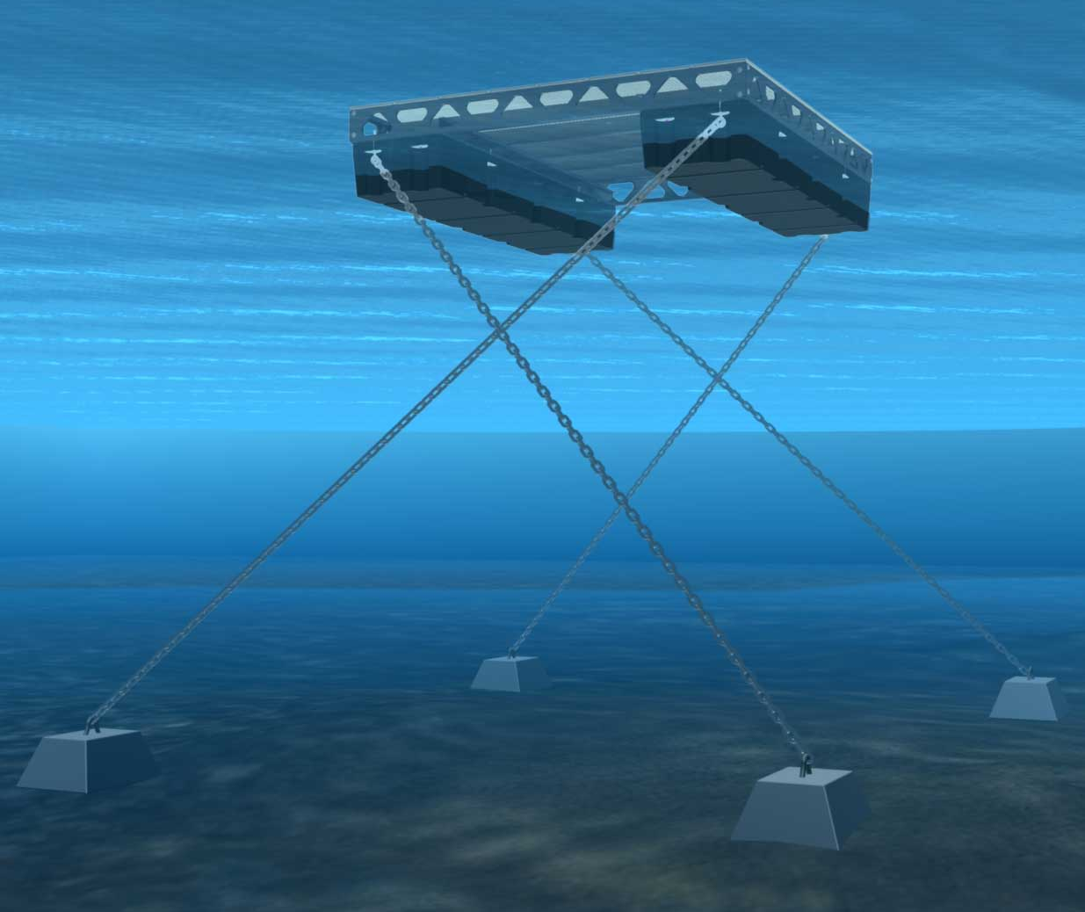
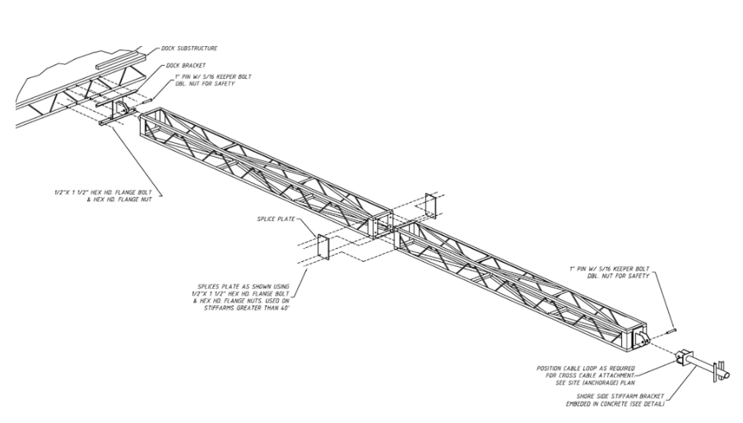
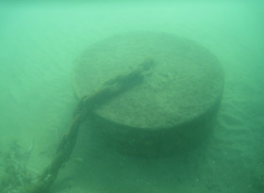
DEADWEIGHT ANCHORING SYSTEMS

Slide 11
DEADWEIGHT ANCHORING SYSTEMS
Deadweight Anchors
Typically concrete (clump) weights
Installed in range of water depths
Involve combination of vertical and lateral force components
Overcome forces purely on deadweight of blocks in water (suction forces help resist as well but difficult to define)
Remember concrete blocks lose approximately 40% of its weight when in water
Mooring lines required to transfer load to anchors (chain, cable, rope, elastic lines) which interferes with navigation
Lines scoped at 1V:4H (and flatter) to limit uplift component and maximize lateral resistance (sometimes blocks in series to bring active force to near horizontal)
Problem with flat scopes is that horizontal movements of docks can still be quite severe
“Quasi” permanent installation so possible to shift plan location and reset anchor blocks
Ignoring FOS, capacities anywhere from 0.3 – 0.7 x dry weight based on statics approach (no way to really know site specific capacity unless tested on site)
DRY WEIGHT IN AIR
9000 lb
2336 lb
2400 lb
584 lb
FRESHWATER
584 lb
4
2400 lb
1
2336 lb
5256 lb
* This approximated example is maximum amount excluding any F.O.S.*
2336 lb
GRAVEL & SAND
Warning – Do Not Design From This Example
With a FOS=1.5, a 9000 lb dry weight block on gravel and sand can restrain 1550 lb force at 1H:4V in freshwater based on static example (but could be much more with suction forces and if caught in rocks, boulders, dead trees, vegetation, etc)

Slide 12
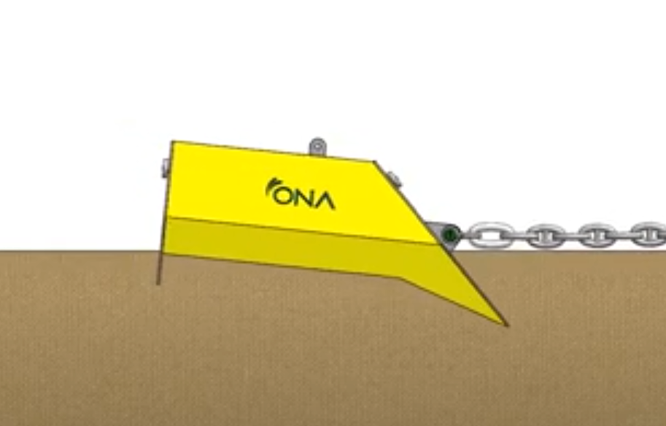
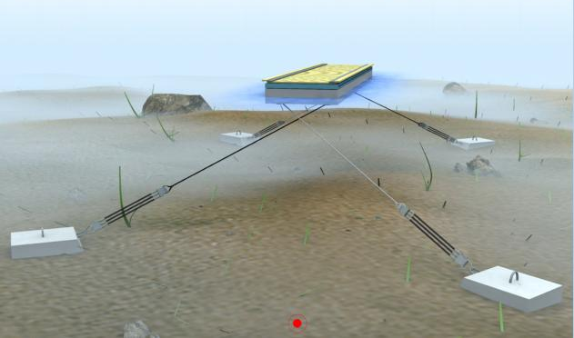
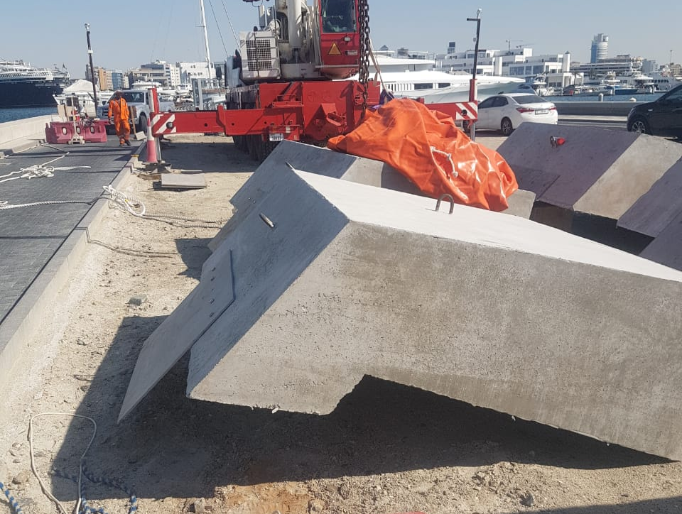
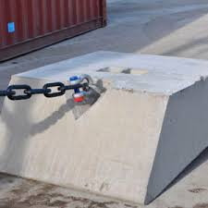
DEADWEIGHT/DRAG ANCHORING SYSTEMS

Slide 13
DEADWEIGHT/DRAG ANCHORING SYSTEMS
Deadweight/Drag Anchors
Typically concrete (clump) weights
Installed in range of water depths
Involve combination of vertical and lateral force components
Overcome forces on deadweight of blocks in water and drag of block in soil (suction forces help resist as well but difficult to define)
Remember concrete blocks lose approximately 40% of its weight when in water
Mooring lines required to transfer load to anchors (chain, cable, rope, elastic lines) which interferes with navigation
Lines scoped at 1V:4H (and flatter) to limit uplift component and maximize lateral resistance (sometimes blocks in series to bring active force to near horizontal)
Problem with flat scopes is that horizontal movements of docks can still be quite severe which is problematic dock connections, gangway connections, utility runs, etc
“Quasi” permanent installation so possible to shift plan location and reset anchor blocks
Ignoring FOS, capacities anywhere from 0.3 x dry weight based on statics approach & 5 – 10 x dry weight (and greater) if purely drag anchor based on NAVFAC anchoring (no way to really know site specific capacity unless tested on site)
DRY WEIGHT IN AIR
9000 lb
2702 lb
2785 lb
676 lb
FRESHWATER
* This approximated example is maximum amount excluding any F.O.S.*
676 lb
4
2785 lb
1
5256 lb
2702 lb
2292 lb
GRAVEL & SAND
410 lb
Warning – Do Not Design From This Example
With a FOS=1.5, a 9000 lb dry weight block dragged into gravel and sand can restrain 1800 lb force at 1H:4V in freshwater (but could be much more with suction forces and if caught in rocks, boulders, dead trees, vegetation, etc)

Slide 14
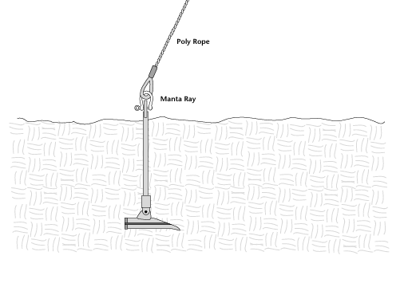
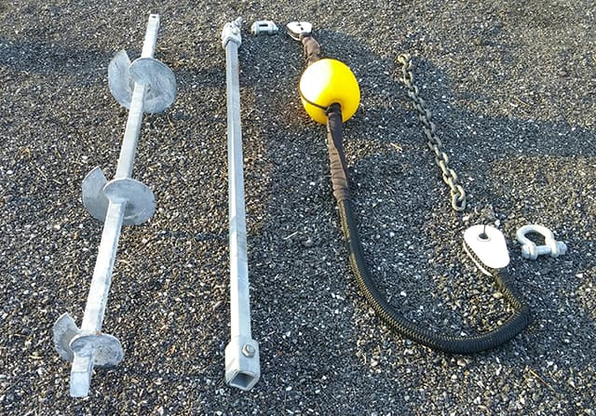
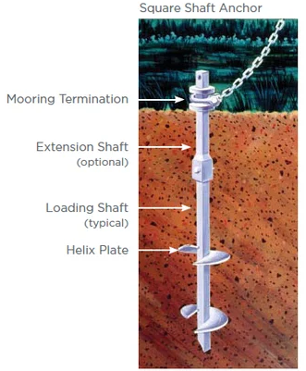
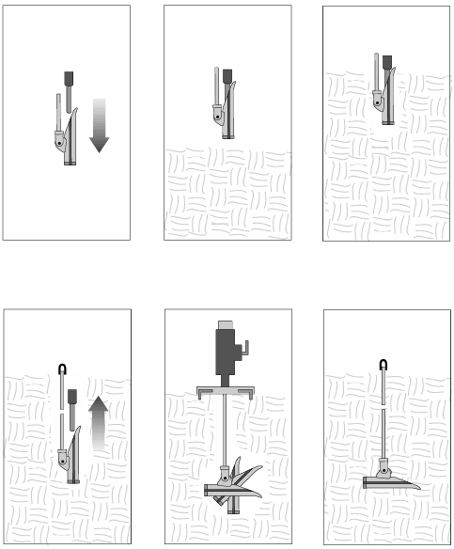
EMBEDMENT ANCHORS ANCHORING SYSTEMS

Slide 15
EMBEDMENT ANCHORS ANCHORING SYSTEMS
Embedment Anchors
Most common are helical screws or embedded plates
Practical applications in range of water depths up to 50 ft (practical installation limitations)
Involve combination of vertical and lateral force components
Weight of soil over the embedded plates is utilized to resist the vertical and lateral forces
Mooring lines required to transfer load to anchors (chain, cable, rope, elastic lines)
At high loads, steel shafts will bend through soil to become more tensile load (but steel shafts require substantially greater load to rupture)
Strong uplift resistance means lines scoped up to 1V:2H (if site conditions allow) which interferes less with navigation
Steeper scopes minimize horizontal movements of docks and keep vertical motions limited as well
For helical screws, the capacity of each screw is directly related to the installation torque so the capacity of every screw is known at installation
Helical screws are “quasi” permanent installation so possible to shift plan location and reset helical screws (although more sensible approach may be to install screws at pre-determined location to account for planned shifts)
22,361 lb
FRESHWATER
25,000 lb
11,180 lb
* This approximated example is maximum amount excluding any F.O.S.*
11,180 lb +
25,000 lb +
2
1
22,361 lb +
GRAVEL & SAND
With a FOS=1.5, a 3-plate helical screw in gravel and sand can restrain in excess of 16,600 lb force at 1H:2V in freshwater (if winched lines, design becomes limited by 10,000 lb holding capacity of standard winches)

Slide 16
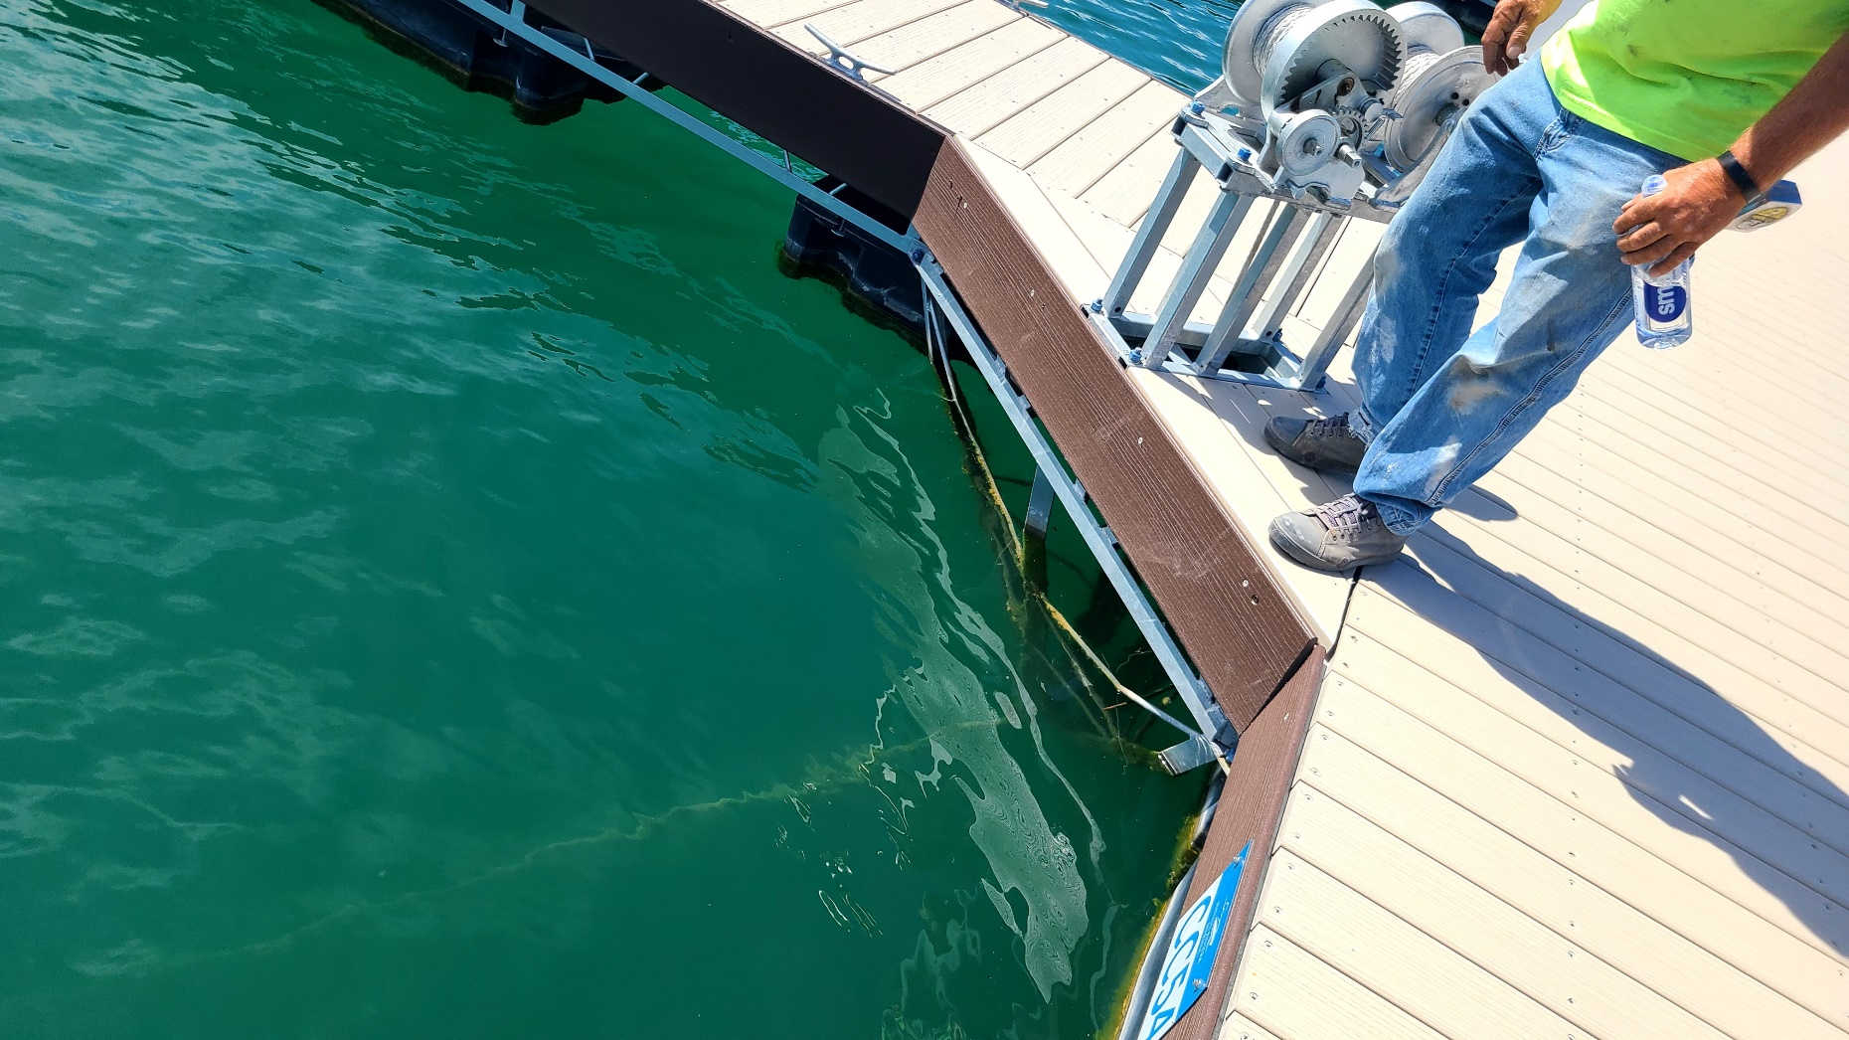
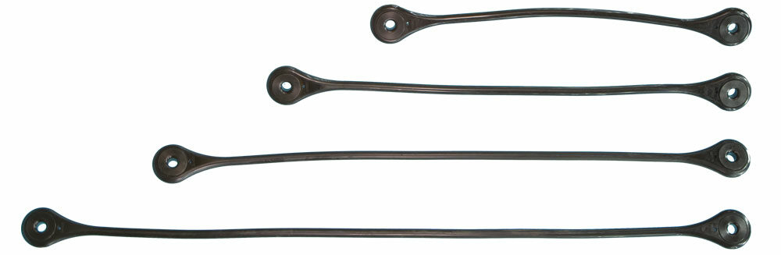
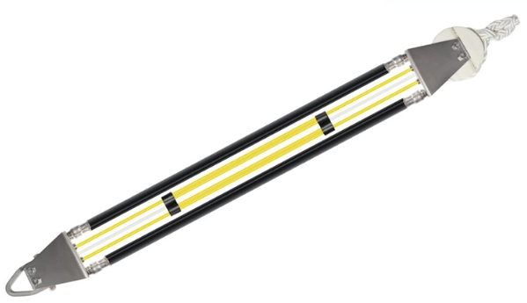
MOORING LINES
Mooring Line Options:
Cable, Chain, Rope (with or without winch)
Corrosion issues a concern
Advances in synthetic rope (e.g., Honeywell Spectra, Dyneema, etc)
Elastic Rodes (Hazelett, Seaflex, Supflex, Ocean Spring, etc)
Keep mooring lines in tension through varying water level stages
Elastic rodes can offer SOME wave load reduction
Combination (e.g., rope then chain to chain catch)
Are Mooring Line Adjustments Needed:
Most standard winches are 10,000 lb holding capacity which may then be the limitation on anchor capacity
Remove winches and install chain catches, rope cleats, or similar connections to increase connection capacity which would then increase anchor capacity
Remove winches and install elastic rodes to eliminate and/or minimize frequency of line adjustments
Honeywell 12-Strand Spectra Rope
(1/2 in Rope has 34,000 lb Tensile Strength)
Chain or Cable
Hazelett Elastic Rodes
Seaflex Elastic Rodes

Slide 17
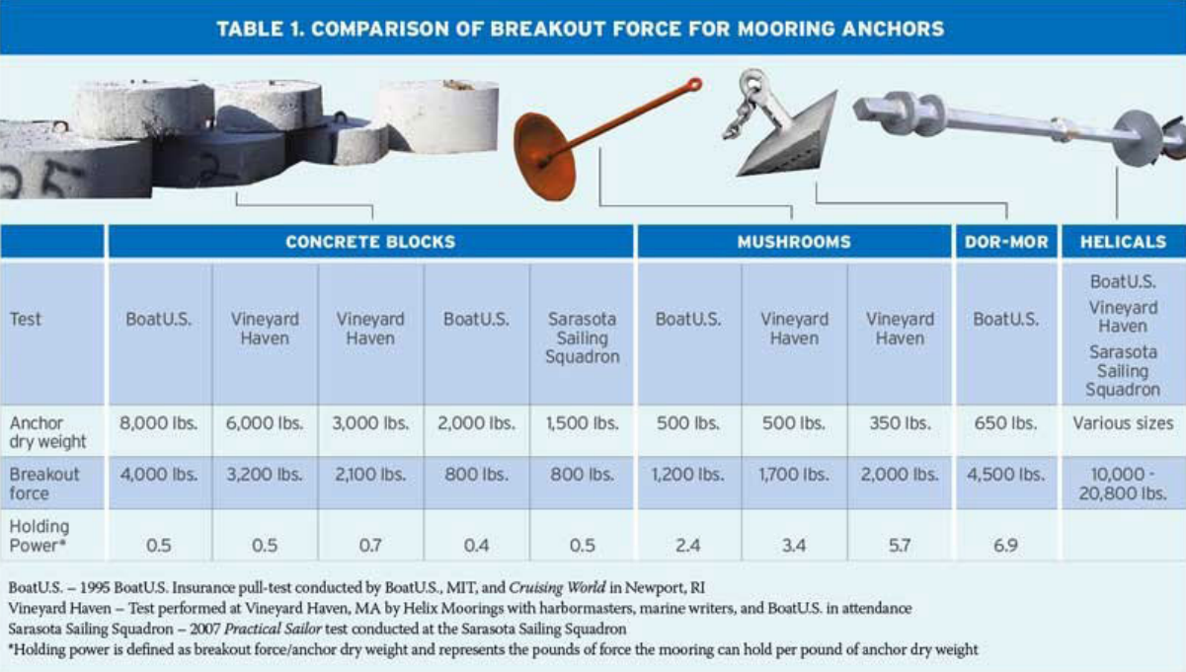
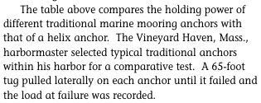
HISTORIC STUDY OF BREAKOUT FORCES OF MOORING ANCHORS
Values Exclude F.O.S.

Slide 18
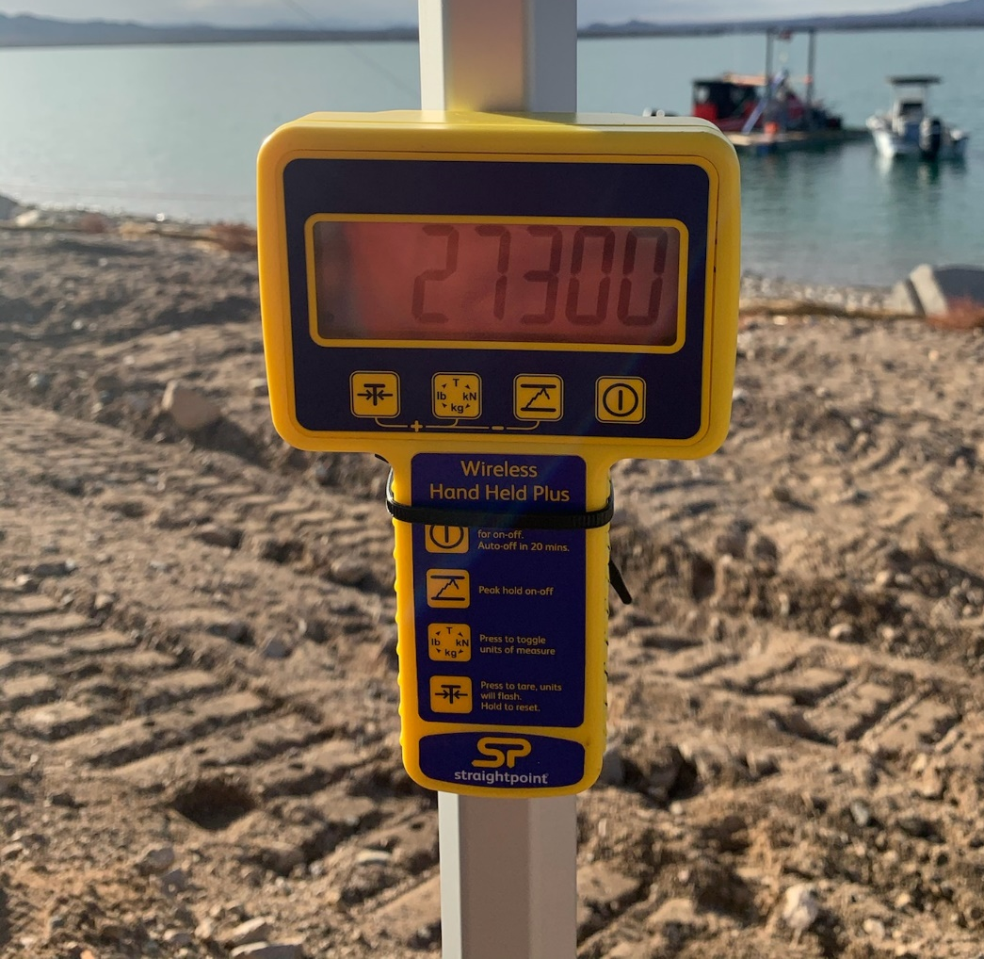
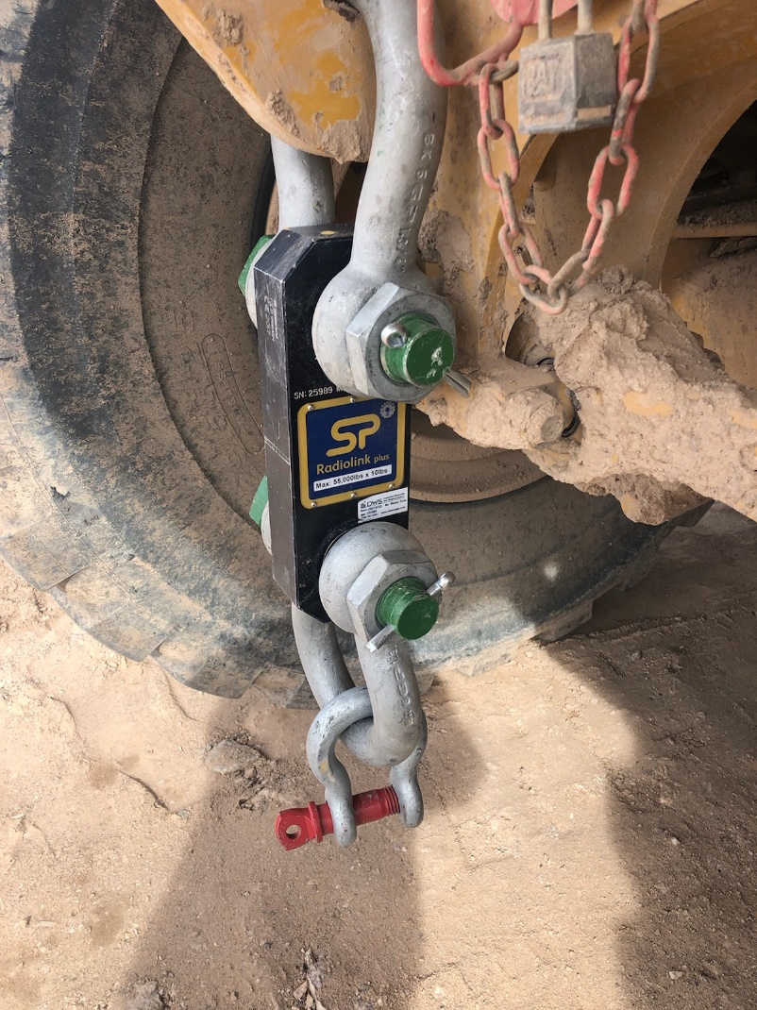
FIELD TESTING
Field Testing
Without soils data, it is difficult to predict the anchor response specific to your site (and even with soils data, phenomenon such as suction forces in deadweight anchor blocks are not considered in design)
Soils could be muck, rock/boulders, tree stumps, etc., all of which can vary the restraining capacity but unaccounted for in the design
Field tests are best way to validate and confirm capacity of anchor design
Suggest preliminary design and feasibility analysis to identify most suitable option then test on site, then adjust final design to suit based on load test results
Pre-plan to extent possible but sometimes costs are unavoidable
Field Test Recommendations
Lease a wireless chain link load cell (relatively inexpensive)
Be sure to replicate the direction/scope of loading applied
For Piles: Strap two piles together with load cell and use boat, crane, winch (or other measures) to pull until design load achieved, pile yields or break-out/slip occurs.
For Blocks: Set mooring line with load cell to design scope and use boat, crane, winch (or other measures) to pull until design load achieved or block break-out/slip occurs.
Embedment Anchors: Not needed if using helical screws

Slide 19
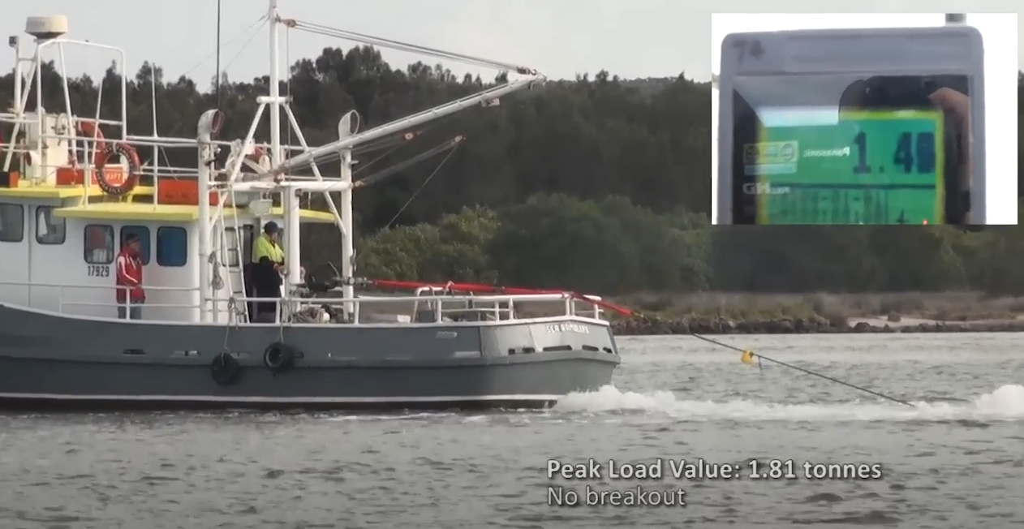
IN-SITU TESTING
(~ 3,990 lbs)

Slide 20
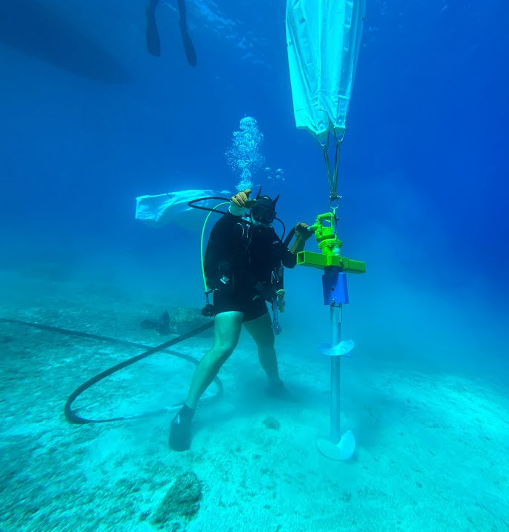
CONCLUSIONS
In our experience, many existing marinas and new facilities are not adequately anchored to withstand a significant design event
Our experience indicates this is more prevalent on lake/inland marinas then on coastal marinas
Several reasons why this continues but is slowly changing as codes and guidelines continue to evolve
Embedment anchors are a far superior choice in terms of anchoring capacity (but have limitations like all anchoring solutions)
Uncertainty remains in many instances designing the anchoring restraints
Field testing your anchors is the best way to resolve uncertainties in site conditions and design approach
Modify anchoring solution based on field test results to ensure your facility is protected for the design event

Slide 21
THANK YOU
QUESTIONS?
Christopher Goshow, P.E.
Phone: +1 904 400 1074
Email: cgoshow@iwcllc.com
Web: www.iwcllc.com

